Slide 1

Culture of witnessing and tribal messiaship
Adaptive witnessing
Rev. Hyungtae Ha
District 8 Pastor

Slide 2
Witnessing is Lifestyle

Slide 3
Adaptive Witnessing
Notes:
Adapt ourselves to a lifestyle witnessing
Adapt to what you can do.. The people living with a lifestyle witnessing start thinking a new way of witnessing as well.
Use what you are good at
Adapt to the target audience.. Learn the audience and adapt to what the need instead of trying to putting them into our framework.
Try new ways to breakthrough
Introduce a few example of new adaptive witnessing from my district.

Slide 4
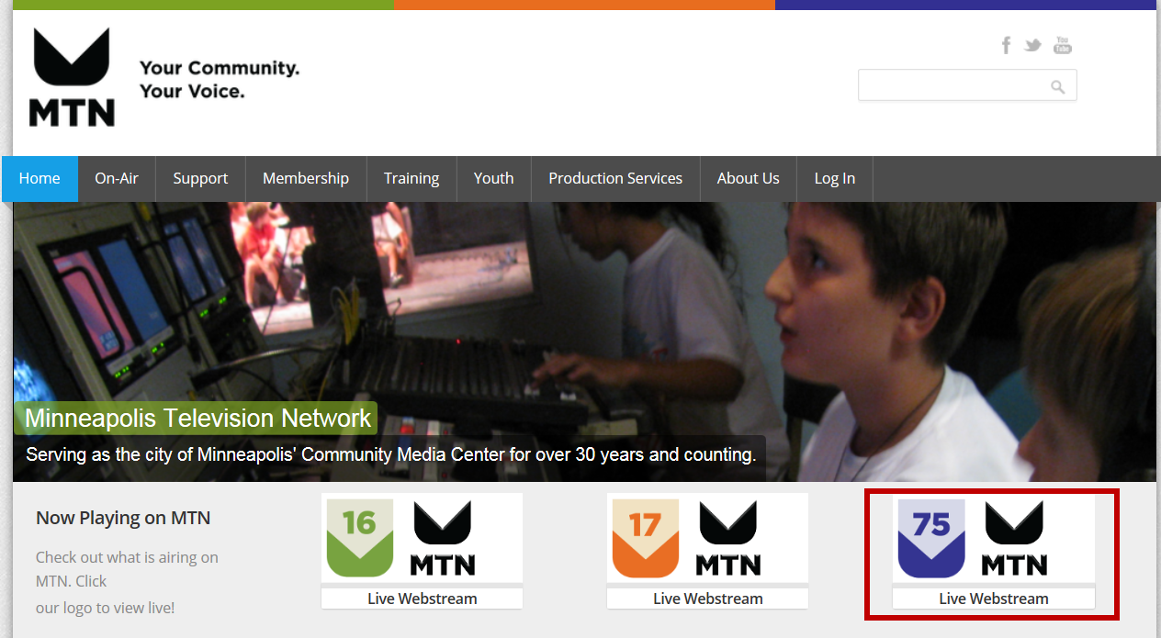
Notes:
Hennepin County Community Channel
Channel 16/Connect offers community affairs programming, news & information, public discussion, politics & government.
Channel 17/Create is home to cultural and educational programming made by local artists & creatives and by MTN's vibrant Youth Programs.
Channel 75/Inspire features a diverse array of religions and spiritual programming from around the region.
Channel 75 broadcast and live streaming at 10 AM on every Sunday
Nadia Metaweh and Marika Hoegl leading the ministry and sending minimum 4 videos per month
Nadia’s Condition.. Checking on every Sunday

Slide 5
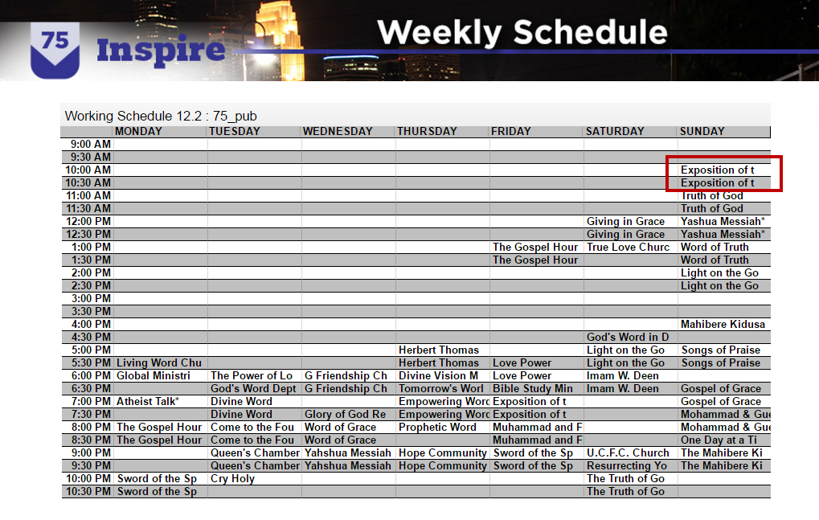

Slide 6
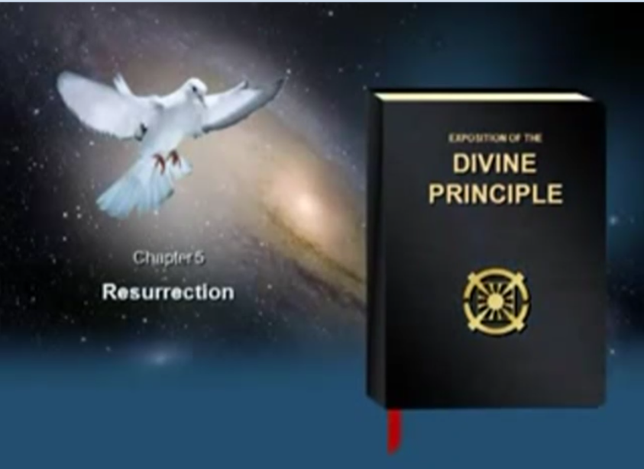
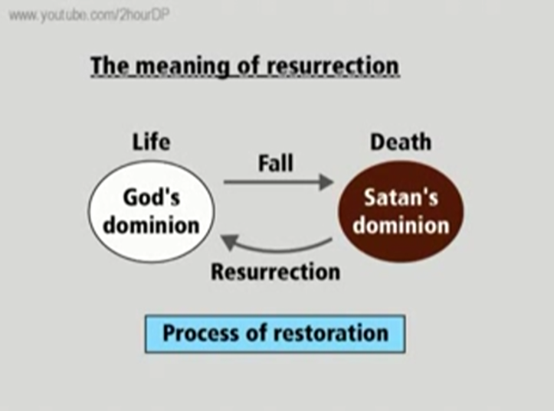
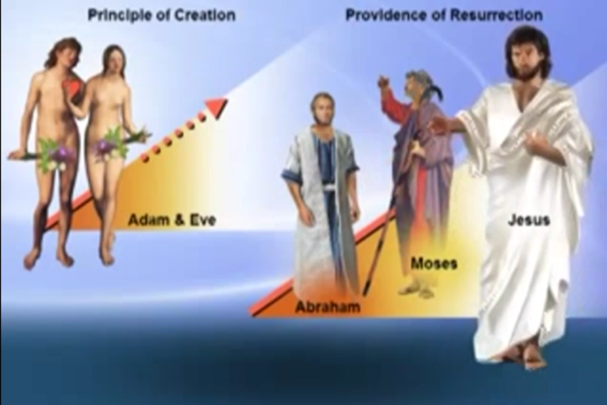
Notes:
DP slides show from Michael Callaghan.
More graphical, graphics, music, written words
Predestine
Use DP .. Reading of Red of DP

Slide 7

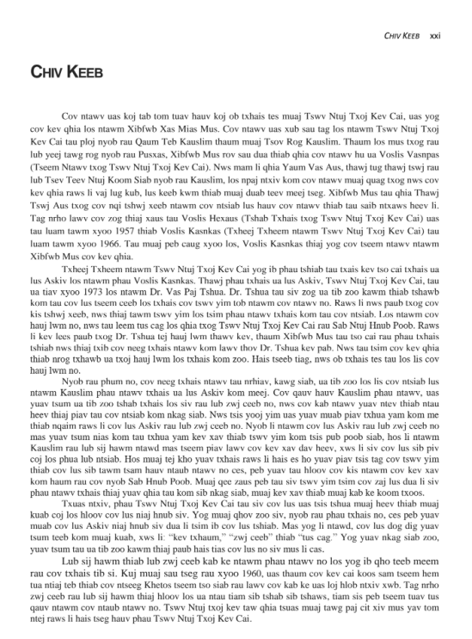

Slide 8
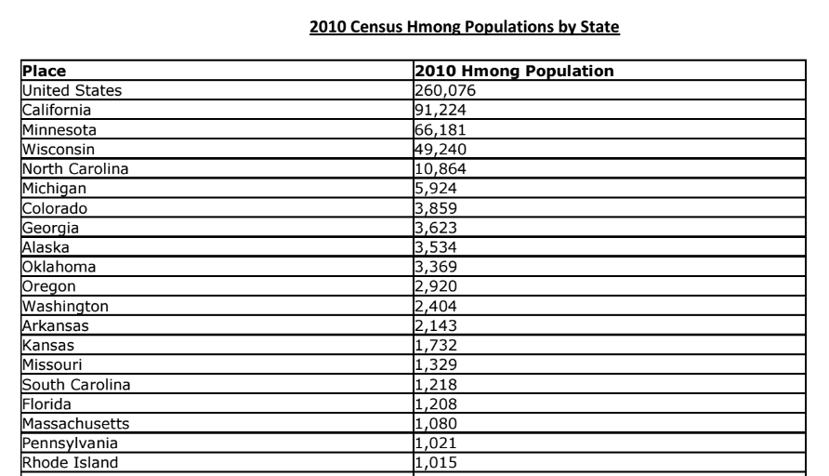

Slide 9
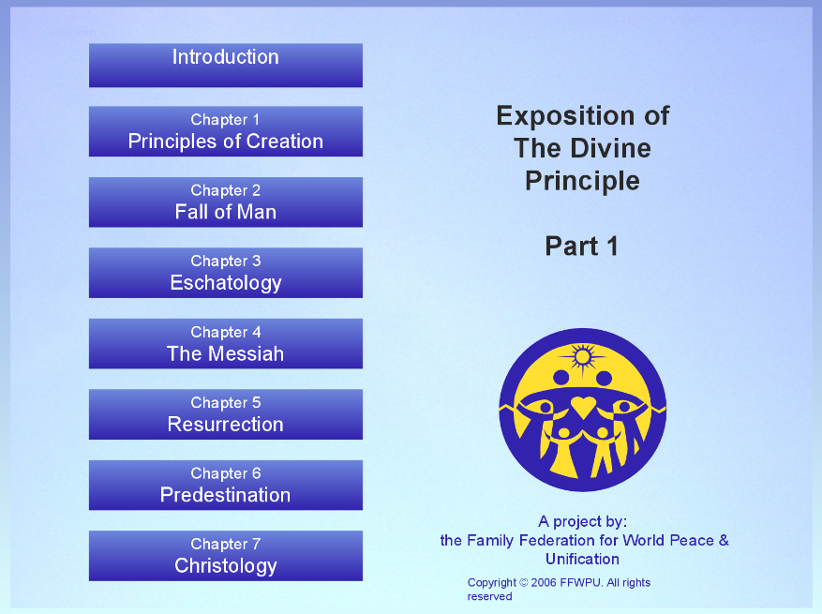
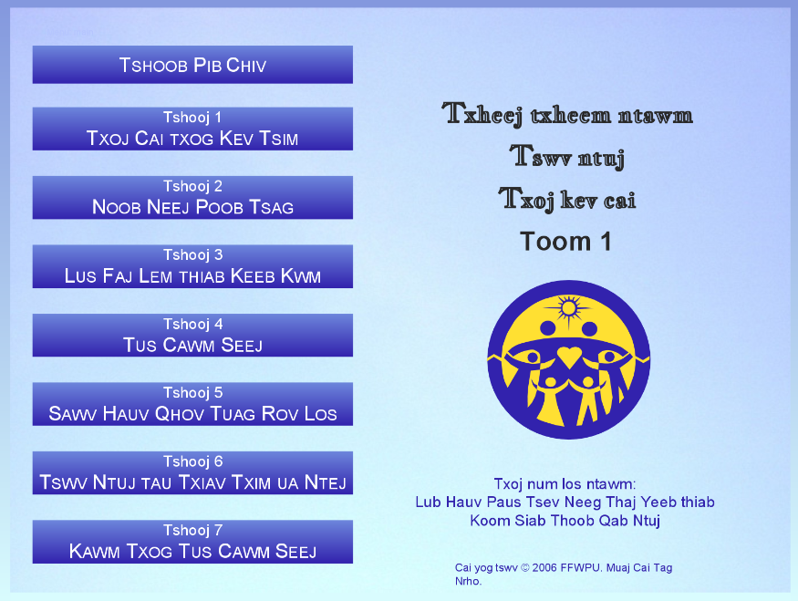

Slide 10
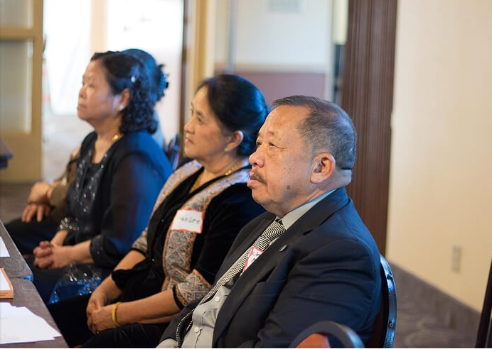

Slide 11
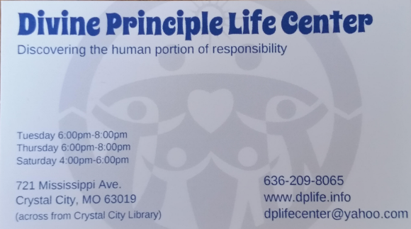
Notes:
Ottosson, Bjorn & Carol

Slide 12
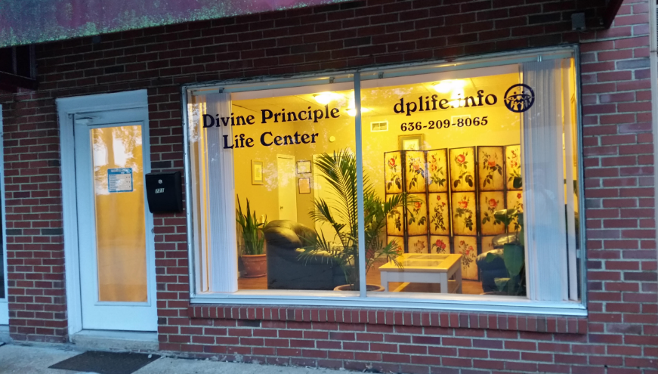
Notes:
Rev. Bjorn and Carol Ottoson

Slide 13
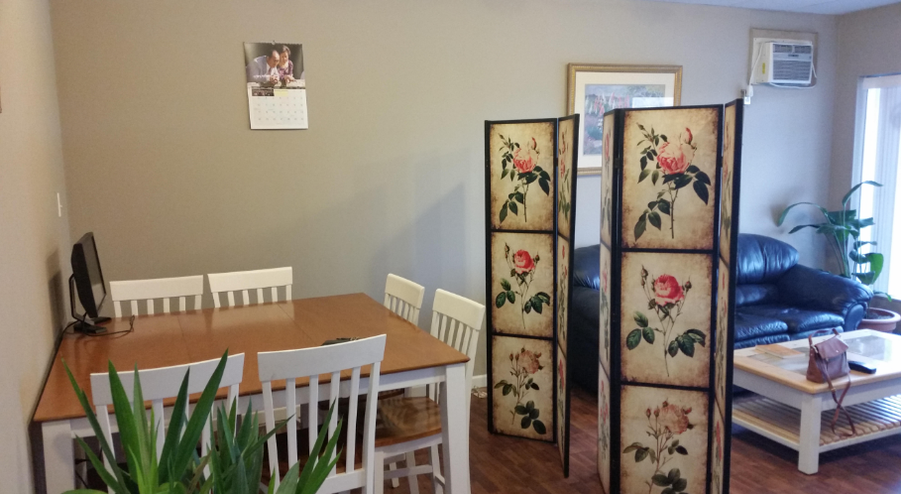

Slide 14
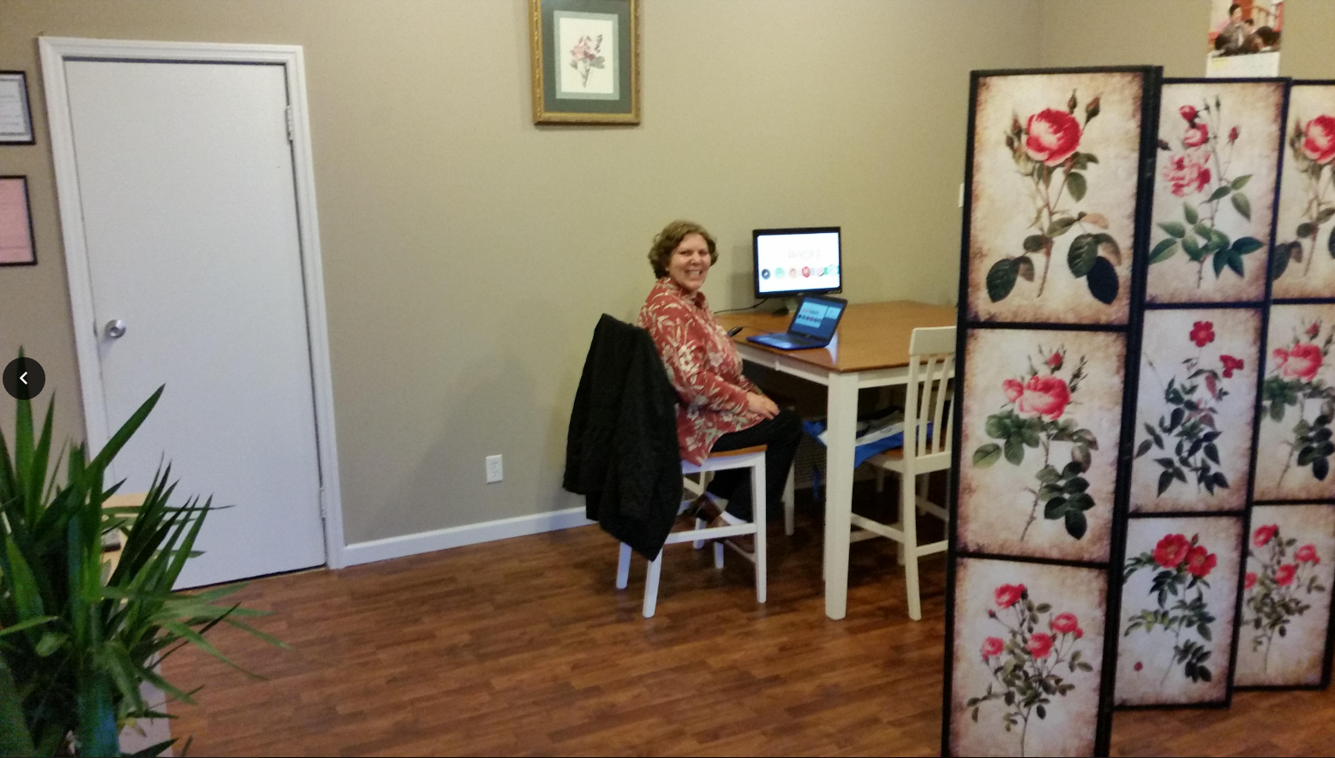

Slide 15
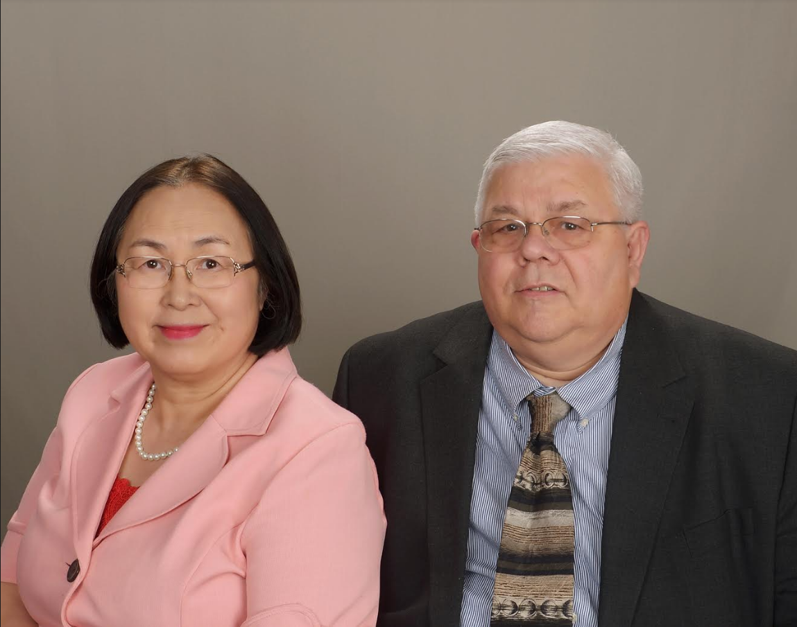
Dennis and Mayuri Hoffman
Notes:
We give the blessing to 120,000 people. We went to the state fair or any big event to give holy wine or candy and a message of True Family Values on a 2x3 inch paper. We went door to door to give blessings.
- 40-day, 3-day ceremony (224 couples)
- South Dakota, Minnesota, Washington DC, Maryland, and Iowa (1088 couples)
- We went to every city of South Dakota and Nebraska, Iowa (Near SD) and visited every church and gave Minister blessing (130 ministers).
- We went to the governor's office (1 blessing).
- We went to the mayor's office (1 blessing).
- I went to Japan. I gave the blessing to my father's side and my mother's side (30 people blessed).
- We blessed Rev. Hakim Kane family and friends (300 people blessed).

Slide 16
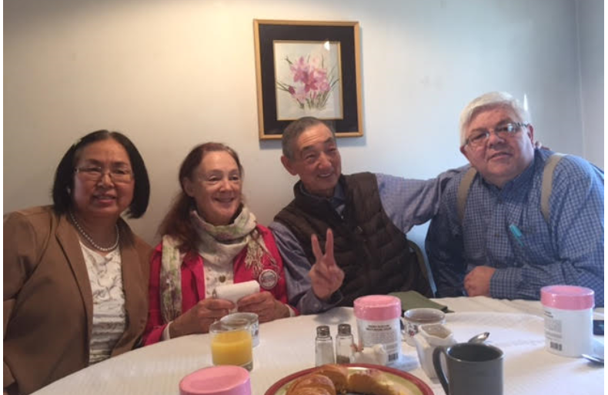
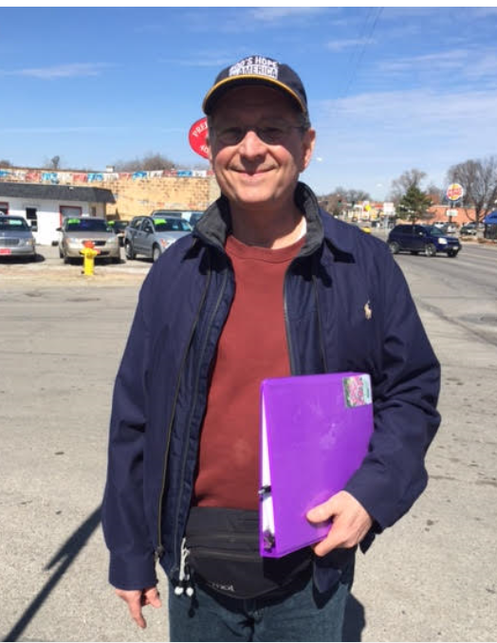
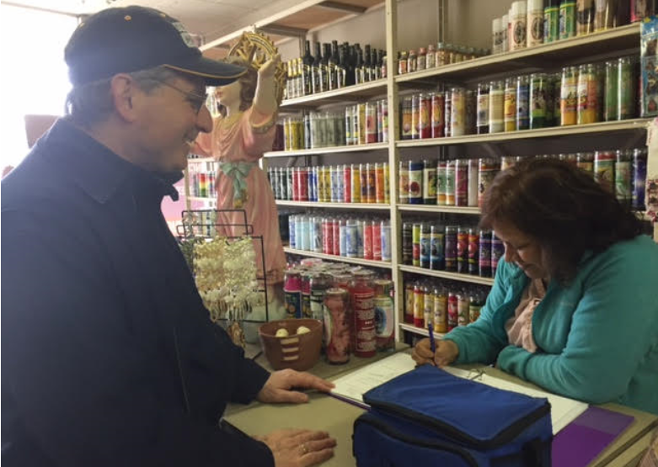
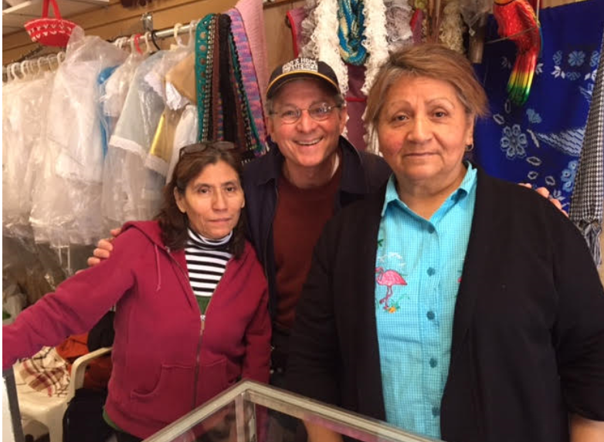
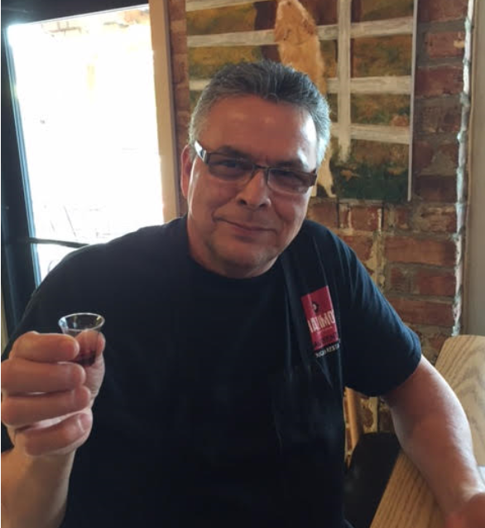
Pre-blessing / Witnessing in Nebraska
Notes:
After Dennis & Mayuri Hoffman came to Nebraska & demonstrated how to do the pre-blessing, 2 families with Dennis and Mayuri spent 3 hours for pre-blessing people and blessed 54 couples total.
They prepared a pre-blessing kit to use. Folder – 4 marriage commitment, and sign up with their contact information and drink Holy Wine.
Nebraska set their state goal of 430 pre-blessed families to build momentum and move 430 families to educate and attend one of official marriage blessing ceremony.
Omaha church added one more active family join in the team. They now have 3 active families and go out for pre-blessing every week.
Hoffman will come to Minneapolis on April 15-16 to put their spiritual fire on us.

