Slide 1
CALL
TO ACTION!

Slide 2
Note to Team
I would like to include the 10-12 best photos from FAMICON in this presentation, toward the end. Obviously we don’t have them yet.
Input & Suggestions welcome and needed. I think I know where I’m going with this, but the flow of FAMICON itself will impact it.

Slide 3
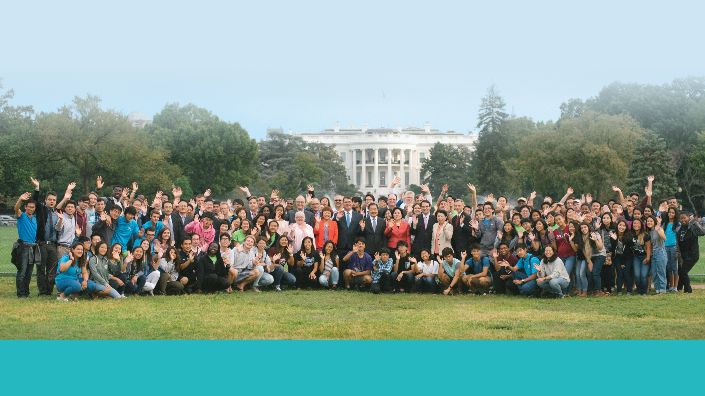
2016
Year In Review
Notes:
How many of you have received and read a copy of this document, our year in review?

Slide 4
2017
Year In Review
Notes:
But let’s fast forward to the year we’re all thinking about …

Slide 5
2018
Year In Review

Slide 6
2019
Year In Review

Slide 7
2020
Year In Review

Slide 8
2020
Year In Review

Slide 9

AMERICA FIRST!

Slide 10
AMERICA FIRST!
In Giving

Slide 11
AMERICA FIRST!
In Giving
In Loving

Slide 12
AMERICA FIRST!
In Giving
In Loving
In Serving

Slide 13
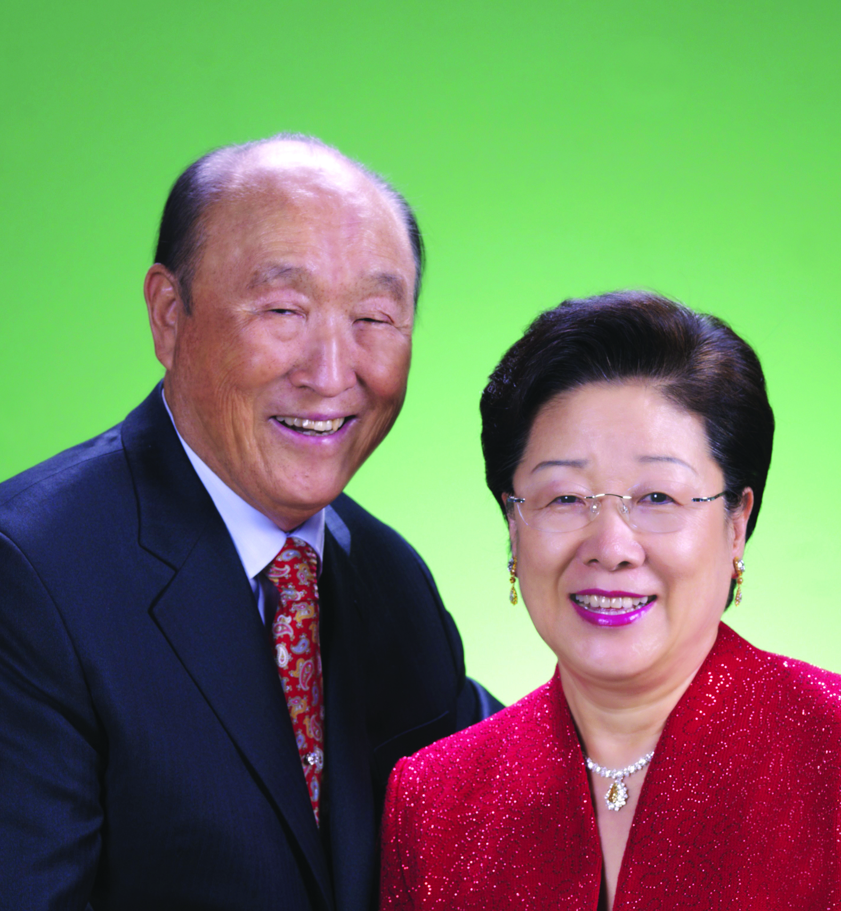
True Parents Are Happy!

Slide 14
We are Happy!

Slide 15
THESE GUYS ARE IN CHARGE!

Slide 16
RESULTS ARE GREAT
Blessings in 900 locations
5 in every State,
40 in the largest

Slide 17
RESULTS ARE GREAT
1,000,000+ Blessed by all of us working together
100,000 + Associates

Slide 18
WE ARE GROWING
30,000 worship weekly
In shiny new facilities
Led by young, educated men & women

Slide 19
WE ARE GIVING
$10m each year to our world missions
To the SunHak Prize
And much, much more

Slide 20
RESTORED NATION
True Father’s Centenary held on the National Level.

Slide 21
RESTORED NATION
Blessings are hosted in major arenas

Slide 22
RESTORED NATION
All faiths joining as one in Blessing and living for others

Slide 23
IN FACT—

Slide 24
America is coming back to God

Slide 25
Through the teachings

Slide 26
and Marriage Blessing

Slide 27
Of
True Parents

Slide 28
Notes:
Deliberately black slide

Slide 29
How did we get here?

Slide 30
2020
1,000,000

Slide 31
2019
200,000

Slide 32
2018
40,000

Slide 33
2017
10,000

Slide 34
THIS IS WHERE IT ALL STARTED!
April 3-6, IPEC, Las Vegas

Slide 35
WE PROMISE
All of us, FFWPU, ACLC, UPF, WFWP, & CARP will work together to fulfill the 430 Heavenly Tribal Messiah goals:

Slide 36
WE PROMISE
  12 in 2017
  72 in 2018

Slide 37
WE PROMISE
To take proud ownership of the Hyojeong East Garden Museum of True Parents’ life and work in America, raising:

Slide 38
WE PROMISE
  $100k now
  $1m in 2017

Slide 39
Vision 2020
승리! 승리! 승리!
VICTORY!

