Slide 1
EAST GARDEN HYOJEONG
Museum of True Parents’ Life and Work

Slide 2
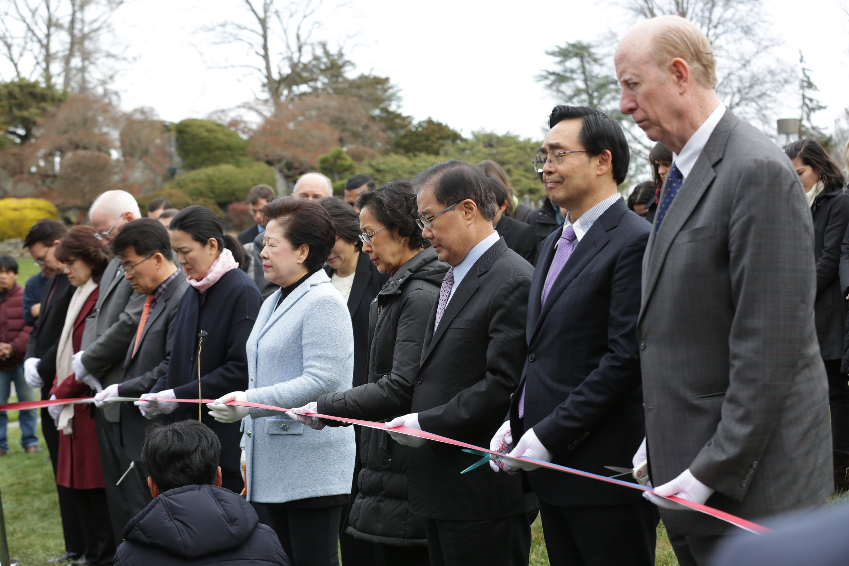

Slide 3
TRUE MOTHER’S PRAYER
We offer this as a place where people can learn about True Parents’ history and the results of their achievements and a place where they can repent and resolve to follow True Parents’ way in order to make Heavenly Parent’s dream come true. In doing so, this nation can fulfill its responsibilities as the providential Elder Son Nation. Father, Heavenly Parent, please receive this happily.

Slide 4
TRUE MOTHER’S PRAYER
Please move the hearts of all members and visitors who come here, so that this people and the world can absolutely receive Heaven’s Will during True Parents’ lifetime. I pray that this can be the starting point for the Unification movement in America and the people of this nation to move toward that day—the day when the Kingdom of Heaven is realized and all people become citizens of Cheon Il Guk.

Slide 5
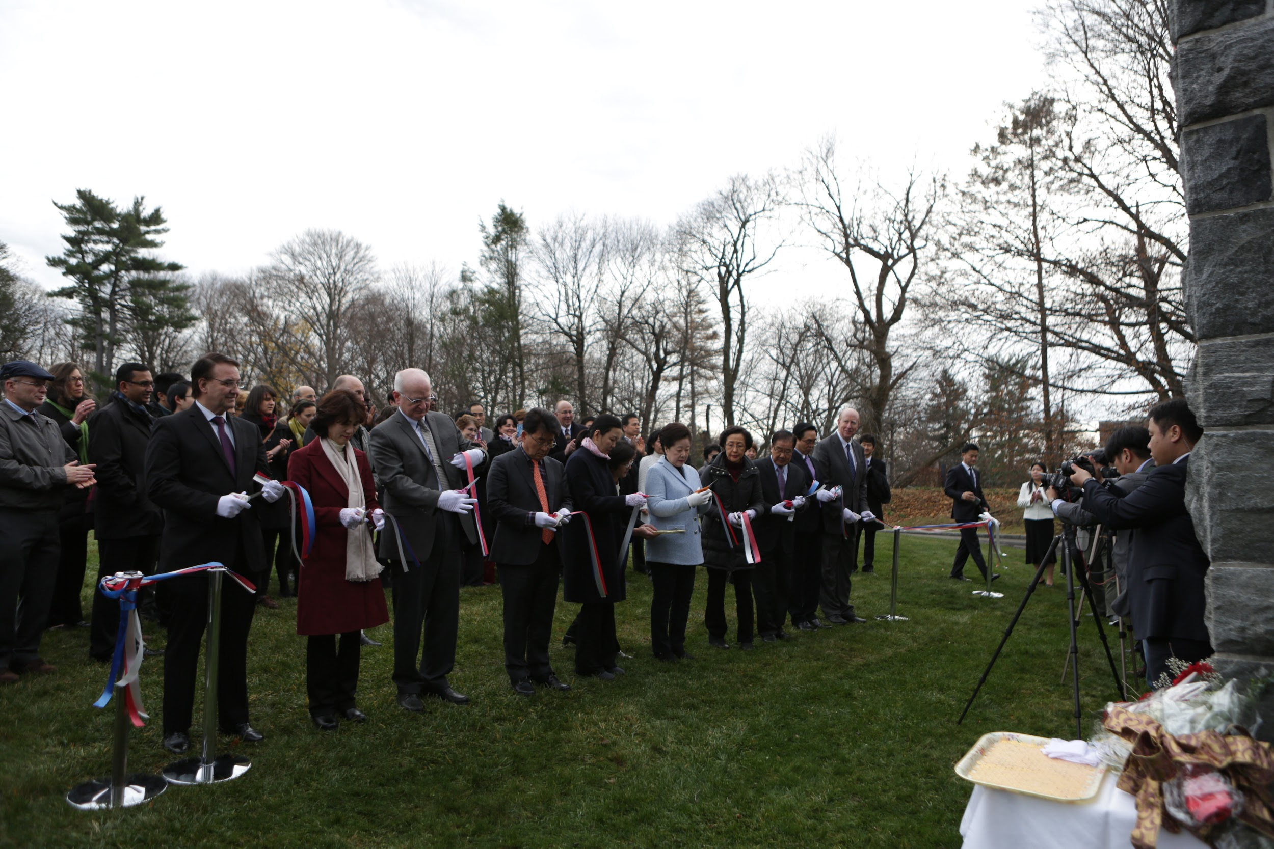

Slide 6
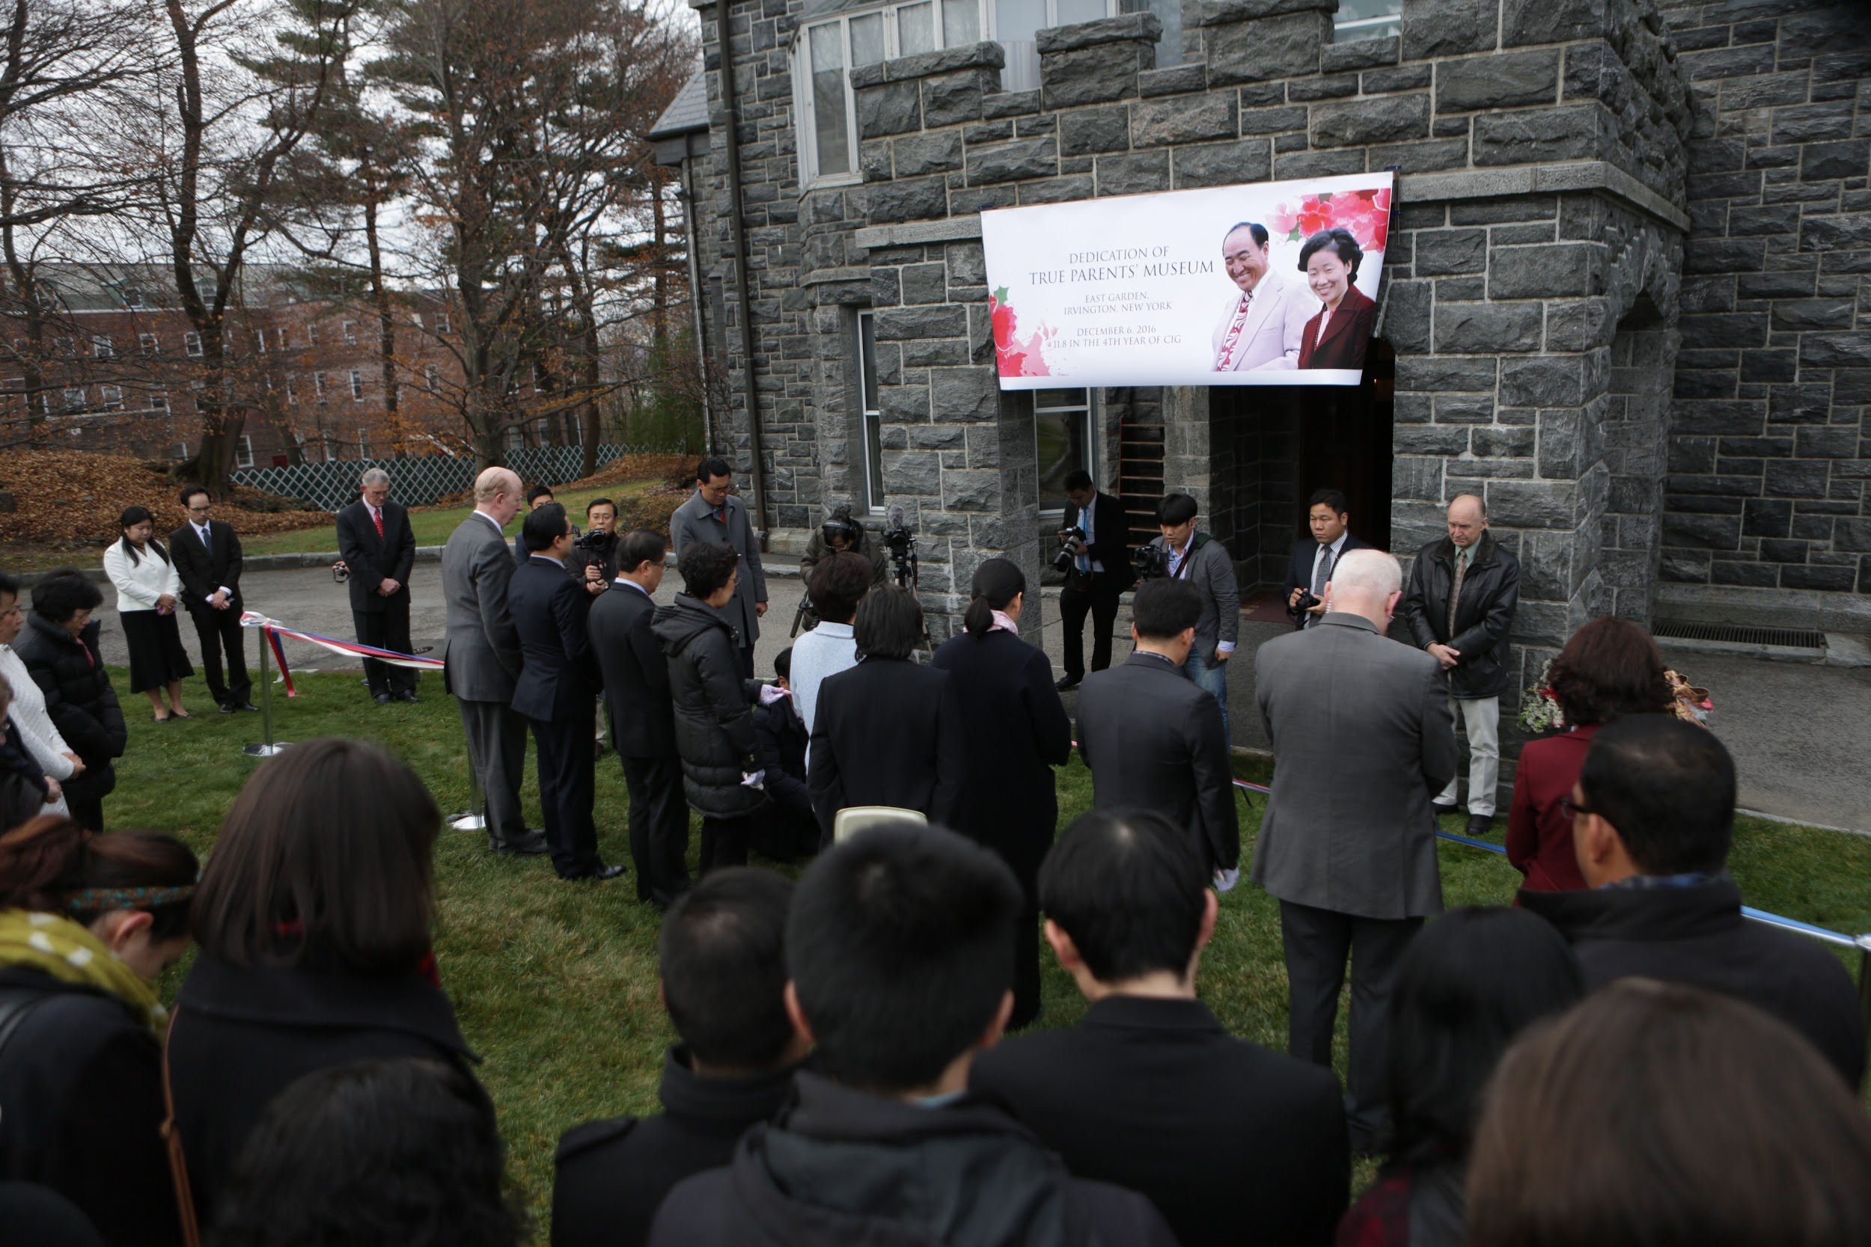

Slide 7
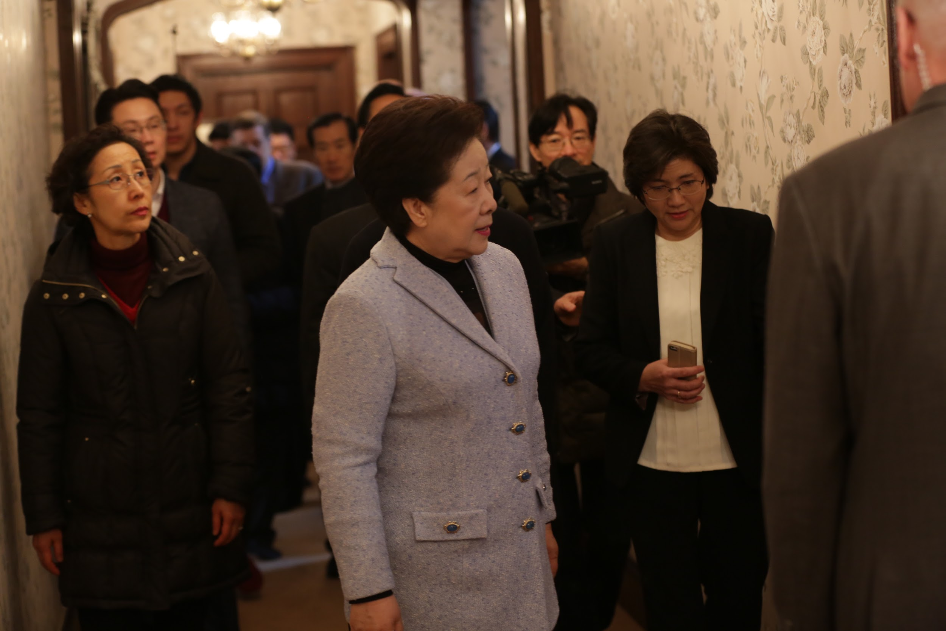

Slide 8
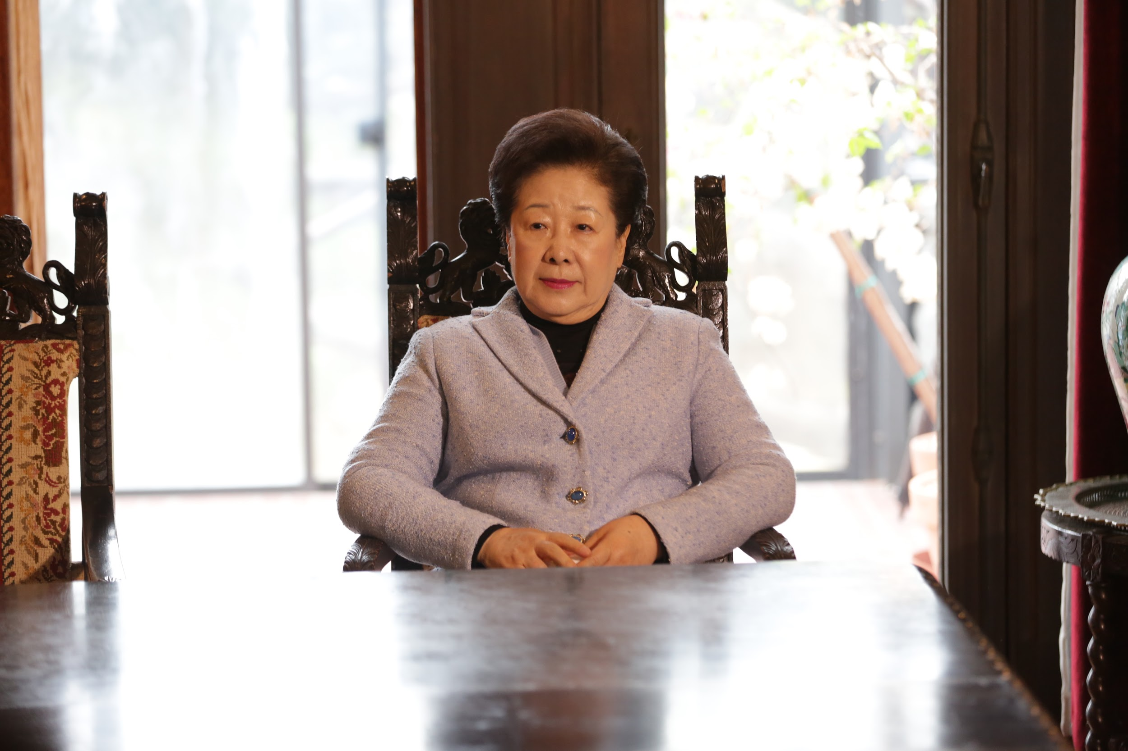

Slide 9
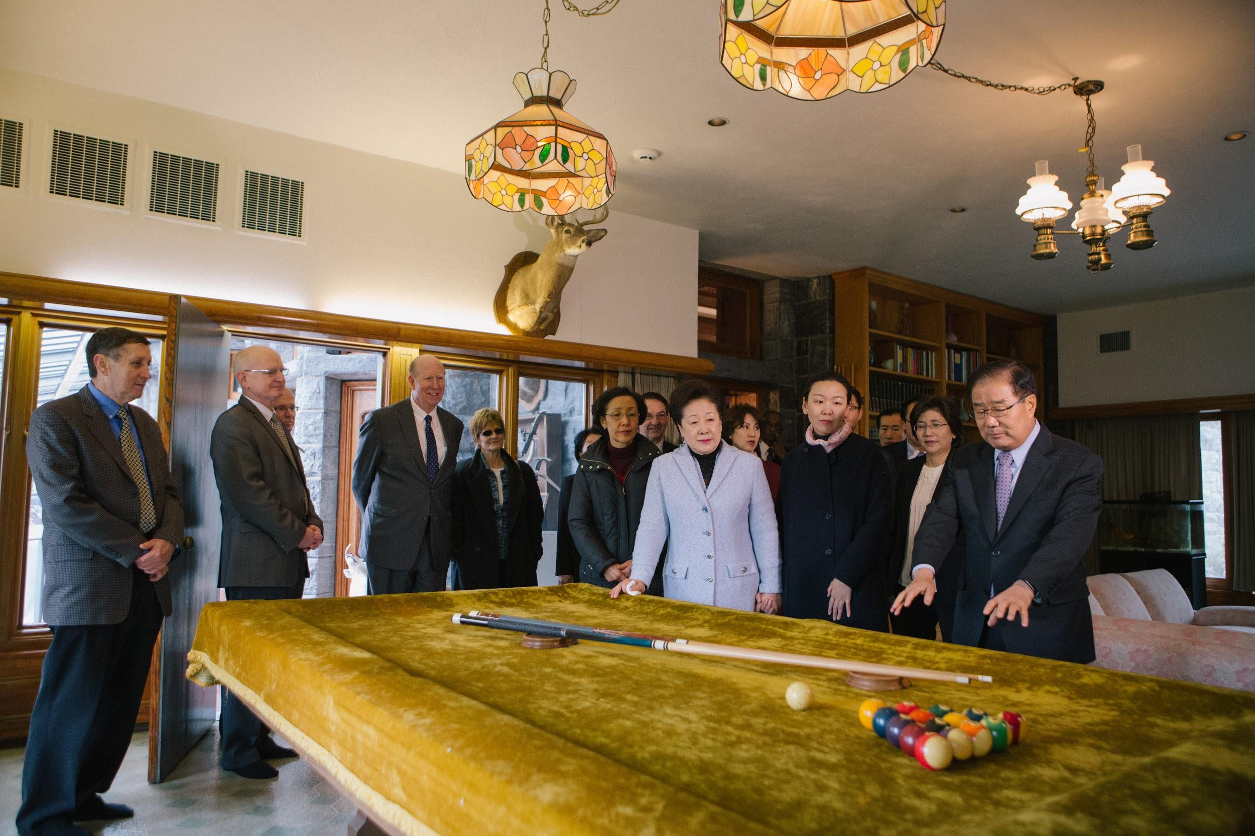

Slide 10
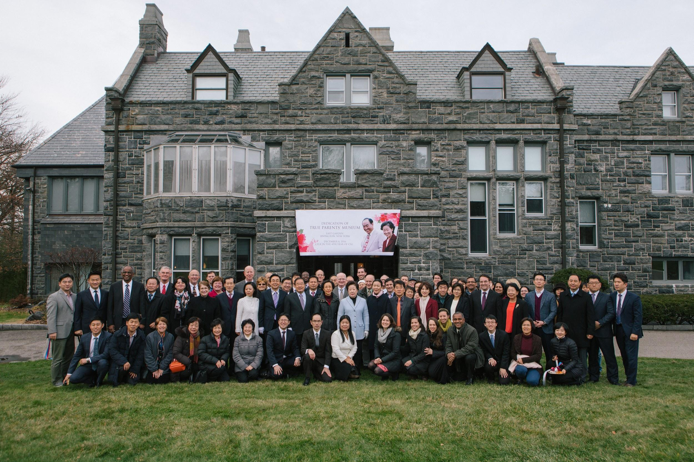

Slide 11
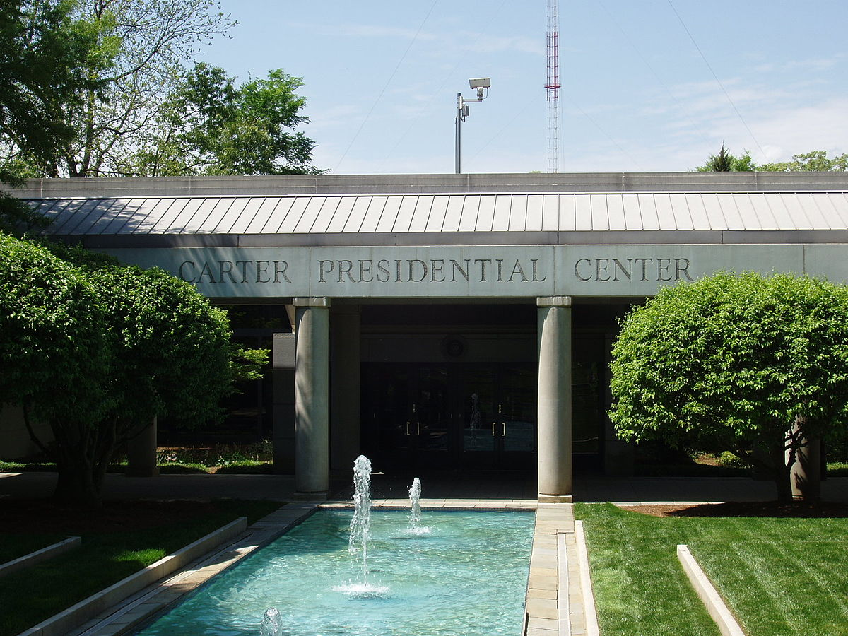

Slide 12
UPCOMING PROJECTS
Renovating the solarium for special displays
Renderings and construction of a donors’ memorial wall.
Repaving the entry road
Display cases and timeline wall
Developing the collection database,
Collecting documents, materials, oral histories,
Developing a team of tour guides / docents,
We would be interested in talking with anyone who has professional museum training or work experience.

Slide 13
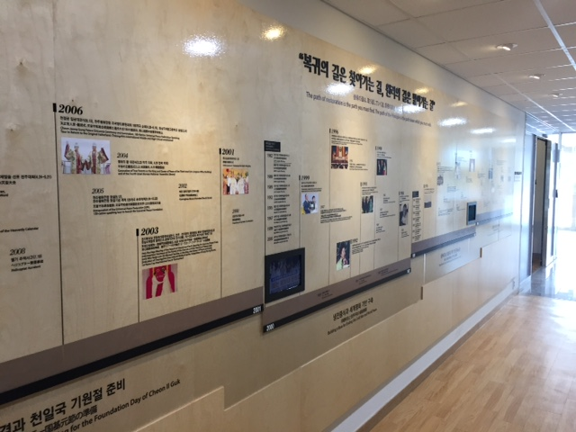

Slide 14
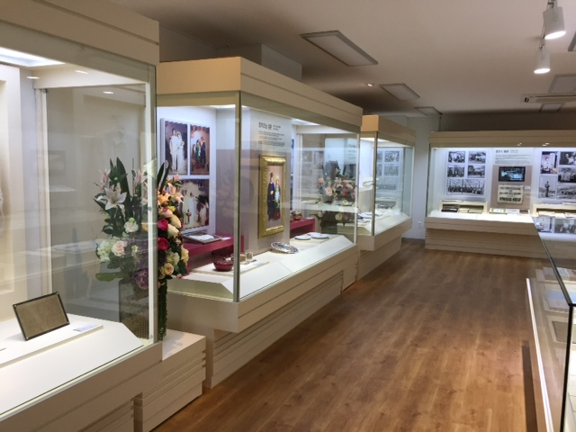

Slide 15
DONOR LEVELS
LEVEL | AMOUNT
Founder’s Circle | $100,000
Platinum | $50,000
Gold | $10,000
Silver | $5,000
Bronze | $2,500
Friend | $1,200
Supporter | $ all donations

Slide 16
HOW TO GIVE
Make our pledge today
Encourage others when we return
Donate Online or
Send a check to HQ marked “TP Museum”

