Slide 1

Notes:
Good afternoon, dear leaders,
Thanks to all who organized this great HTM convocation.
During the presentation and our breakout sessions we would like to re- introduce WFWP to you in the context of how you can use WFWP as a tool for Tribal Messiahship. We also want also share with you some of the changes and new developments that have occurred over the last few years.
This is the year of the Fire Rooster, and it so happens that our WFWP annual theme is “Igniting a Culture of Heart -
WFWP is one of the social impact organizations, to create positive social change by transiforming this current culture (of war,conflict, hate, confusion of values) into a culture and life- style of peace, beauty, harmony and goodness.
We work together with and educate women of all ages to understand their providential and important roles in creating a culture of heart and love starting in their families and communities.
.

Slide 2
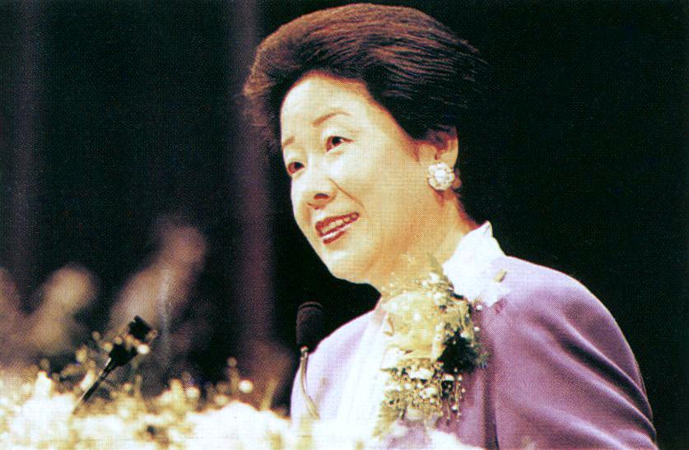
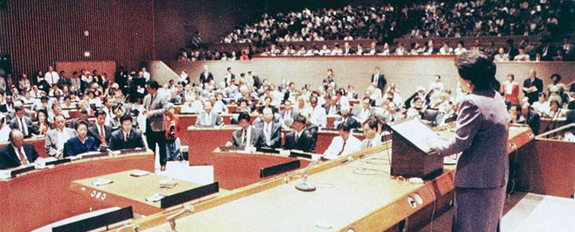
WFWP is
True Mother’s Organization
“I sincerely ask you to choose the path of a true mother, the path of a true wife, of a true daughter and of a true woman leader who will build a united world where freedom, peace and happiness overflow in its truest form.”
Notes:
As you know WFWP is True Mother’s Organization:
Not many might know that originally WFWP was founded to spread the Blessing to all nations through the 1,600 Japanese women that were sent out to all corners of the world in 1994. And also TF and True Mother co-founded WFWP for the time when True Mother would lead the movement, to be able to stand on a substantial foundation she could work from as a woman leader. Especially at this time….
Before he passed in 2012, TF asked all women to choose the path of a true woman, etc based on True Mother’s example and leadership but also motivated by a their own motherly heart, and together build a united world of peace and harmony. .
The internal goal of WFWP is therefore to connect as many women and women leaders of all ages as possible - to the realm of True Mother.
When being appointed to this mission in 2010 I was especially inspired by TMs many speeches which I read in order to understand more deeply what WFWP is all about. In many of those speeches True Mother calls for social change which we then made our guideline for our areas of focus and activities.

Slide 3

Where are we at?
Notes:
However, what was the reality? Does this look familiar?
Having been a pastor for 4 years myself, I completely resonate with what many of you might be going through with your congregations. Even though the reality doesn’t look quite as drastic, this image reflects what I felt like internally...I saw members who are tired, burnt out and uninspired…The same was true in 2010 when I took on the leadership of WFWP. Some sisters told me right up front: I quit, I have done this long enough!
How could I turn things around? I needed a different approach… there was no way of pushing or even inspiring anyone. I realized, that in order for them or anyone to move forward to another level or even get inspired about a new vision, they first needed to be appreciated, for what they had already done.

Slide 4
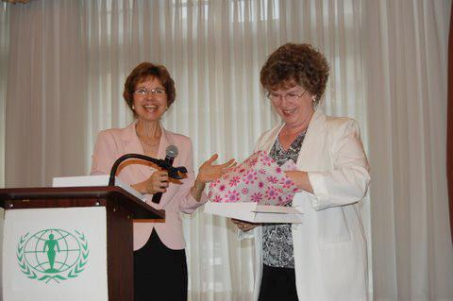
Transform from the inside-out
Notes:
So I decided to surprise our sisters and leaders who had been working tirelessly for a decade and moreI. At our first retreat in Las Vegas, I first of all thanked each and every sister personally for their long years of work, and gave each a beautiful scarf. Needless to say all were overjoyed, and our retreat took on a whole different dimension… I also went around the different chapters and did the same… Here is Pam Stein in Washington DC

Slide 5
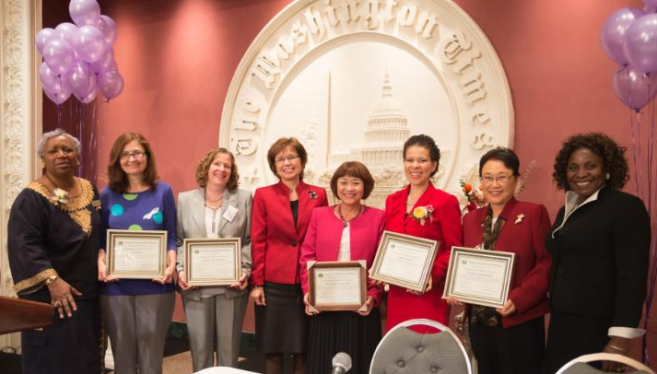
Transform from the inside-out
Notes:
We continue to honor and appreciate our sisters also in public. Here is Fanny Smith - far left - our SOA coordinator giving certificates to those who had invested in and sacrificed for the Schools of Africa. See the smiles

Slide 6
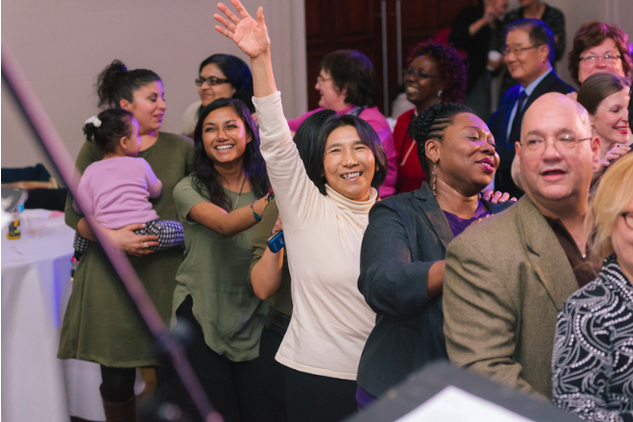
Reignite the vision in action
Notes:
Next we asked the ladies what their passions and gifts were and showed them how their gifts would contribute to and to realize the vision of WFWP. That re-ignited their vision, their commitment and moved them to action, as they felt a sense of ownership -which continued to this day.
We also said, in this new era of CIG it is ok to have fun, sing and dance and enjoy life.
To many women we also had to say, it is ok to take time and to take care of yourself, your health and your family. Many of our ladies, sisters and wives almost need to relearn how to live life…
The love and joy that WFWP has been able to develop the years has also become contagious and is being felt in our national assemblies, retreats and local events, which prompts many of our contacts and guests to ask deeper questions about who we are and what makes us tick.
..more in the breakouts. This the 25th anniversary in New York.

Slide 7
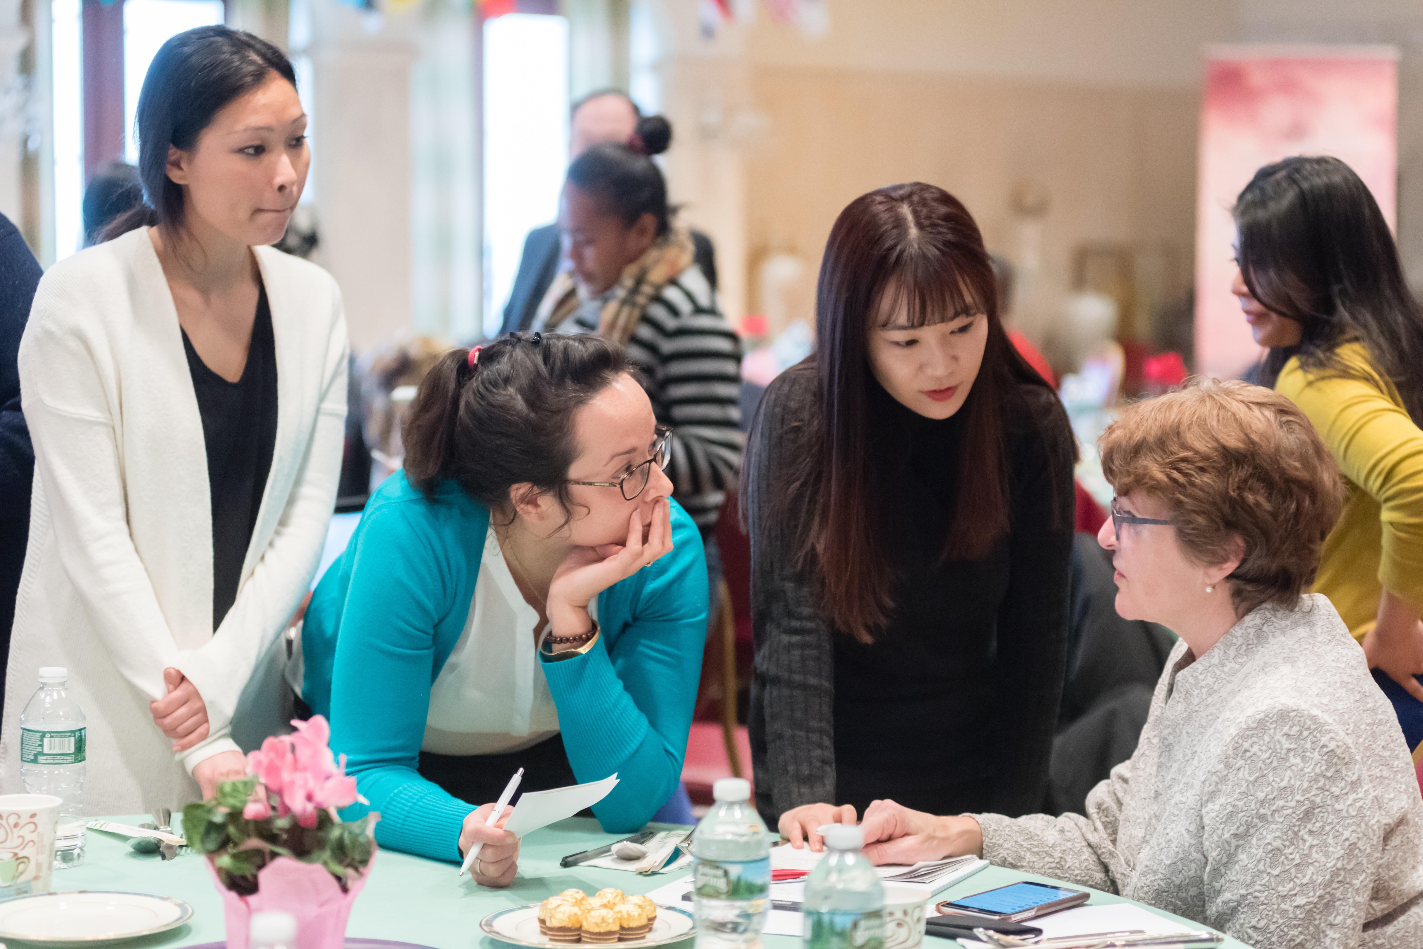
Inspiring young women
Notes:
omen joined, culminating in the appointment of Katarina Connery by True Mother in 2014 as the Vice-President. From then on we truly have been working as an intergenerational team - we also have two young ladies on our national board. (Teresa)Since 2010 we always had one young second gen woman working with us and some also in the chapters, But we all got a second wind of energy when Lena Yasutake came back from a conference in Korea and represented WFWP. She was so inspired and had new ideas of how to present WFWP also to a younger generation and highlight the wonderful strengths we have, which we didn’t see any more. We all got a second wind and shortly thereafter more young w

Slide 8
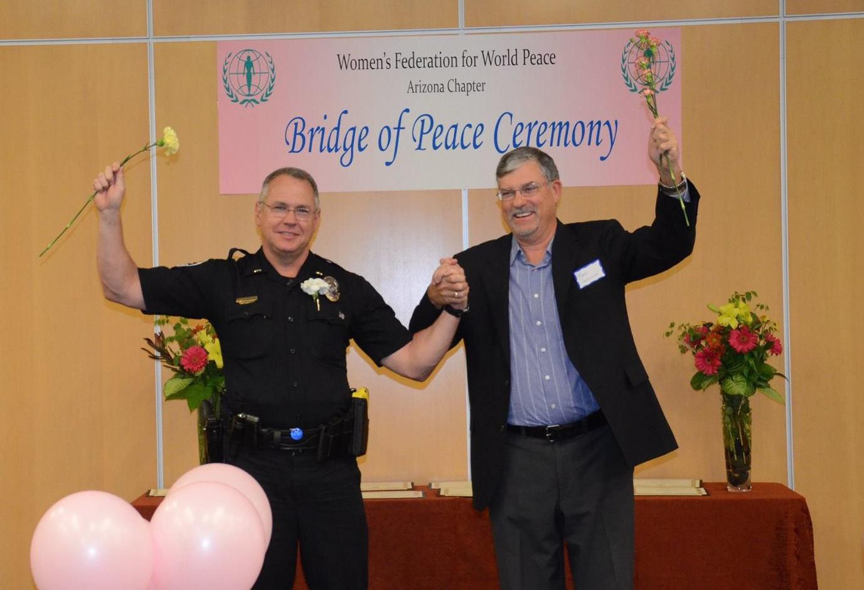
Men joining WFWP
“Together women and men should play a major role in world history by serving alongside each other like the wheels of a great engine pulling the construction of a peaceful world forward.”
Notes:
And then, in 2012, at the 20th WFWP Anniversary right here in Las Vegas True Mother said that men and women need to serve alongside each other, we opened up our membership (only $12 a month) to men!
We had always invited men to participate in our events, and many supported us like (my own husband ) who is a member as is our oldest son and our daughter [$12/month only]). Peace cannot become a reality without harmonious collaboration between men and women.
Men have also participated in our Bridge of Peace Programs, restoring historic pain as well as conflicts in our current societ Here is a police officer in AZ crossing the Bridge of Peace with our brother, Mark Anderson to heal the rift between the Police and community.

Slide 9
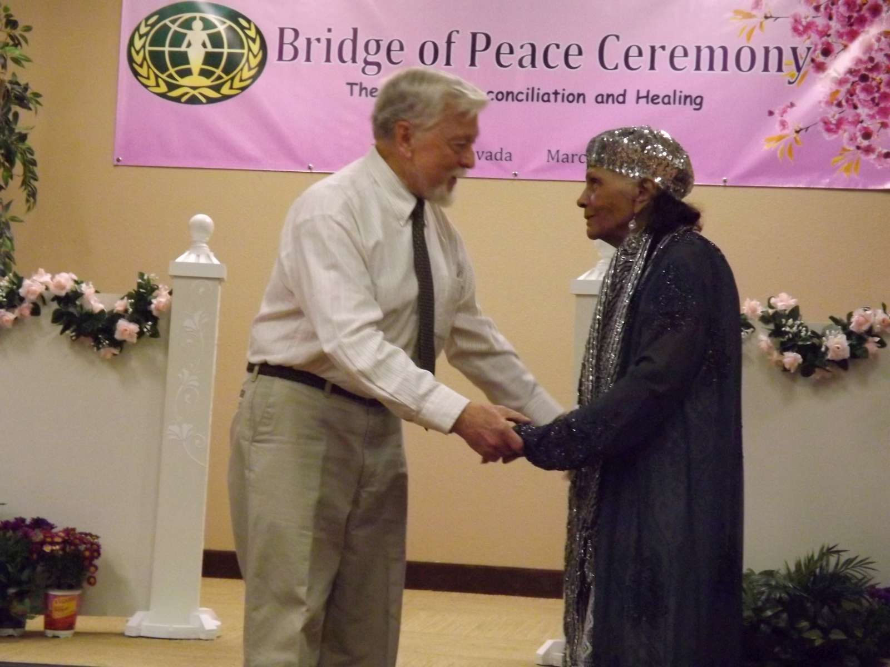
Men joining WFWP
Notes:
This is an event in Las Vegas which was co-sponsored by UPF two years ago.
A former Congressman, representing Whites is reconciling with a Black woman from the Civil Rights movement.
Although we live in the era of women, women alone can alos not bring peace. We need both Mothers and Fathers to heal our families and to heal the human family. Do you agree?

Slide 10
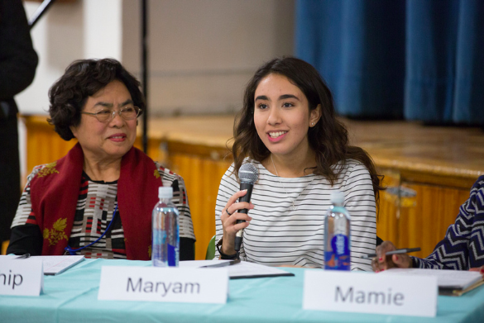

Poll by The Washington Post, 2016
What do you consider yourself?
Notes:
There was a recent poll done by the Washington Post about perceptions of feminism. They asked a large group of women and men how they consider themselves in terms of feminism. While 43 percent of women consider themselves a feminist and 17 percent a strong feminist, a significant group (30 percent) actually don’t identify themselves as feminist at all.

Slide 11
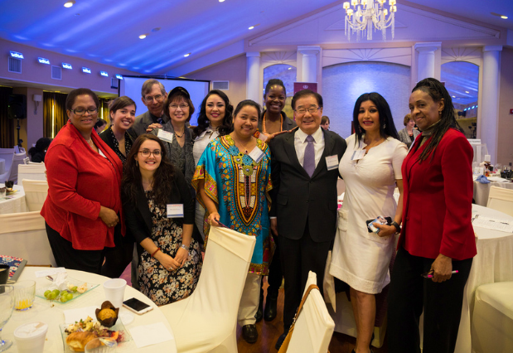

The feminist movement unfairly blames men for women’s challenges. True or not?
Notes:
Another question was about whether it’s true or false that the feminist movement unfairly blames men for women’s challenges. Again, you can see a pretty even split. About 41 percent of women say that this statement is true, and 54 percent said it is not true.
To me, all of this shows that there’s a great deal of confusion in society about equality between men and women and how to achieve it. We know in our original minds that God intended men and women to be equals. But we don’t know what that truly means and how to reach that. Up to this point, the feminist movement has been an incomplete answer. Through WFWP, True Parents are seeking to bring a more comprehensive answer on how women can complete, not compete, with men. And bring true equality, and through equality, peace.

Slide 12
God
True Man
True Woman
True Family
Notes:
Allow me to introduce to you one more graph, perhaps you’ve heard of this one before. In her speeches at WFWP events, True Mother talks about the divine feminine. Since God is the harmonious union of original masculinity and femininity, we will not have true and lasting peace until there is harmony of masculine and feminine, of men and women. Just as when you have harmony between husband and wife, you have and peaceful and loving family.
So at WFWP we are all about educating and empowering women to know that the answer to creating peace and genuine gender equality is already within you.
So then it’s no longer about women competing with men and demanding that we receive certain recognition, because men have had all these things so therefore we should too. But it’s about bringing our divinely feminine natures into our communities, in our jobs, in our families, and in our society.

Slide 13
God
Male Politicians
Female Politicians
True Govern-ment
Notes:
So as a result of having enlightened women who express our femininity in harmony with men, we have, for example, this….

Slide 14
God
Male Lawyers & Judges
Female Lawyers & Judges
True Judicial System
Notes:
Or this...

Slide 15
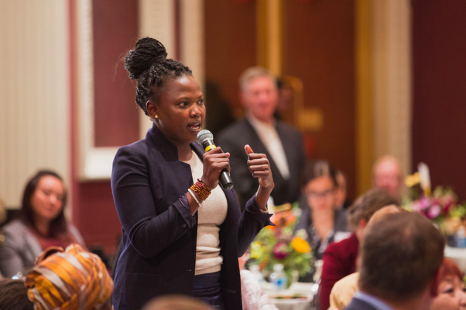
Leadership of the Heart
Notes:
So all of our activities are geared toward awakening this divine feminine, what we are calling leadership of the heart. Whether that’s through our educational seminars such as our National Assemblies

Slide 16
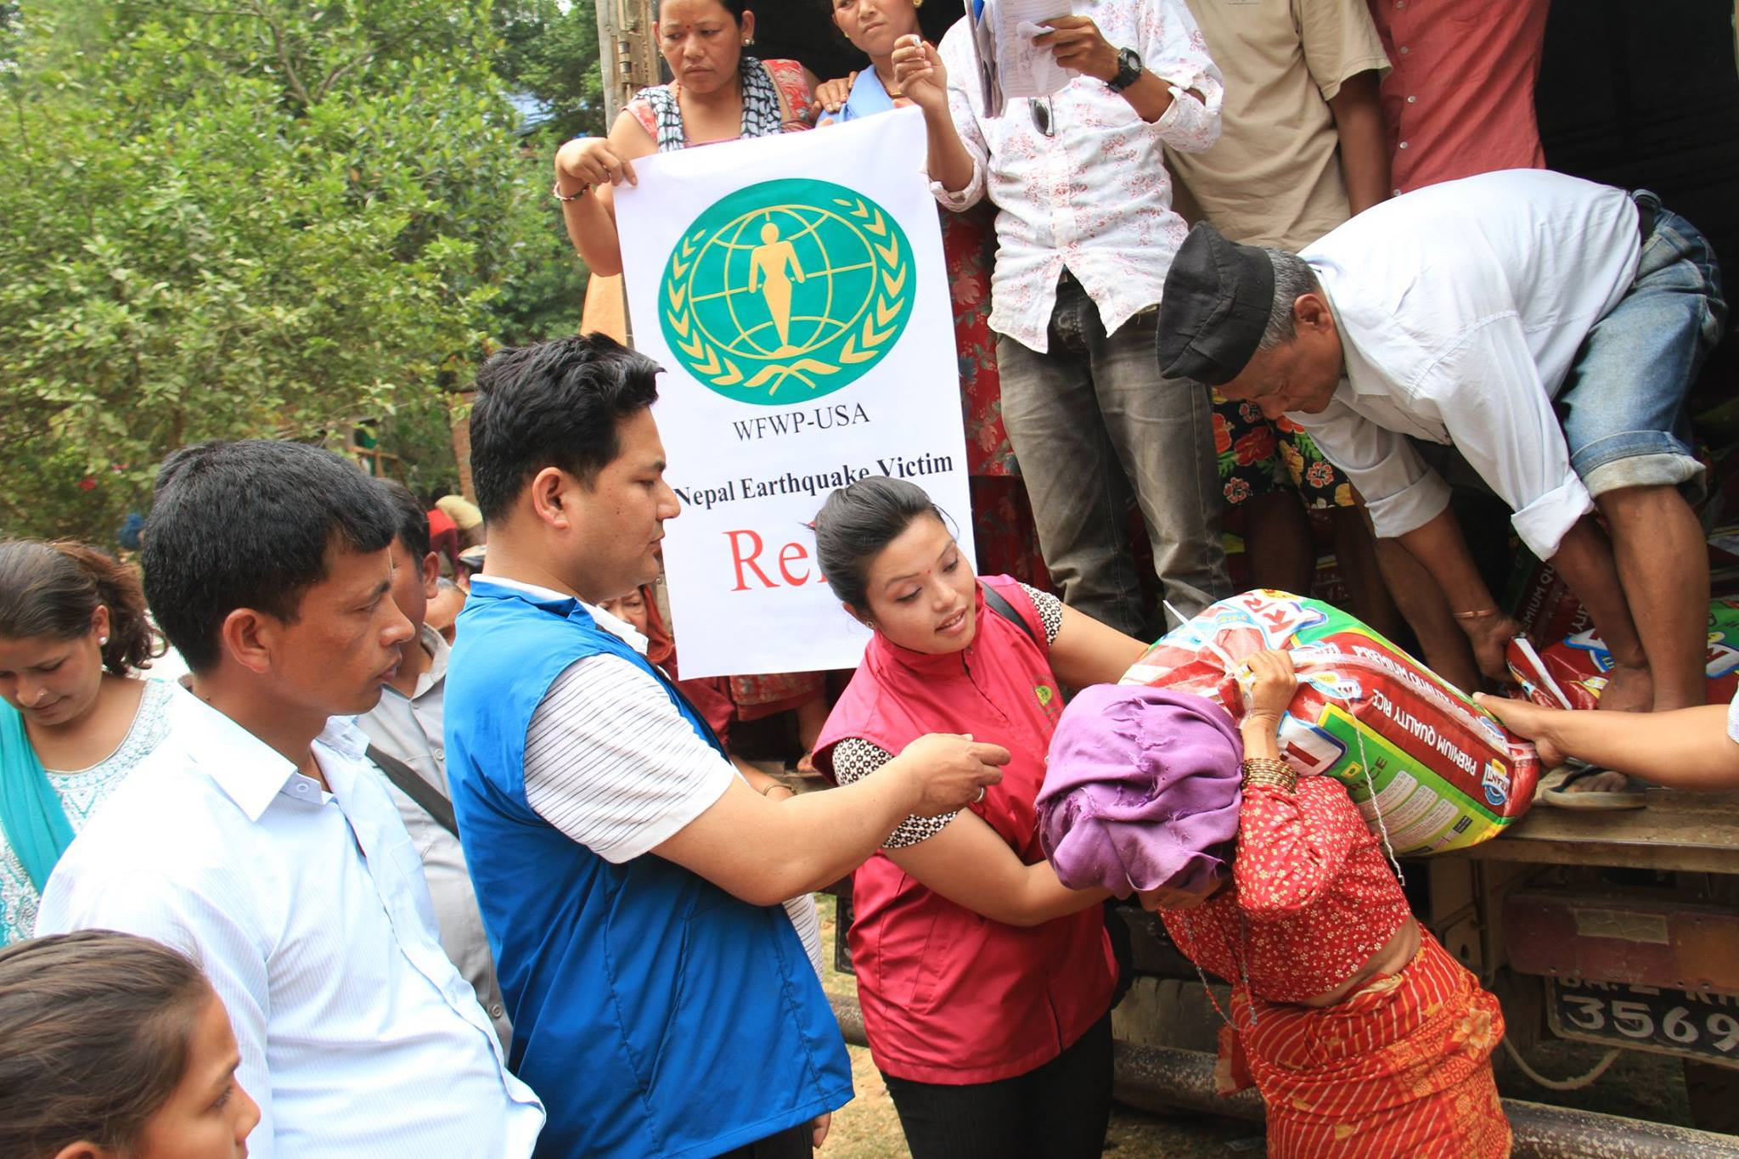
Relief in Nepal
Notes:
Or through our service projects, which awaken and stimulate a heart of service and sincerely caring for others, with a motherly heart. Internationally….

Slide 17
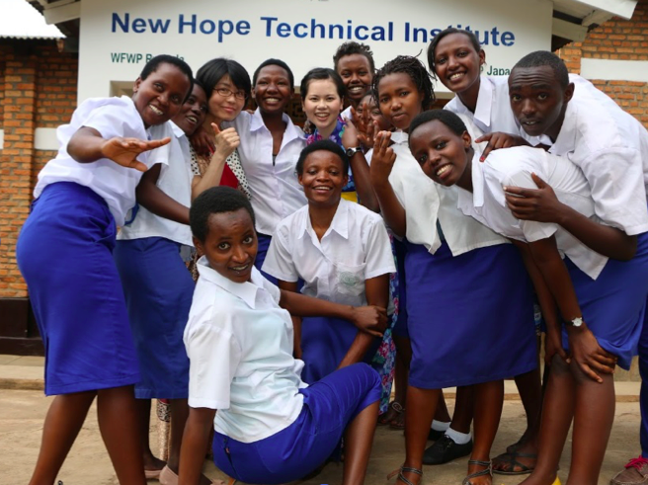
Schools of Africa

Slide 18
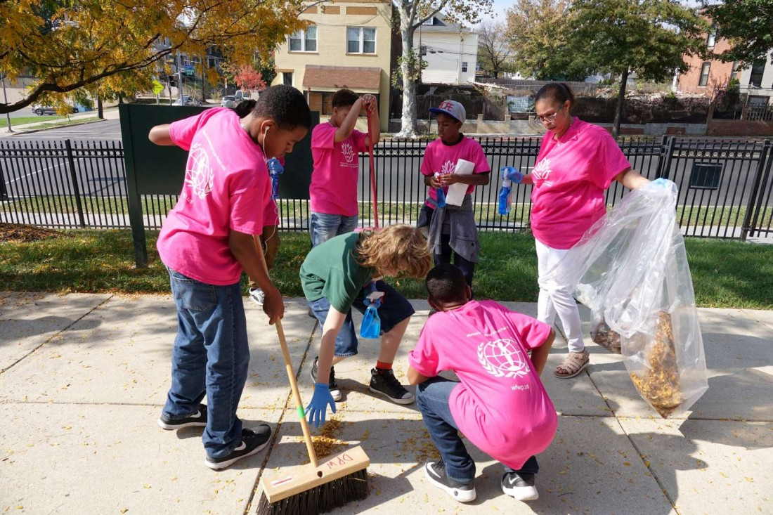
Day of Service in D.C.
Notes:
and locally

Slide 19
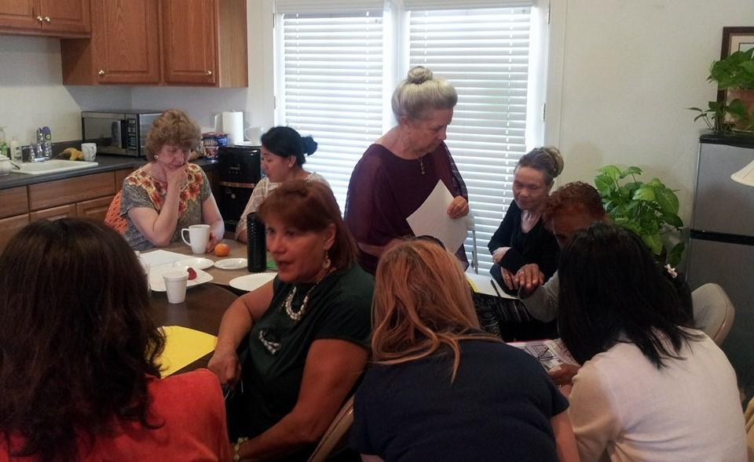
Family Life Education
Notes:
Or through educating on women’s true role in the family as sisters, daughters, wives and mothers, as a way to introduce the Blessing more naturally and approachably, in a way that women can relate to.

Slide 20
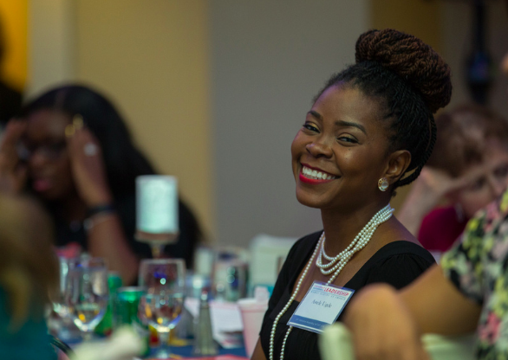
Creating an environment for witnessing
“The central role of women is all the more vital if the unfolding century is to be characterized not by power and technology, but by culture and by love.”
Notes:
Everything we do is purpose driven, to uniquely approach women, and contribute toward our overall goals as a movement of bringing the world to God and True Parents.
Angelika’s example of pastors in Arkansas and Ohio.

Slide 21
What next?
CALL OR TEXT
Katarina Connery
203-520-0725
Call or text Katarina today and we can connect you to your local chapter or help you start a new chapter.
Notes:
What next? How to get involved with WFWP in my community?

Slide 22
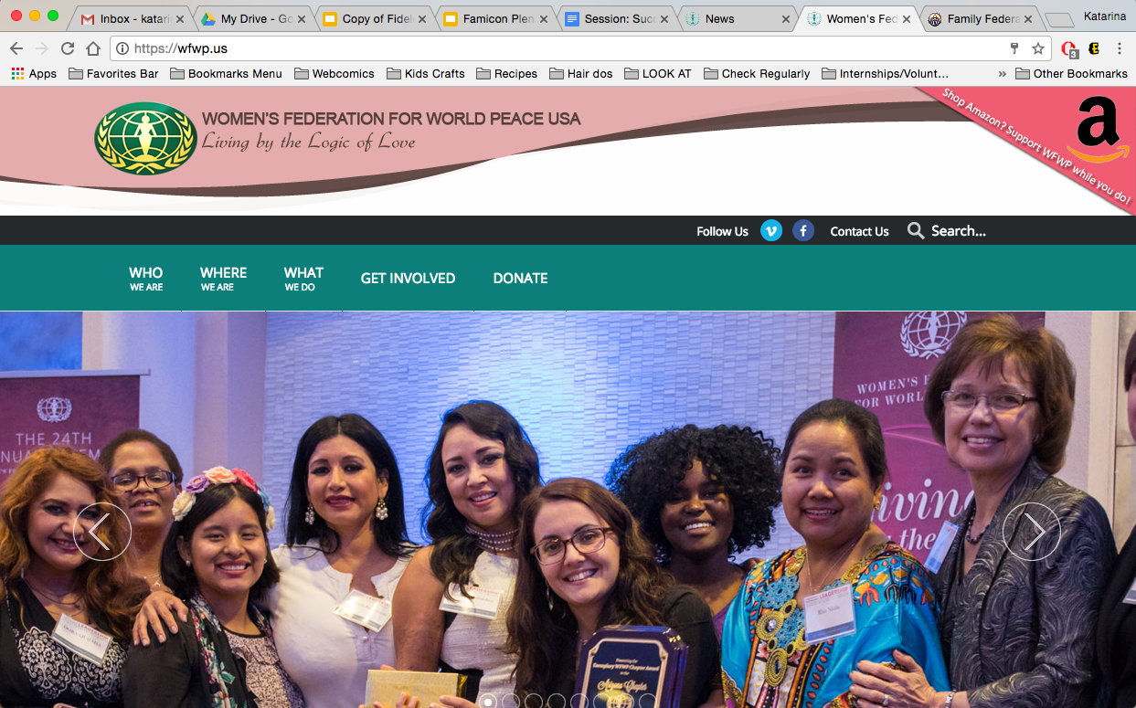
What next?
NEWSLETTER
Place your screenshot here
Sign up for our newsletter at the website, www.wfwp.us, and stay connected to what’s going on!

Slide 23
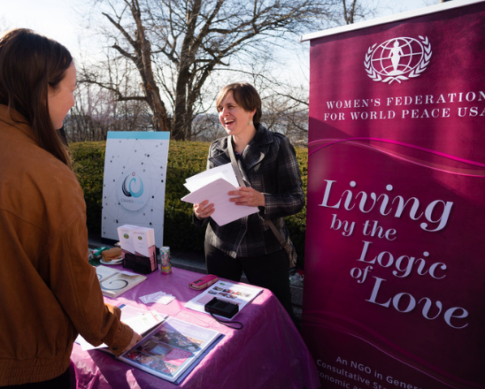
What next?
FAMICON BOOTH
Visit us at our booth and we can chat on how WFWP can be a great tool in your community.

Slide 24
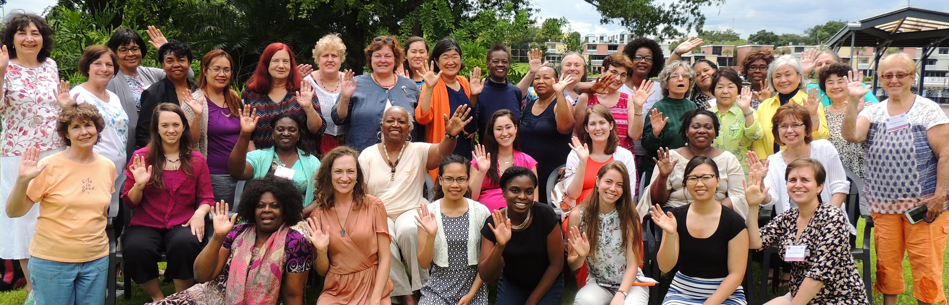
THANK YOU!

