Slide 1

BLESSING & FAMILY MINISTRY

Slide 2
Notes:
This photo represents our goal, a culture of joy, hope, fulfillment, all those other happy words. THIS IS THE FUTURE. A room full of smiling couples. It could be a product that sells itself.
You’ve heard about goals for Vision 2020. At this conference there will be some content about “how” to reach those goals, testimonies and resources to help you. But I’d like to talk a little about “why”. And we also want to let you know a little about how the BFM can help.
First, This photo is young couples but let’s not forget::
.

Slide 3

Notes:
...our senior couples. Still lots of hope and joy.
So the Blessing and Family Ministry, BFM, would like to help you.
Sometimes we’re asked to step OUT of our comfort zone. Let’s step INTO our comfort zone

Slide 4
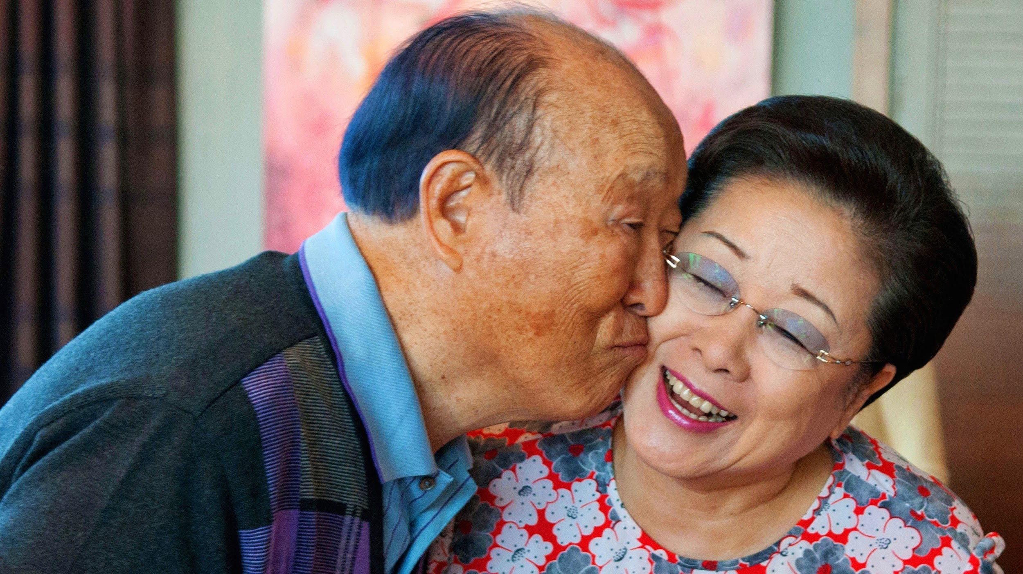
Notes:
As Tribal Messiahs we want to reach out to our neighbors, friends and relatives and invite them to participate in a Blessing. One “WHY” is internal. We want them to have the opportunity to change blood lineage and become part of a heavenly family while True Mother is still on earth. That’s the internal reason.
But we also want to HELP people, make a positive Social Impact. Let’s talk about that for outreach.
We want people to see our great couples and say: I WANT SOME OF THAT!!!

Slide 5
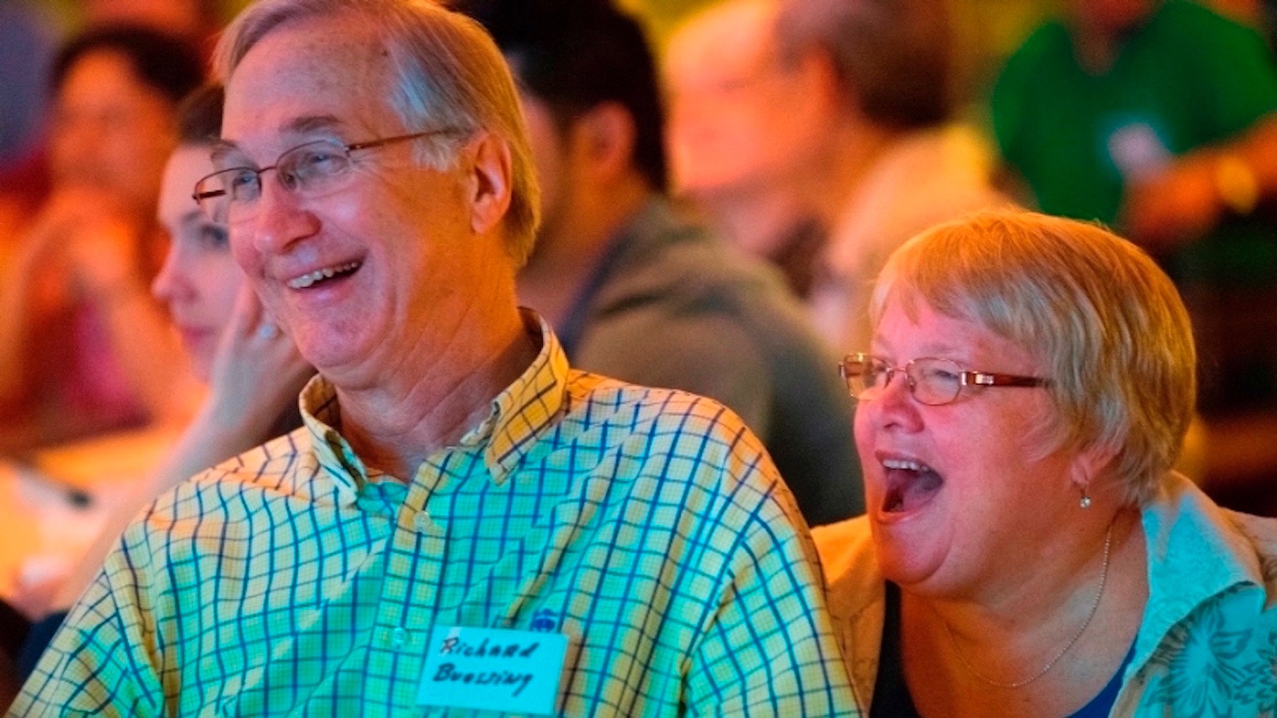
Notes:
I WANT SOME OF THAT!!!
Everybody say it: “I want some of that!!
Richard and Marjorie - a great example of a happy healthy God centered couple.

Slide 6
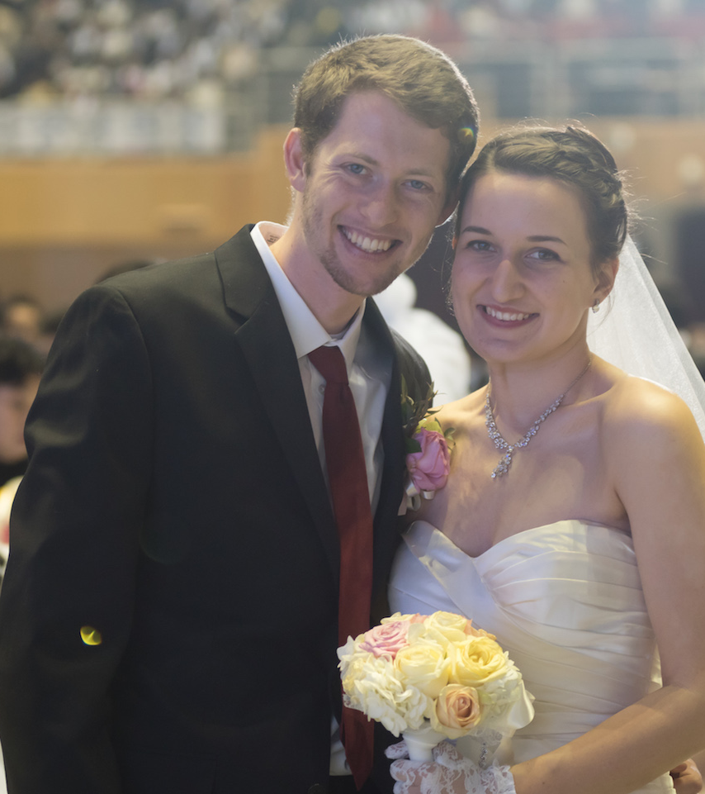
I want some of that.
Notes:
I WANT SOME OF THAT!!!

Slide 7

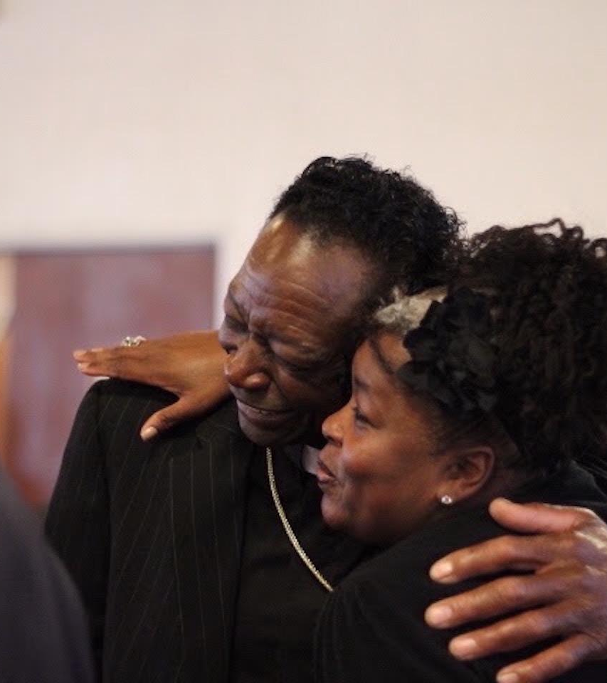
Or some of that!
Notes:
Or SOME OF THAT!!!
If you really enjoy a restaurant you want your friends and family to know about it. You’re happy to talk about it.
You might even suggest specific menu items. I suggest the Big Mac. It fits my budget.

Slide 8

Notes:
So let’s create couples and families that we want to testify about. Nice juicy, tasty, couples.
In addition to expanding heavenly tribes we can make a difference in the society.

Slide 9

DIVORCE IN
THE UNITED STATES
41 % of first marriages end in divorce.
So they try again.
Notes:
Let’s talk about one of the problems we want to solve.
It depends on the agency but we know the statistics are rough. Some say 50% of first marriages end in divorce.
So they try again

Slide 10

DIVORCE IN
THE UNITED STATES
60 % of second marriages end in divorce.
And try again.
Notes:
60% of 2nd marriages end in divorce
So they try again, at least some of the time.

Slide 11

DIVORCE IN
THE UNITED STATES
73 % of third marriages end in divorce.
(practice does not make perfect)
Notes:
Practice does NOT make perfect.
But divorce rate is not the problem, it’s a symptom of a deeper sickness
Need to get married and STAY married

Slide 12
Not just depressing statistics.
Not just heartache for the couple.
But a lasting emotional toll on their children and our society.
Notes:
That’s negative social impact
and doesn’t even include the families that stick together even though they don’t get along
We know the Blessing is eternal.Traditional wedding vow says “Till death do us part”. But for some they wonder if they can make it til the end of the week. Sad.

Slide 13
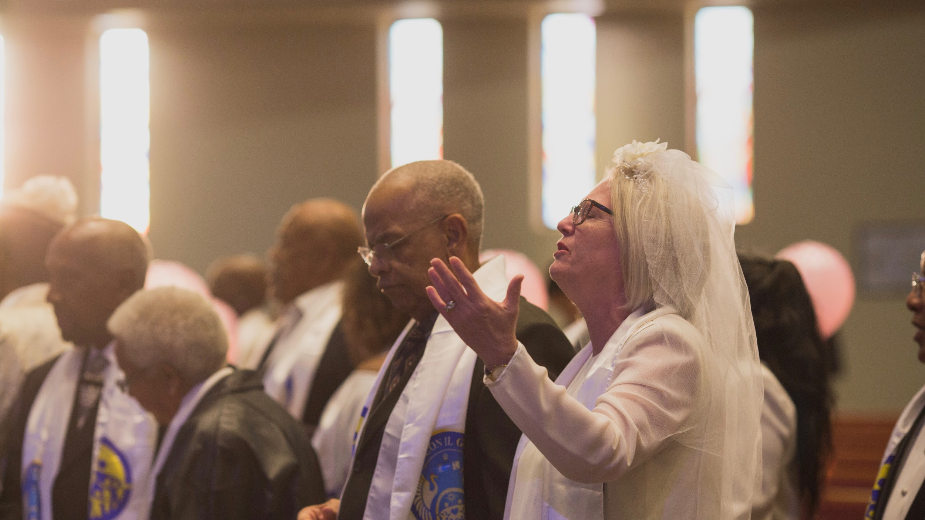

A MOVEMENT
Taking a stand for God and families.
Notes:
That’s why we want a MOVEMENT. The Blessing is not just getting married. By having public Blessing events we’re making a statement, taking a stand and reminding America that God should be in our lives and in our families. We’re saying that True Love and loyalty and fidelity are not old fashioned and passe.

Slide 14
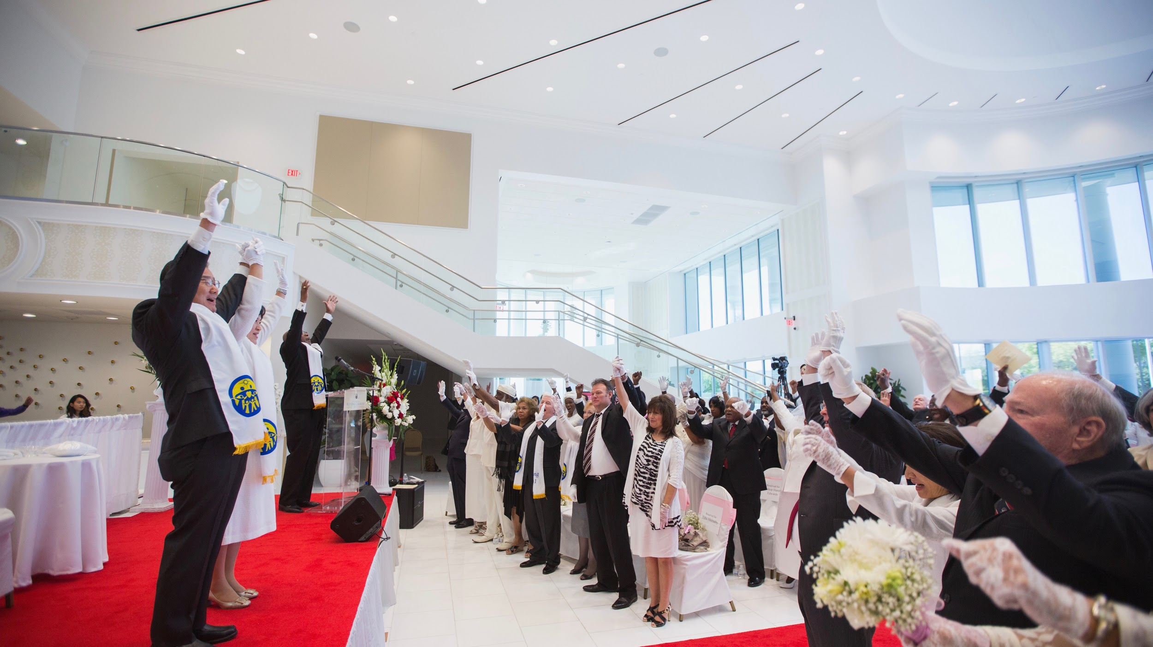
A MESSAGE
Notes:
This kind of movement can send a message

Slide 15
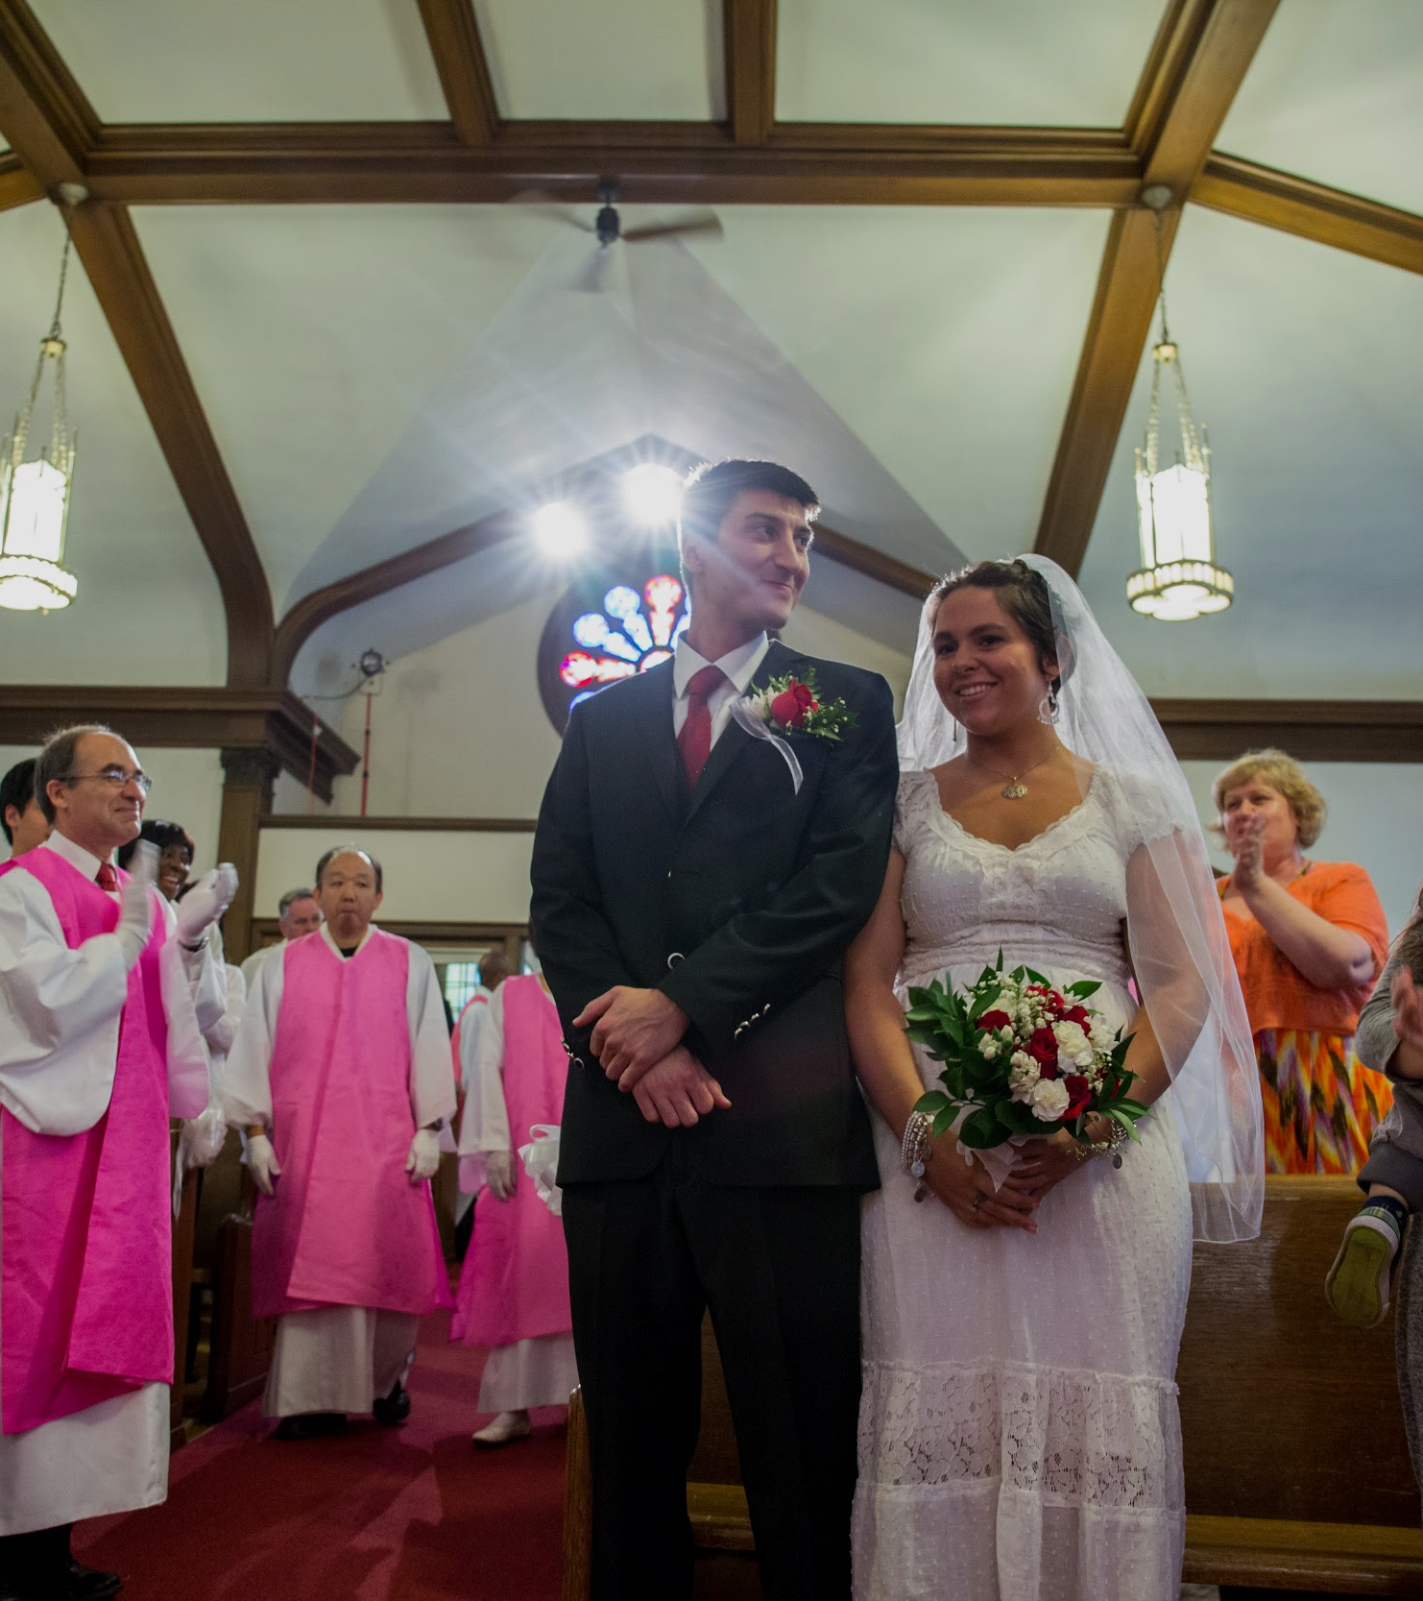
2017
Marriage Blessing Movement Opportunities
April 29
June 24
August 26
September 6 Cosmic Blessing
October 28
December 16
Notes:
We can have lovely, intimate individual ceremonies. But if we want to make a statement we have an opportunity to let everyone know with public community events. Here are some we’ve scheduled.

Slide 16
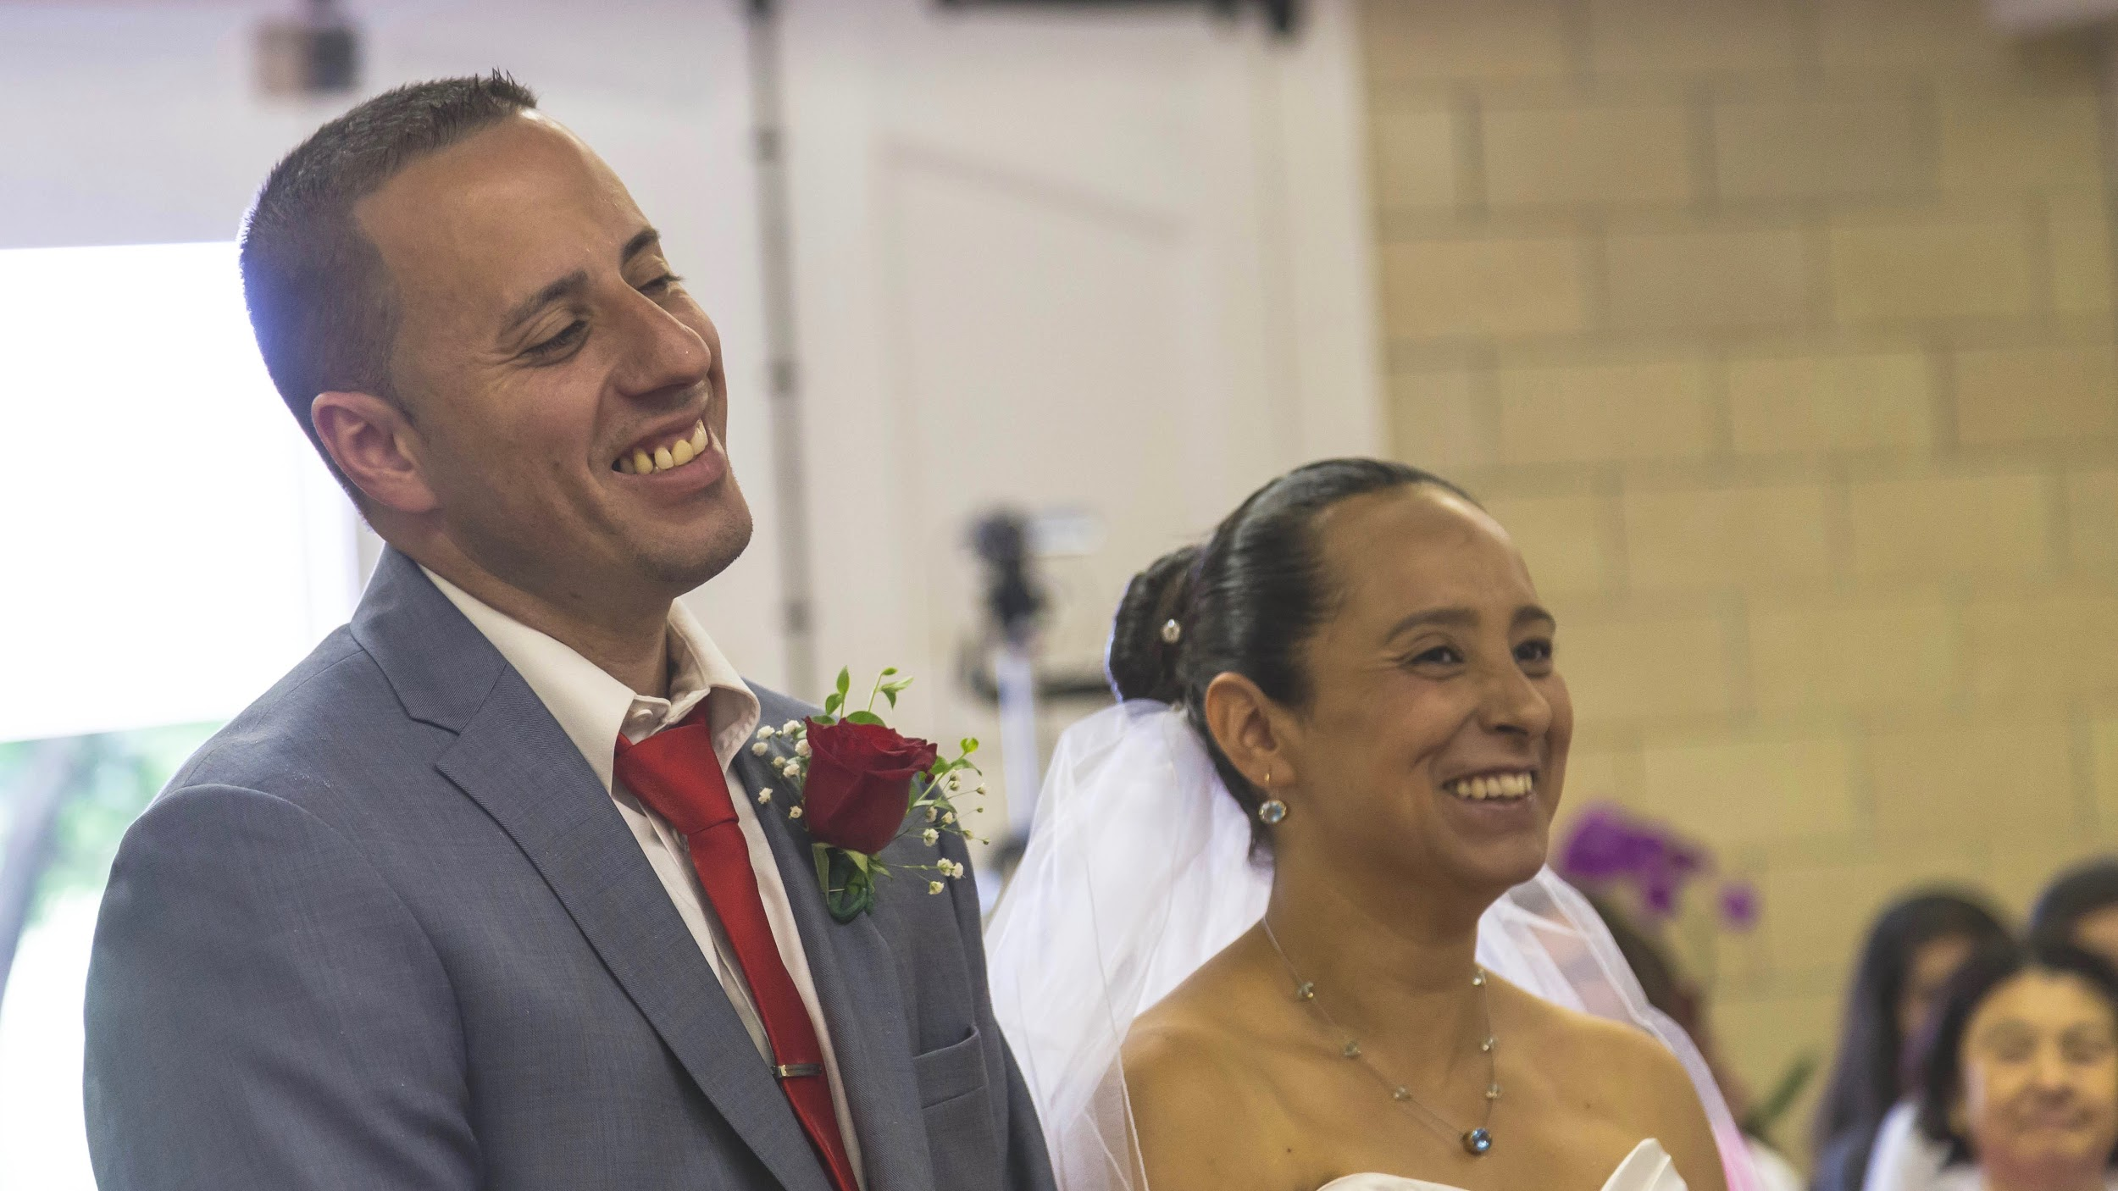
Just the beginning...
Notes:
But the Marriage Blessing is just the beginning.

Slide 17

Blessing is more than Marriage.
It’s Family
Notes:
We want to create a culture of God’s love. That’s not just couples.

Slide 18

Happy children.
Healthy children.
Notes:
It’s happy healthy children

Slide 19
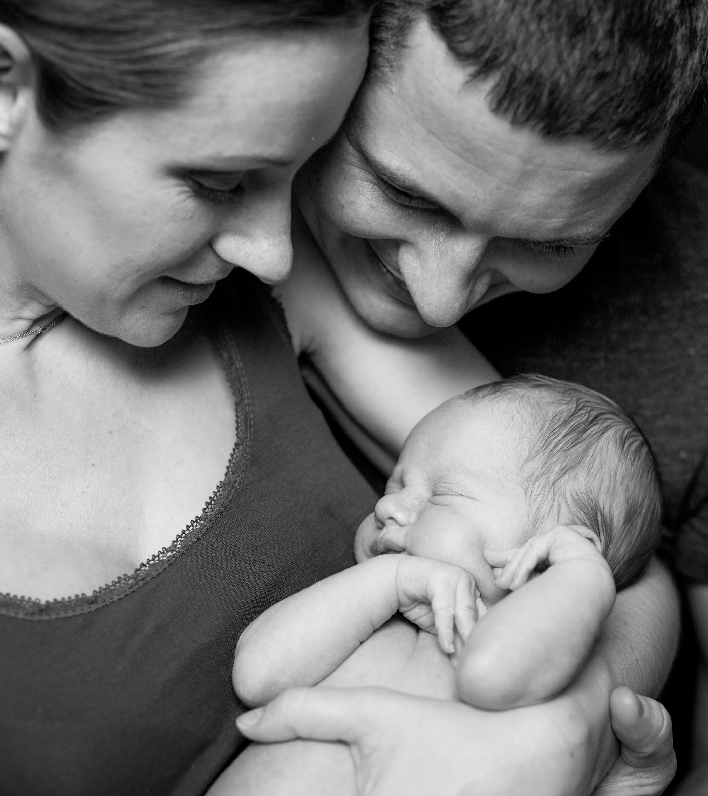
Blessed Children.

Slide 20
Blessed Couple
+ Blessed Children
= Blessed Family
Notes:
Simple math

Slide 21

I want some of that!
Notes:
I want some of that too!

Slide 22

And that.
Notes:
And that

Slide 23
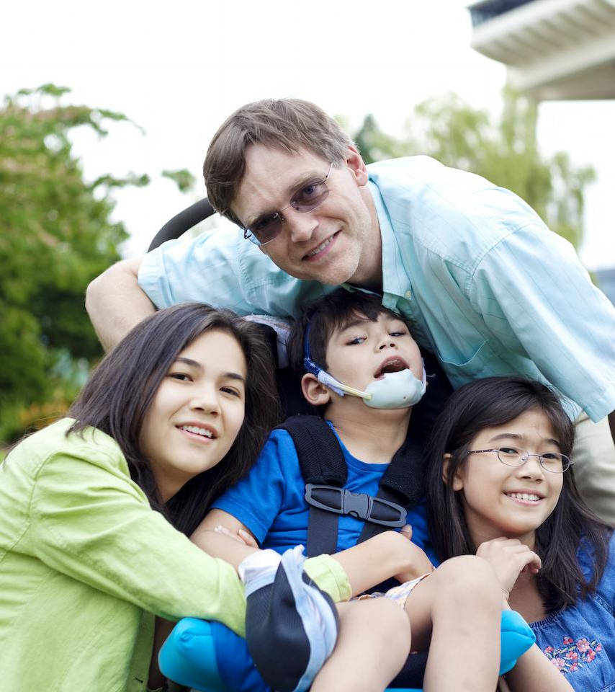
And an extra helping of that.
Notes:
And an extra helping of that
Family. We can sell the whole package. That’s even more attractive.
Happy marriage, healthy family is CONTAGIOUS. Let’s help people catch it. We want an epidemic, a pandemic.
Not just couples, FAMILIES
If you’re selling a car. You can say it gets great gas mileage (and the brakes usually work too.)
This car will get you (most of the way) to where you want to go. Sell the whole package
How do we do that?

Slide 24
Outreach
IN - reach
Notes:
We can testify to the Blessing and Blessed families if we have great Blessings and great families.
So, in addition to outreach, we need IN REACH
In some of the breakout sessions you’ll be hearing about some great resources for marriage enrichment, and parenting to help build great families.
We all want great families and we want our tribes to have great families as well. However….

Slide 25

Notes:
I DON’T want some of that!
Principle says “be fruitful” and then multiply. Grow to perfection and THEN have a family.
So for the few of us in this room, and I won’t name names, who didn’t quite make it to perfection, we have some catching up to do.
(Or maybe our spouse is a lot closer than we are.)

Slide 26
“Everyone without exception is struggling to gain happiness…”
Notes:
The first sentence of Divine Principle says” “Everyone without exception is struggling to gain happiness…” Let’s see if we can help get rid of some of the struggling and add to the happiness.

Slide 27

Notes:
Some think our struggling is a breakdown in communication.
The break down isn’t just communication, it’s a false concept of love. We say:
I love my spouse
I love my kids.
I love a good cheese steak sandwich where the roll is crunchy on the outside and the cheese is melted into the meat.
“Love” is a pretty important word. But our society has trivialized it. sometimes from a shallow perspectives. In our culture we have inherited false love.
We need to know TRUE love taught to us by TRUE Parents.
This means we need more than a ceremony. More that drinking Holy Wine and saying a prayer and doing the steps. The Blessing doesn’t guarantee a healthy marriage.
Like I said we need to promote the whole package. Outreach and IN reach, . Resources to help. Couples and Kids, Soup to nuts. Cradle to grave.

Slide 28


From womb.
To tomb.
Notes:
Womb to tomb.
That includes INreach to help our families be healthy and happy.
At BFM we offer support for everything from the matching to the Seonghwa

Slide 29

SOCIAL IMPACT
Family is the fabric of society.
Notes:
No you’re not in a medical conference. But this is a virus.

Slide 30

Notes:
It’s thought of as a negative. But they use viruses to cure cancer because a virus can get in where nothing else can.
FALSE love is so deeply ingrained into our society it’s really hard to get it out.
But family is the fabric of society. SO if we can restore God centered families, True Love families, we can reach into society and help in a significant way. This is restoration. This is Social Impact. An opportunity to purify the corrupted love that steals people’s lives. Like cancer.
How can we do that?

Slide 31
Our focus is much more than Matching and Blessing.
Notes:
We go beyond the matching and Blessing.
The Blessing isn’t a magic pill that solves all the relationship problems. Isn’t it sad if a couple gets Blessed but their relationship falls apart.
Let’s help.
How many have spent time on the BFM website?
How many get the newsletter?
I’m selling it here but it’s free.
BFM is a ONE STOP SHOP for your Blessed Family Needs
There will be a session on BFM resources. PLEASE recommend more for us to promote. We’re always expanding and developing.

Slide 32
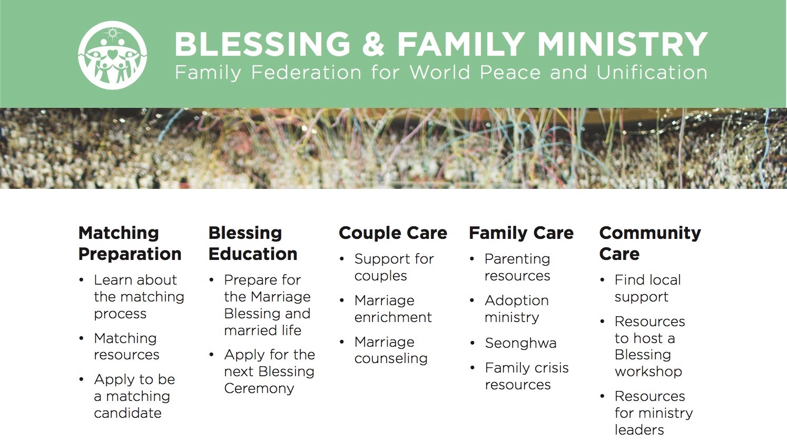
Notes:
Just a few of the resources on the BFM website

Slide 33
Upcoming National Events for 2017
May: Family Matching Convocation
June: Start Smart: Level 3 Blessing Workshop
August: 24+ Connect Retreat
August: Level 2 Blessing Workshop
November: Young Blessed Couples Retreat
Notes:
National Events

Slide 34

Notes:
Coming up right here in a few days. True Father said:
“High noon settlement is possible when there is no shadow. When the mind and body become one, the shadow disappears”

Slide 35
Webinar Resources
In Your Home
Family Money Matching Smarts Series
Family Matching Support Webinar Series
Parenting Webinar Series
Marriage Enrichment
All past recordings can be found at bfm.familyfed.org
Notes:
Webinars - you can participate in your pajamas
Homework, “action steps”
Go to the BFM website.

Slide 36
bfm.familyfed.org

Slide 37
1. Go to the BFM website.
2. Find BFM Coordinators in your district or community.
3. Go home and love your family.
Notes:
Go to our website and look around. Sign up for the newsletter, send us suggestions for even more and better resources.:
2. Find BFM coordinators in your district or community. They can be your point person for all the Blessing related information. Important to have a helpful go-to person. Pastors, they'll be on your team but we can help train them to help you and your community.
3. Go home, love your spouse, love your kids so when your friends and neighbors see you, when your tribe looks at your family, they all say

Slide 38
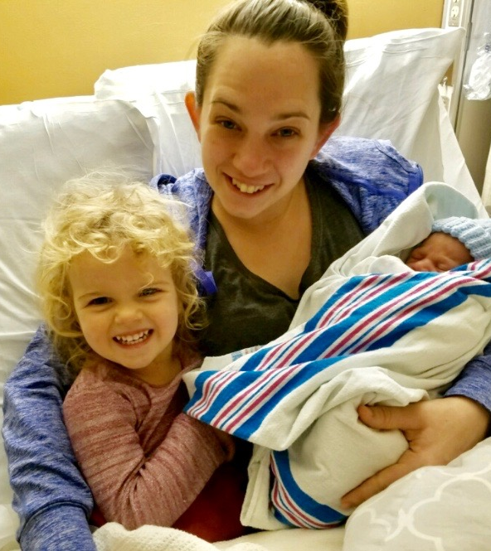
I want some of that!
Notes:
“I want some of that”
JOIN THE BLESSING MOVEMENT and bring everyone you know to come along.
From Crescentia and the Blessing and Family Ministry. Thank you and God Bless you and your families.

Slide 39
bfm.familyfed.org

