Slide 1


Universal
Peace Federation
UPF.ORG

Slide 2
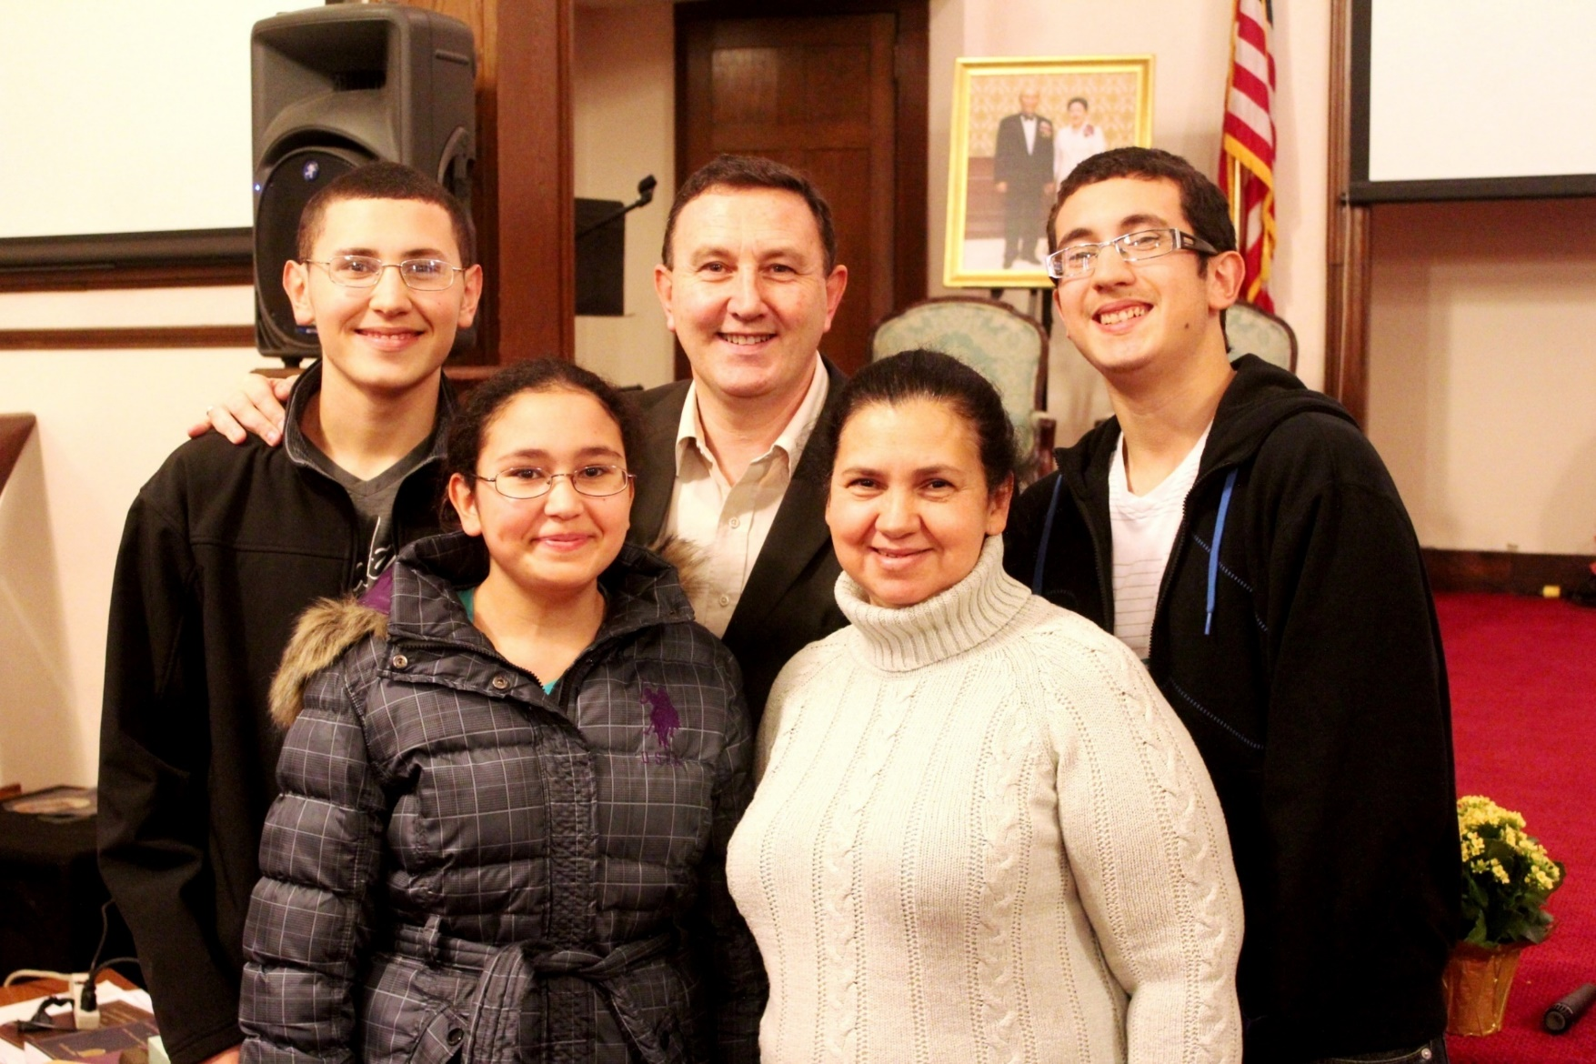

Slide 3
Hosting an American Leadership Conference in your District is an Excellent Tool to Fulfill Tribal Messiaship

Slide 4
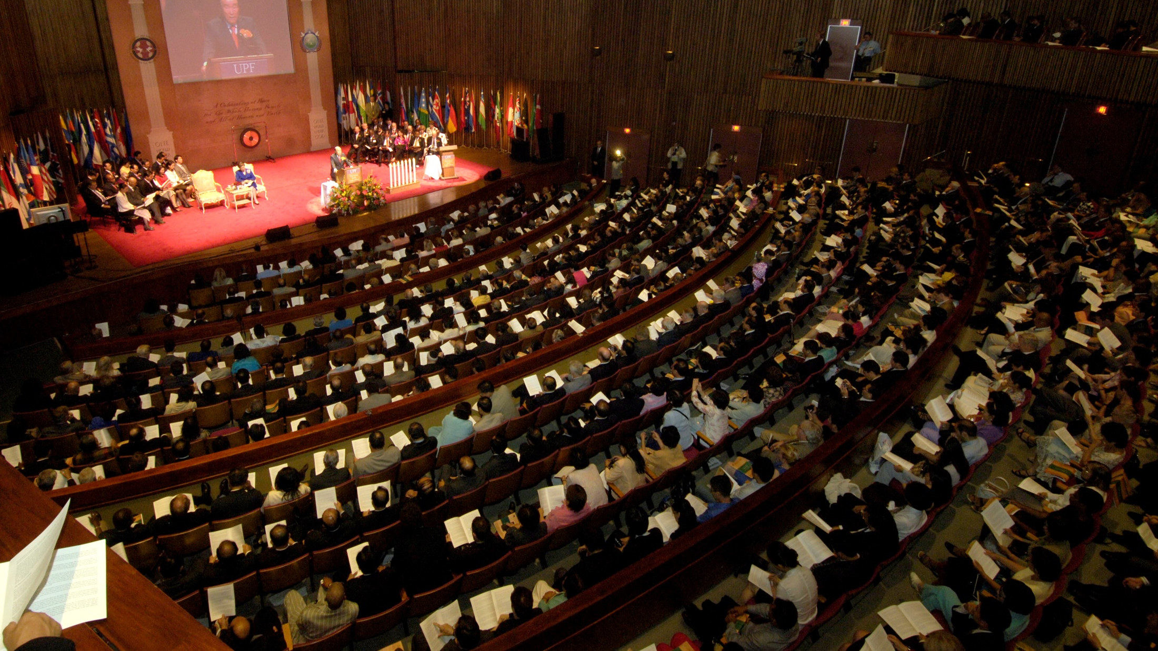
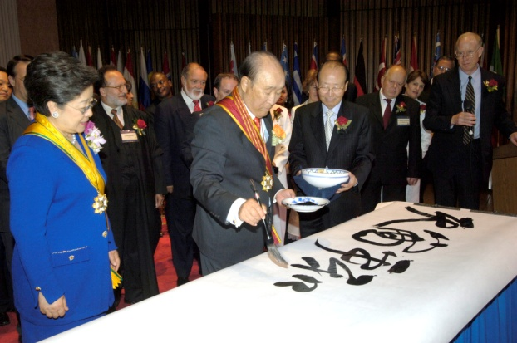

Historical inauguration
“True Love is the Ideal and the Guiding Principle of the Universal Peace Federation”
Rev. Dr. Sun Myung Moon
New York City, September 12, 2005

Slide 5
Universal Peace Federation
“I declare today before all humanity the founding of a new international organization, the Universal Peace Federation. Its mission is to renew the existing United Nations and provide a new level of leadership as an “Abel-type” United Nations, that is, a United Nations whose efforts for peace are offered to Heaven, investing itself ceaselessly in living for the sake of others.”

Slide 6
UPF International Leadership Conferences 2016
Seoul, Korea - February 12–16
Kathmandu, Nepal - July 28-31
Ouagadougou, Burkina Faso - August 8-10
London, United Kingdom - September 7-9
San José, Costa Rica - October 6-8
Asunción, Paraguay - October 10-12
Lusaka, Zambia - November 5-7
Tokyo, Japan - November 15-17

Slide 7
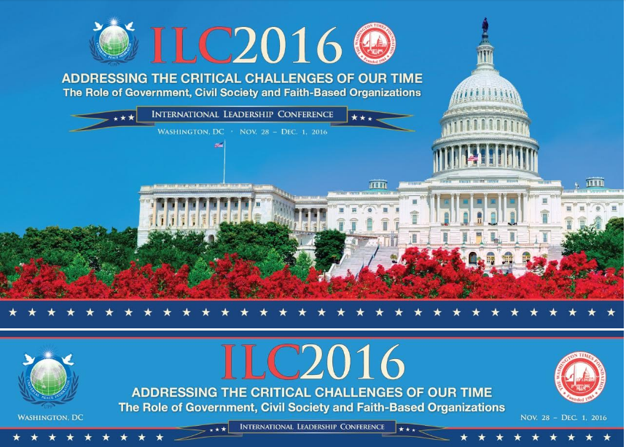

Slide 8
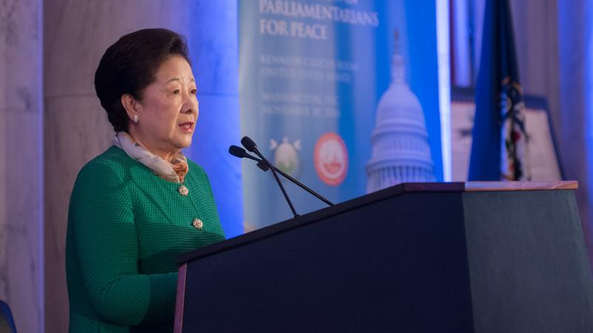
True Mother’s Address at the Kennedy Caucus Room

Slide 9
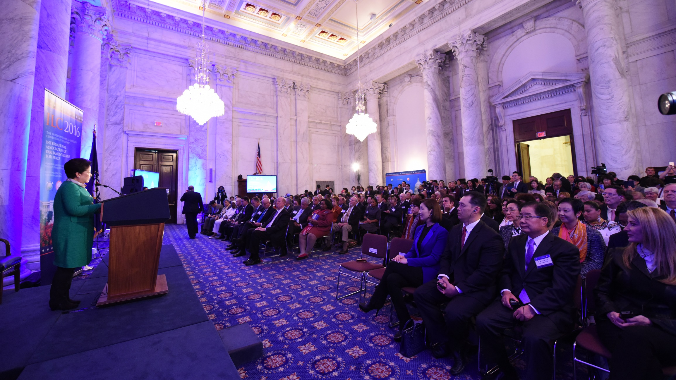
True Mother told the group “You are most needed by God”

Slide 10
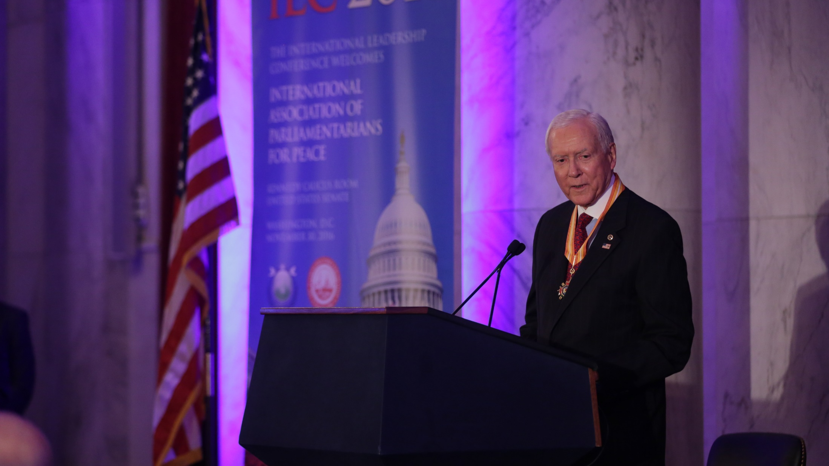
Senator Orrin Hatch shares his respects for working with True Parents

Slide 11
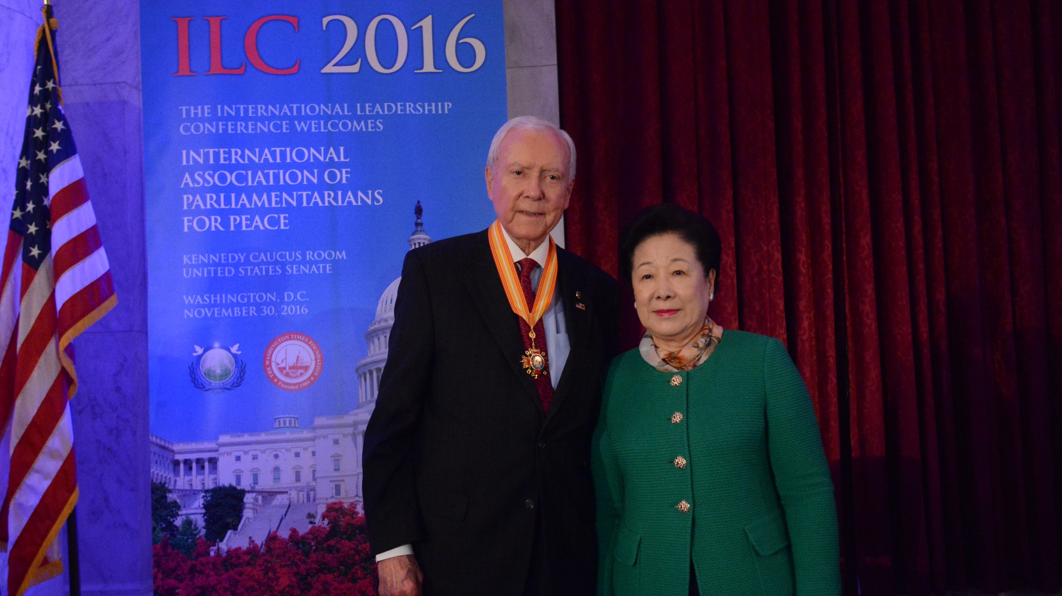

Slide 12
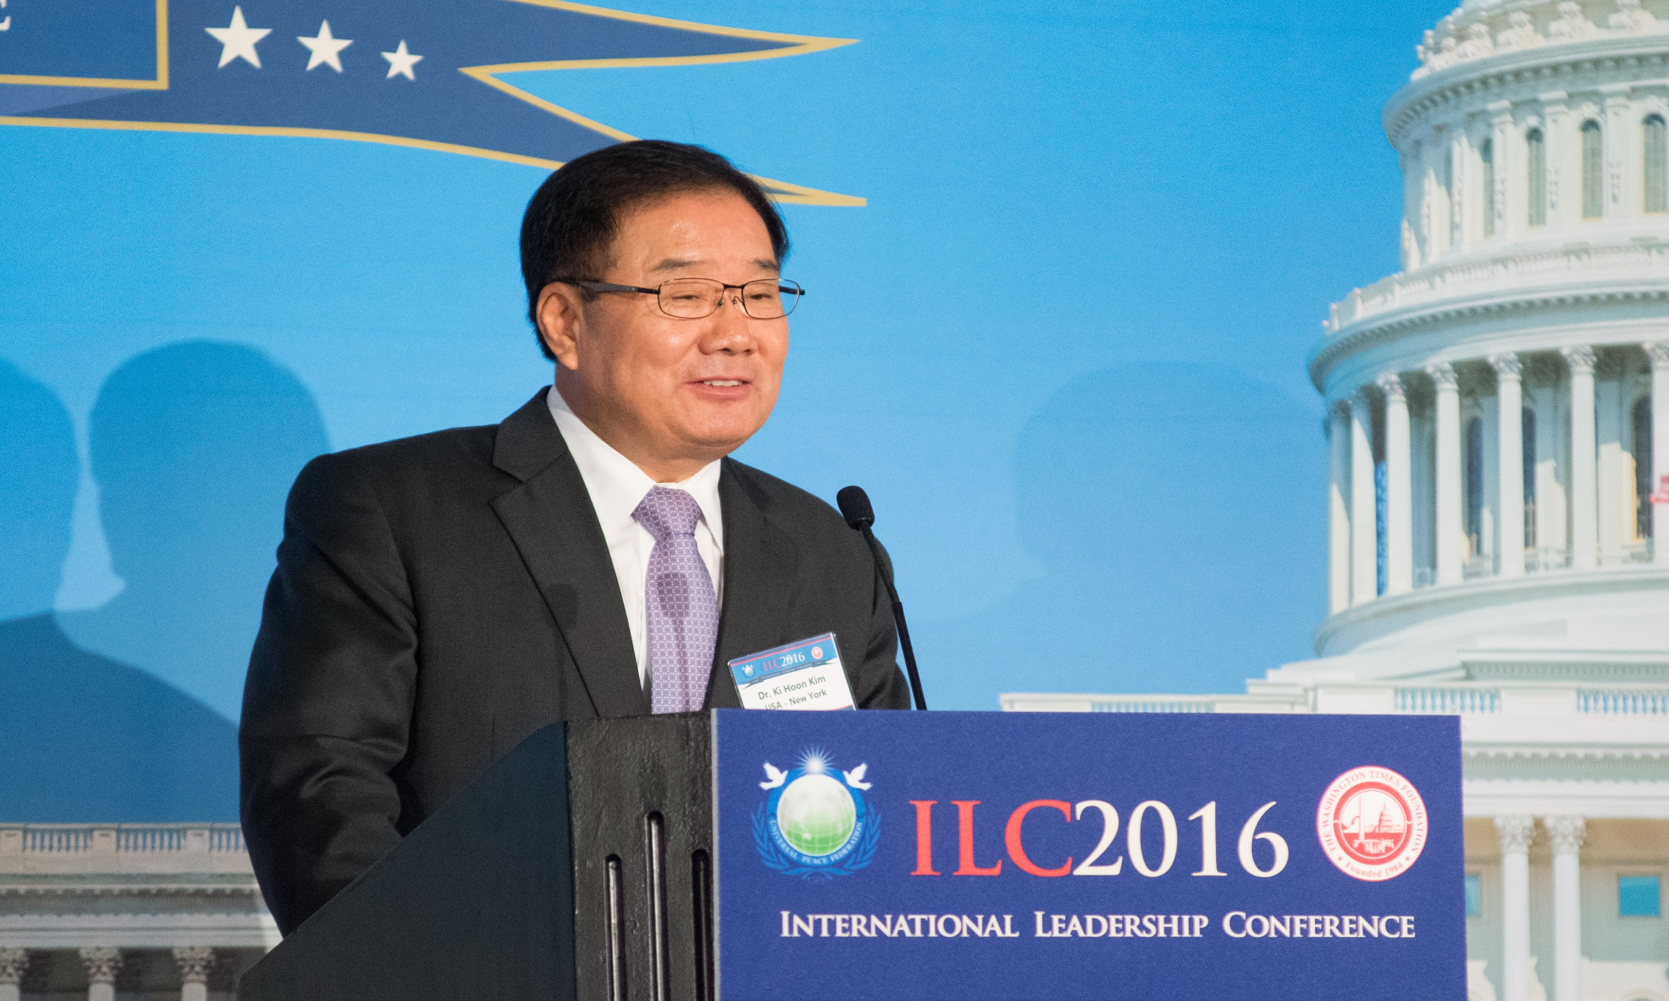

Washington DC, United States Nov-Dec 2016
Dr. Ki Hoon Kim, Chairman, UPF North America

Slide 13
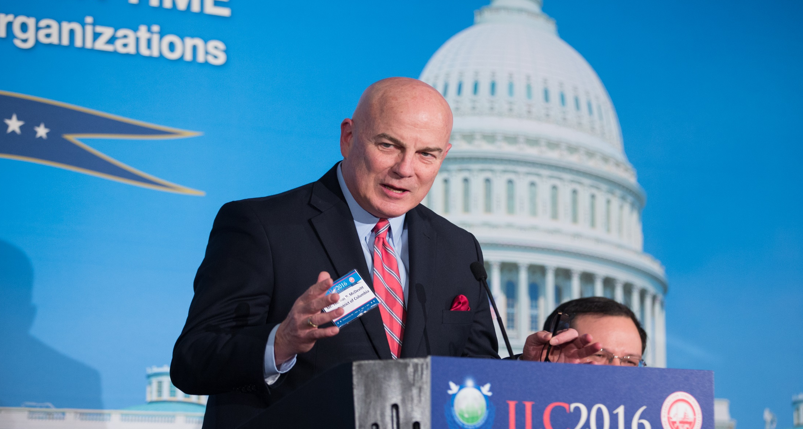
Mr. Tom McDevitt, Chairman of The Washington Times

Slide 14
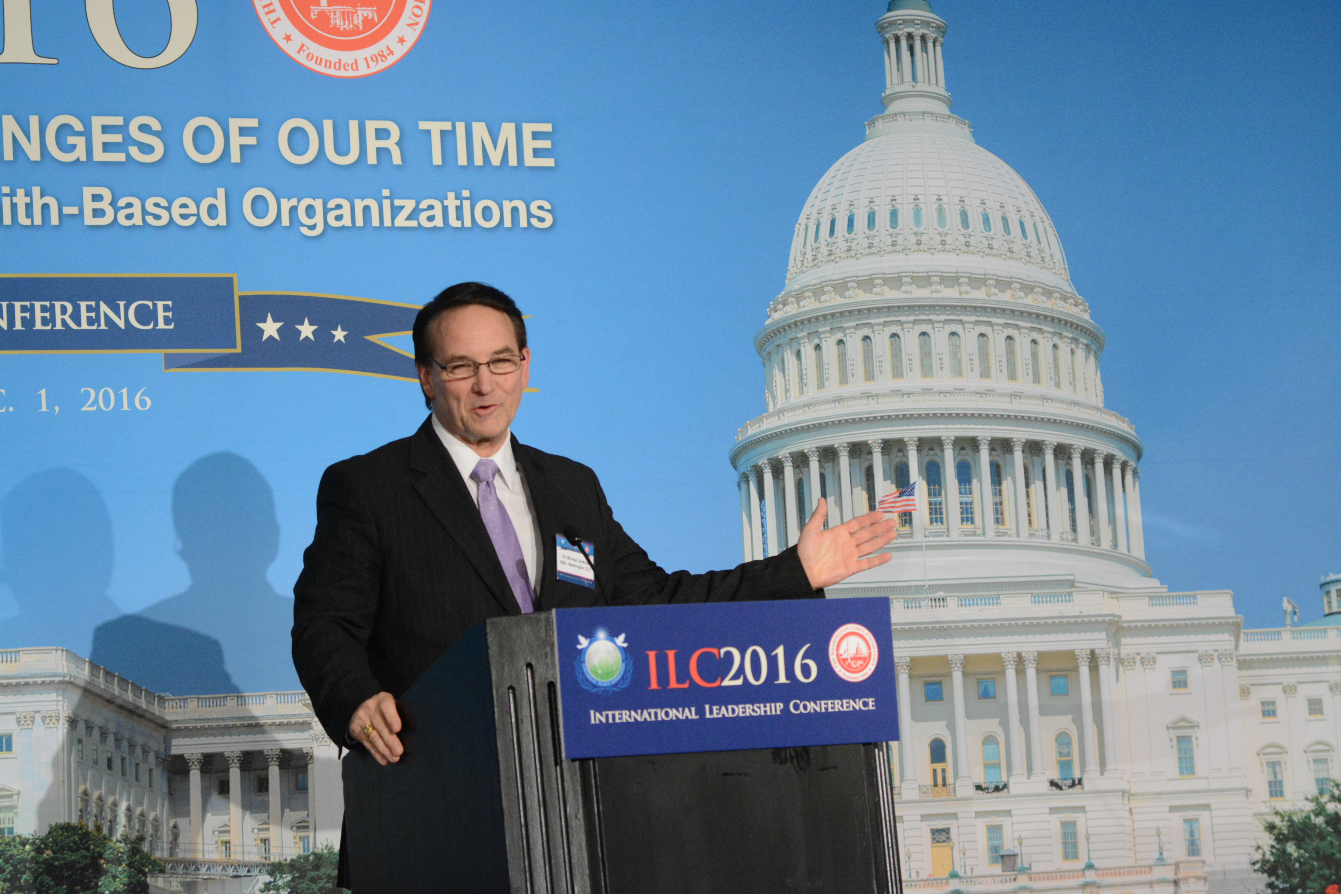
Dr. Michael Jenkins, President of The Washington Times Foundation

Slide 15
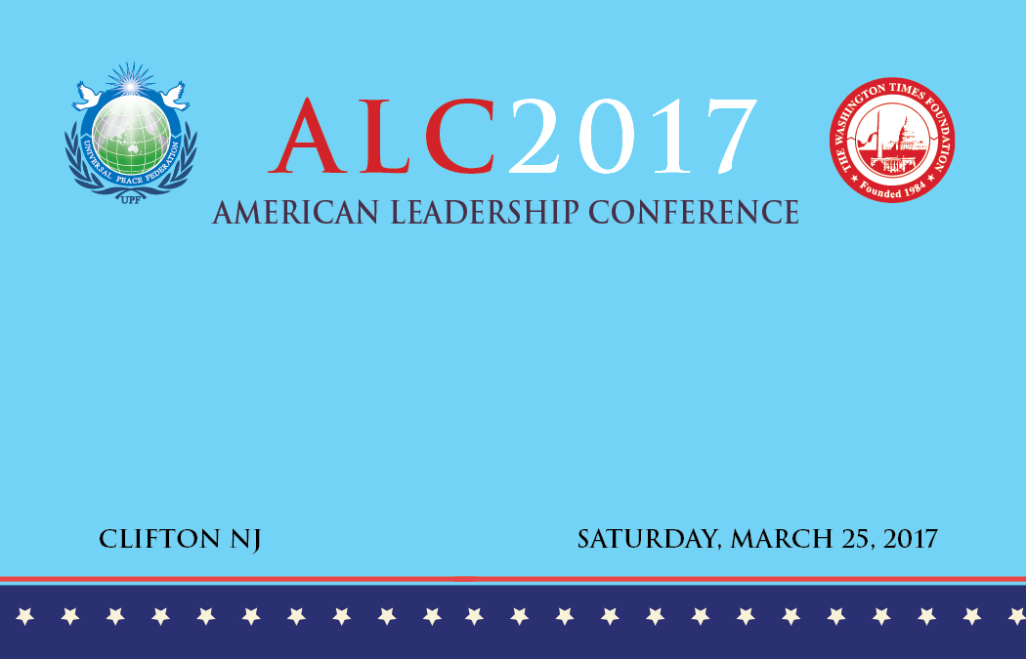
Three Pilot Conferences
New York (March 11)
New Jersey (March 25)
Washington, DC (April 1)

Slide 16
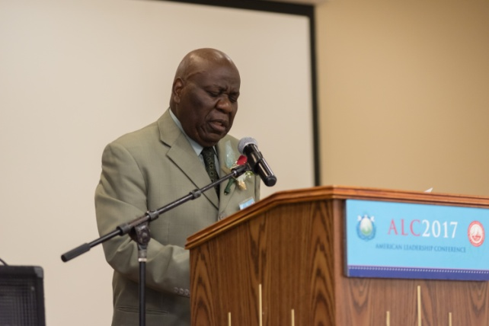

Slide 17
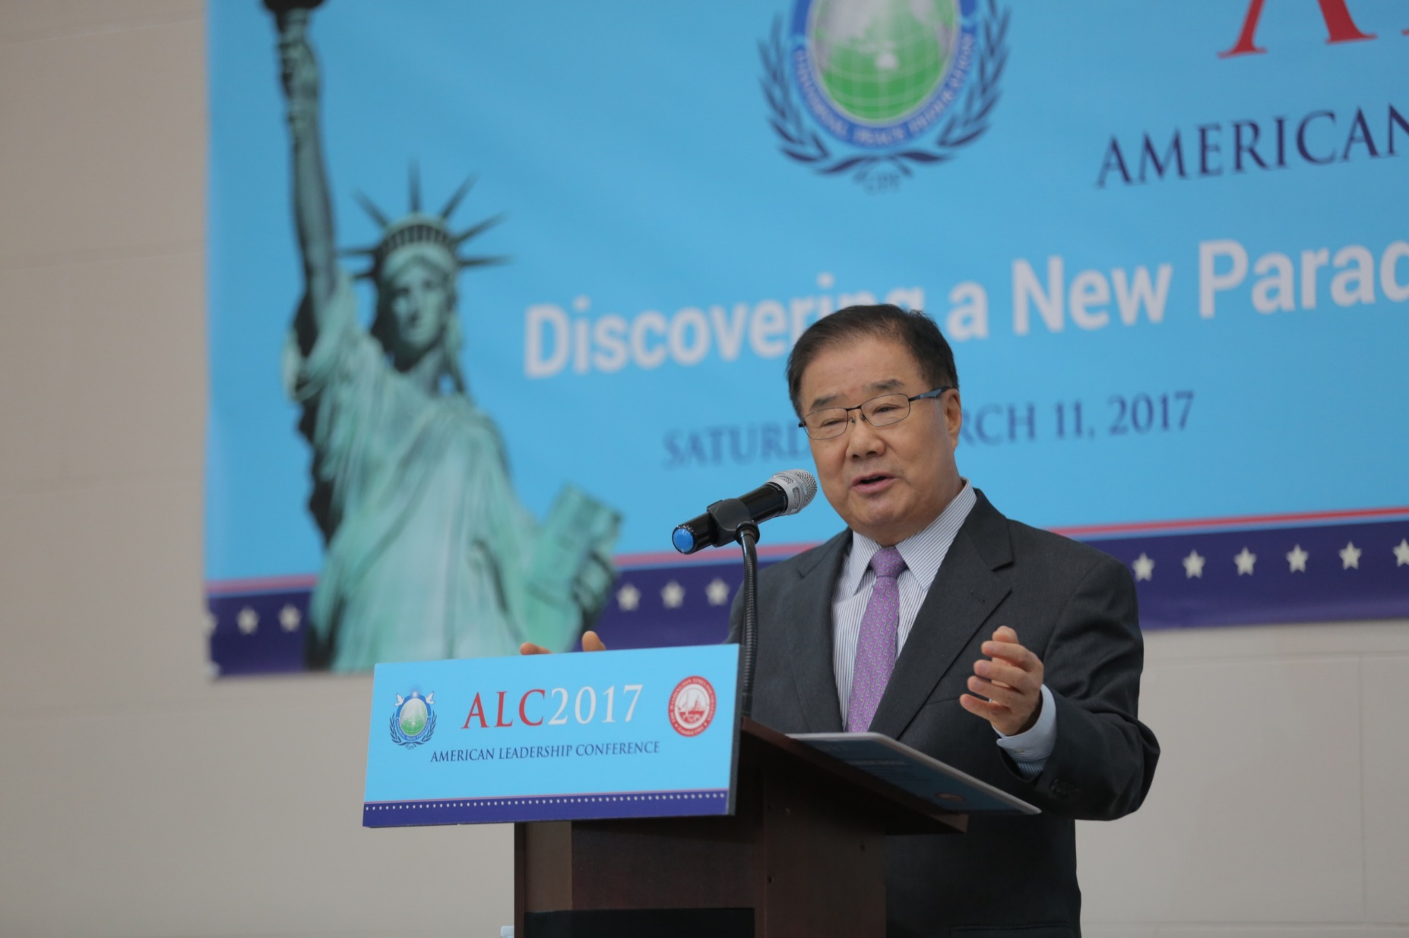

Slide 18
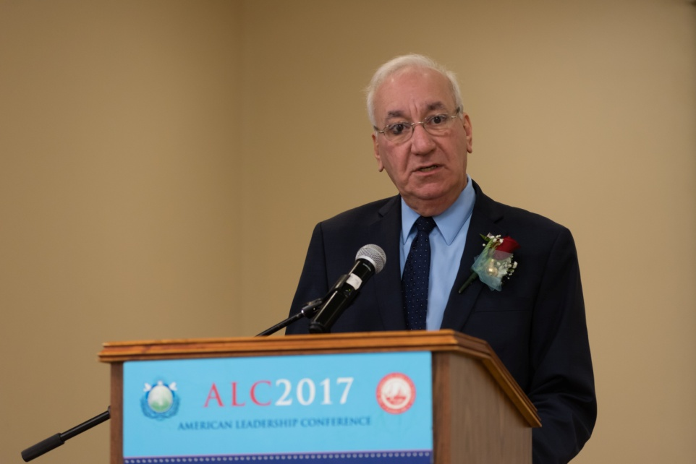

Slide 19
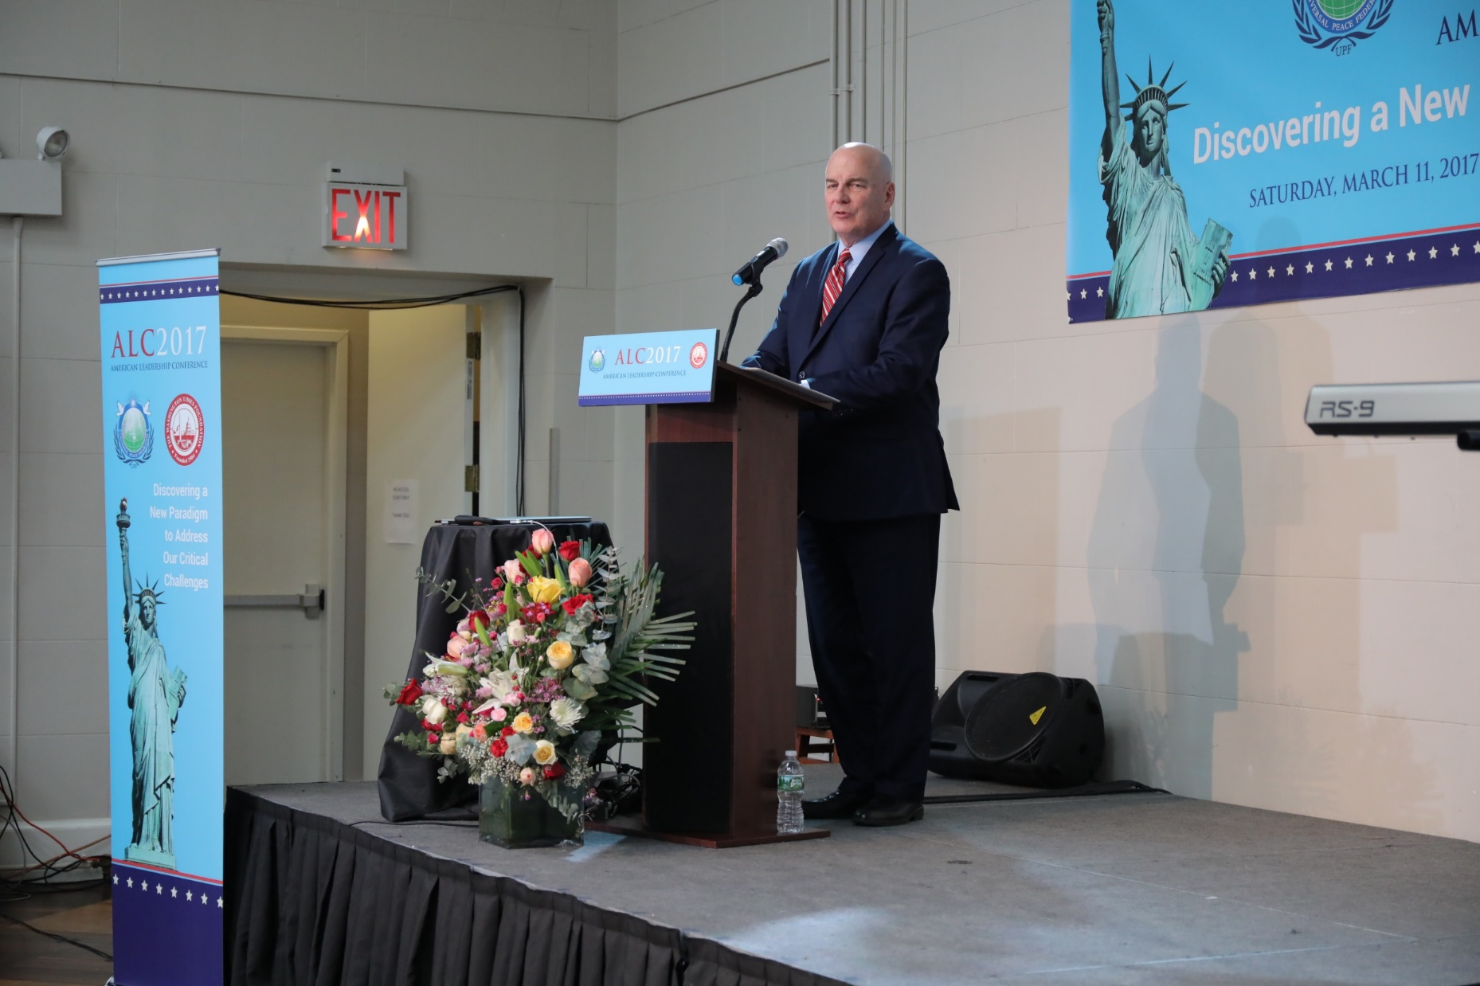

Slide 20

SESSION I:
CHARACTER, LEADERSHIP AND GOOD GOVERNANCE
SESSION II:
MARRIAGE AND FAMILY AS OUR ESSENTIAL RESOURCE
SESSION III:
BUILDING COMMUNITY AND CIVIL SOCIETY BEYOND THE
BOUNDARIES OF RACE AND RELIGION
SESSION IV:
AMERICA AS GOD’S HOPE – IS THIS EVEN POSSIBLE TODAY?

Slide 21
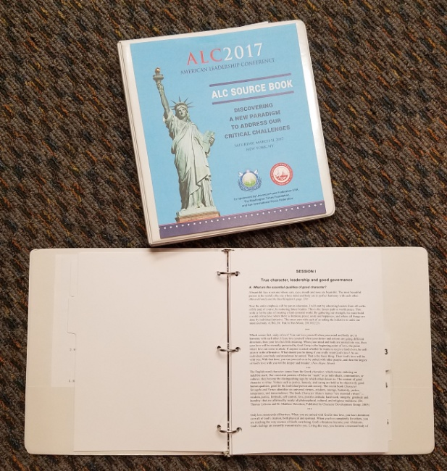
Title: “Discovering a New Paradigm to Address our Critical Challenges”
(based on ILC model in 2016 and World Summit 2017)
Main textbook is the new
“ALC Source Book”, a
100-page study material
Operational goal is to hold
ALC’s in each District every
quarter or even every month!

Slide 22
SESSION I:
CHARACTER, LEADERSHIP AND GOOD GOVERNANCE
A. What are the essential qualities of good character?
B. Why is good character important to leadership?
C. How do we develop good character, as a life-long pursuit?
D. What is the best environment for the development of good character?

Slide 23
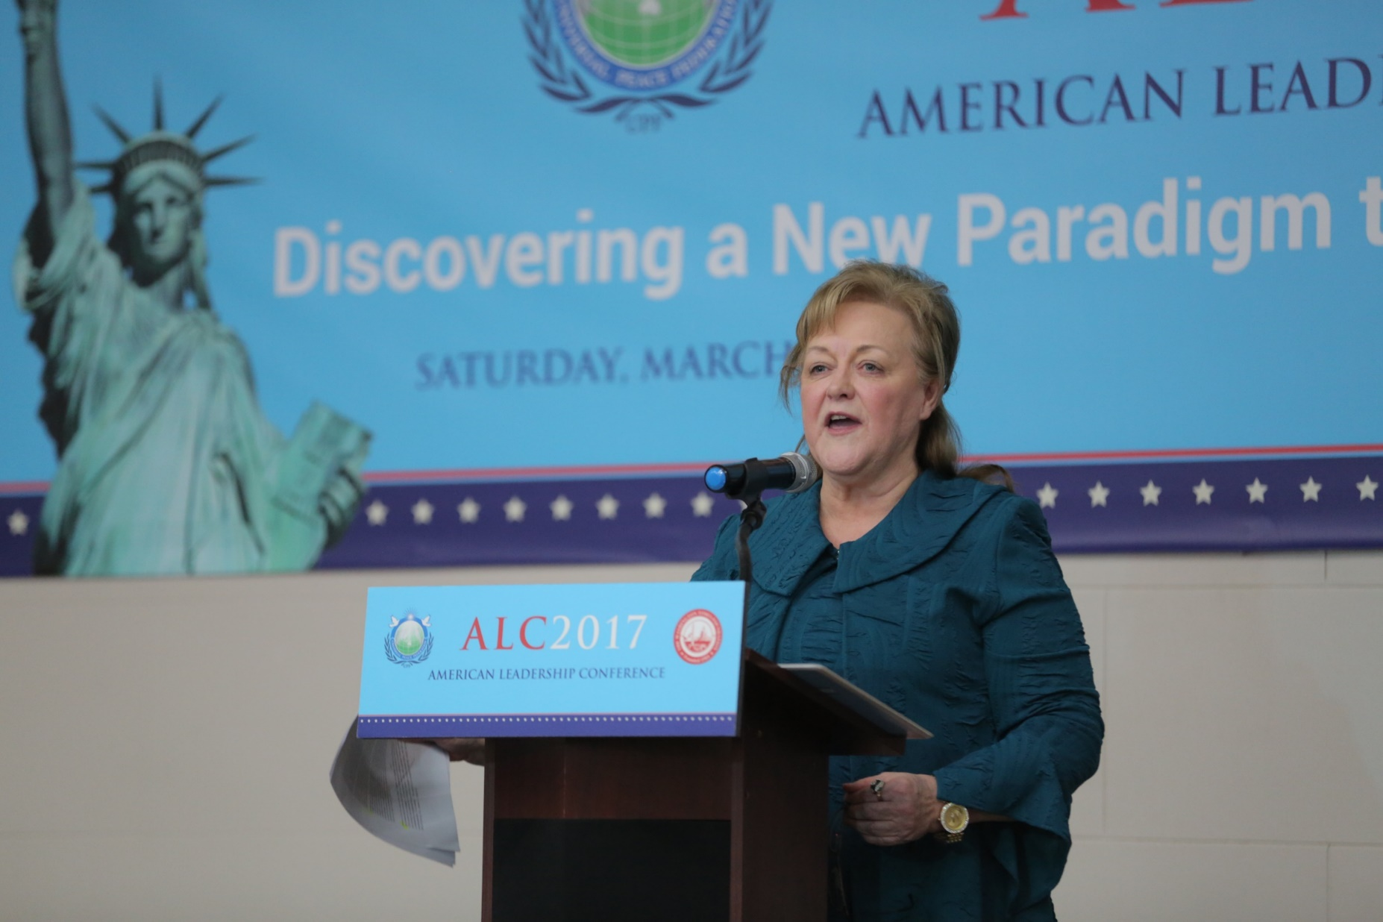

Slide 24
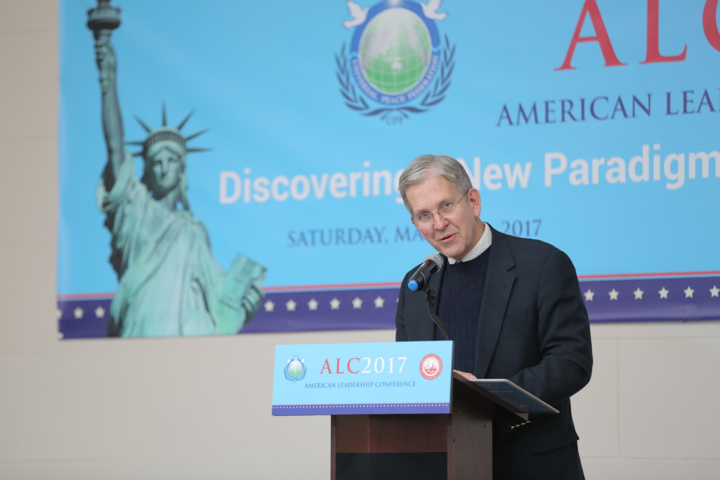

Slide 25
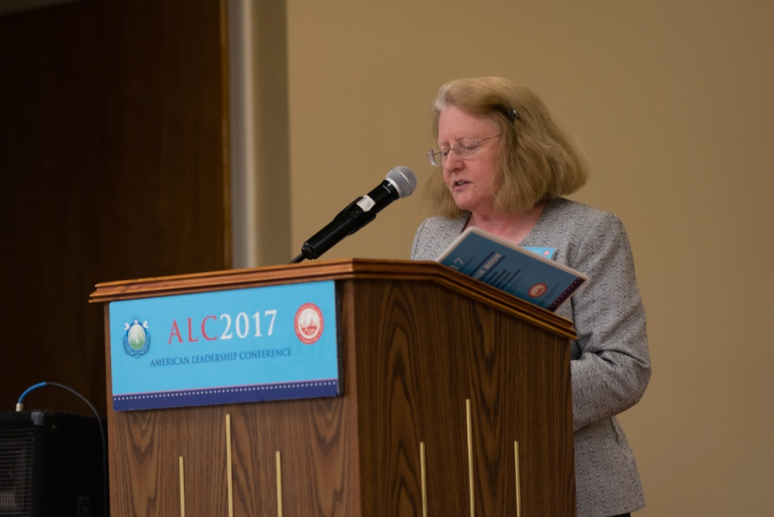
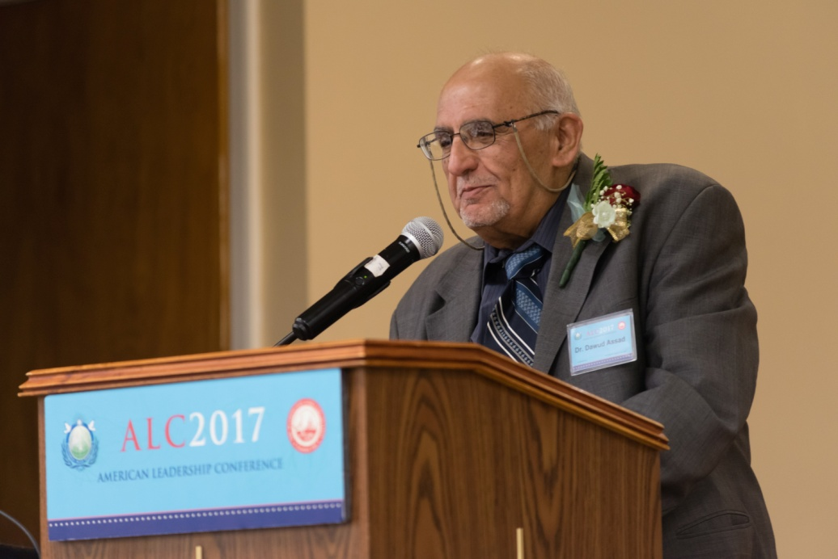
SESSION I. True Character, Leadership and Good Governance
Reader: (8 minutes reading)
Joy Lascari,
Treasurer, WFWP NJ
Commentator: (5 mins. reflection)
Dr. Dawud Assad, Chairman, Islamic Society of Central Jersey

Slide 26
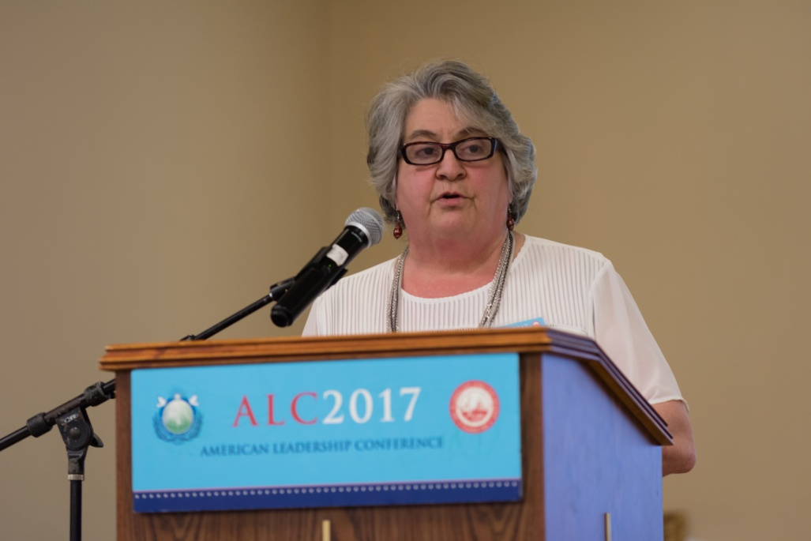
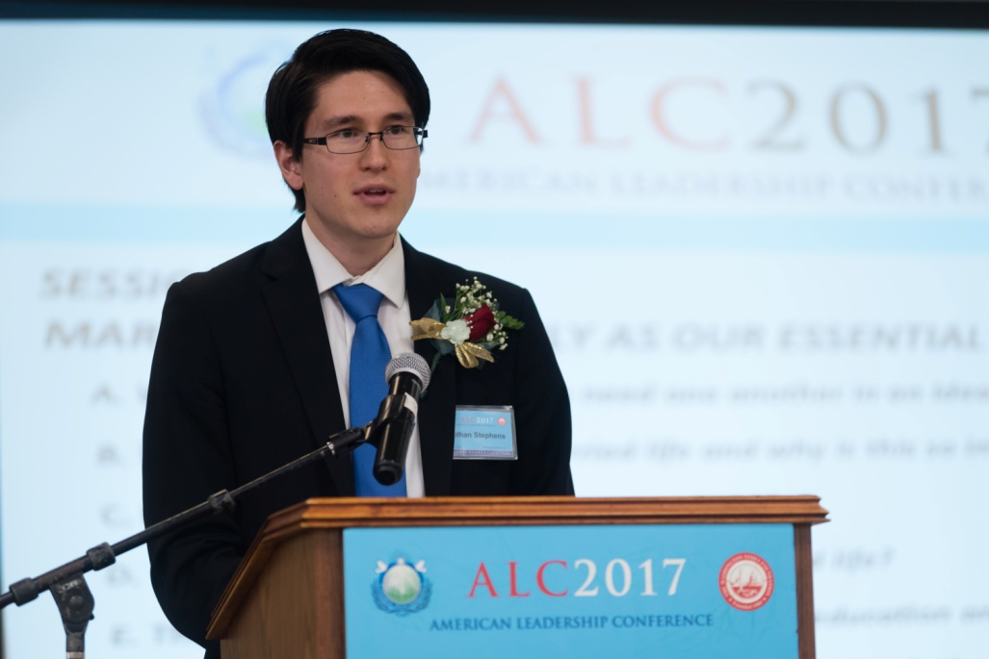
SESSION II. Marriage and Family as Our Essential Resource
Reader: (8 minutes reading)
Rev. Carol Pobanz,
Director, Peace In Project
Commentator: (5 mins. reflection)
Rev. Miilhan Stephens,
Vice President, FFWPU USA

Slide 27
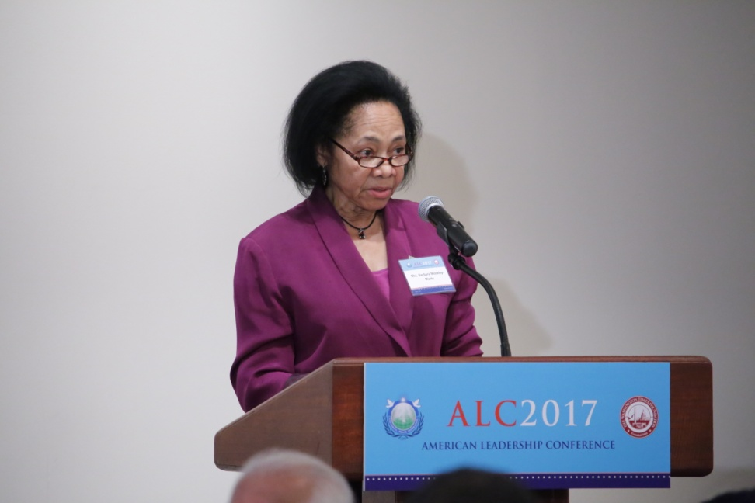
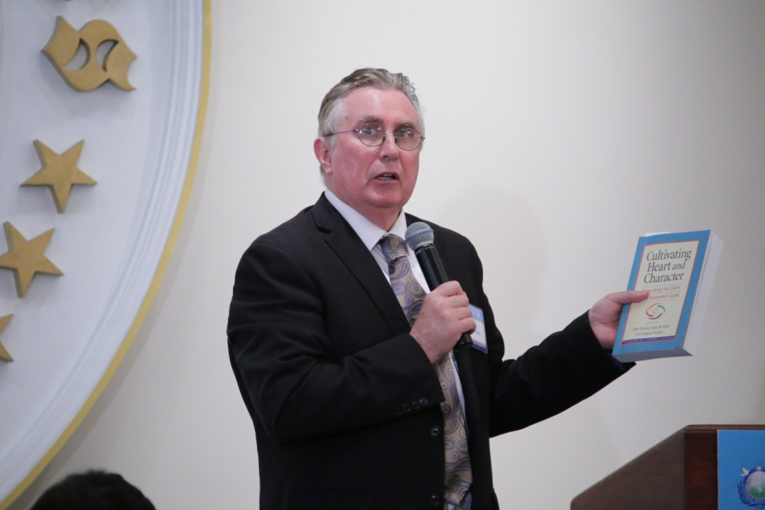
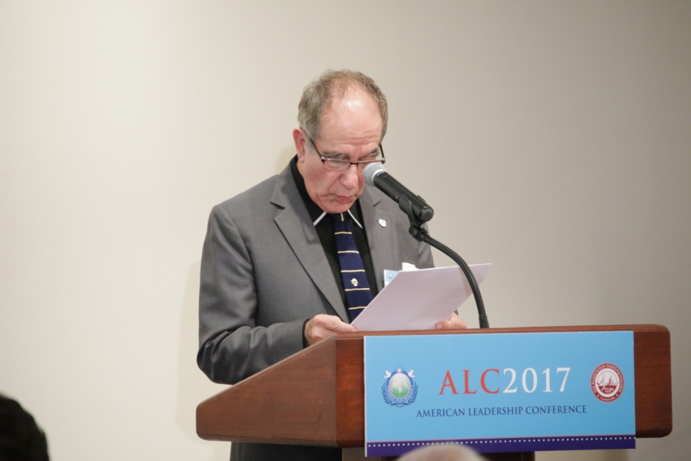
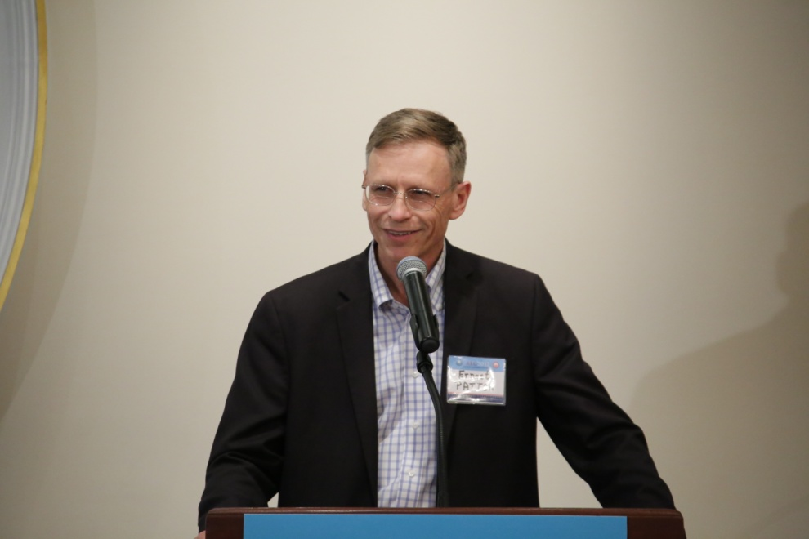

Slide 28
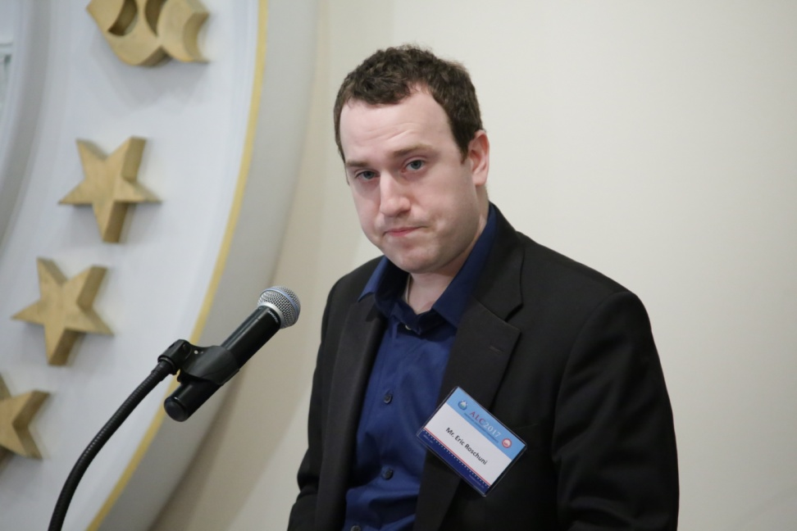
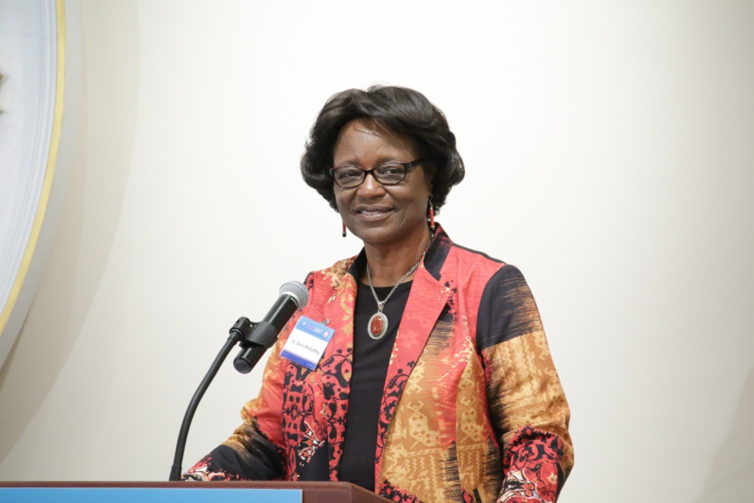
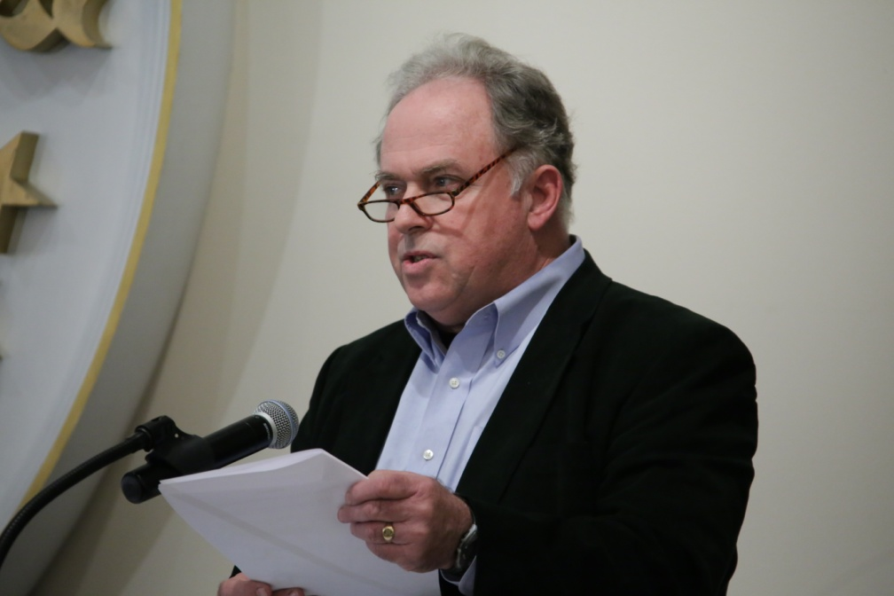
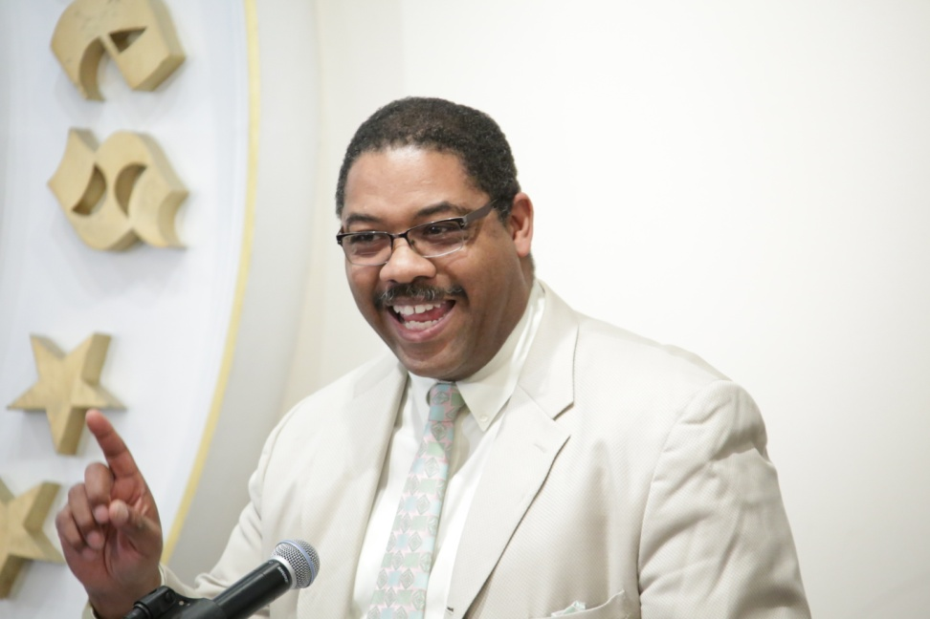

Slide 29
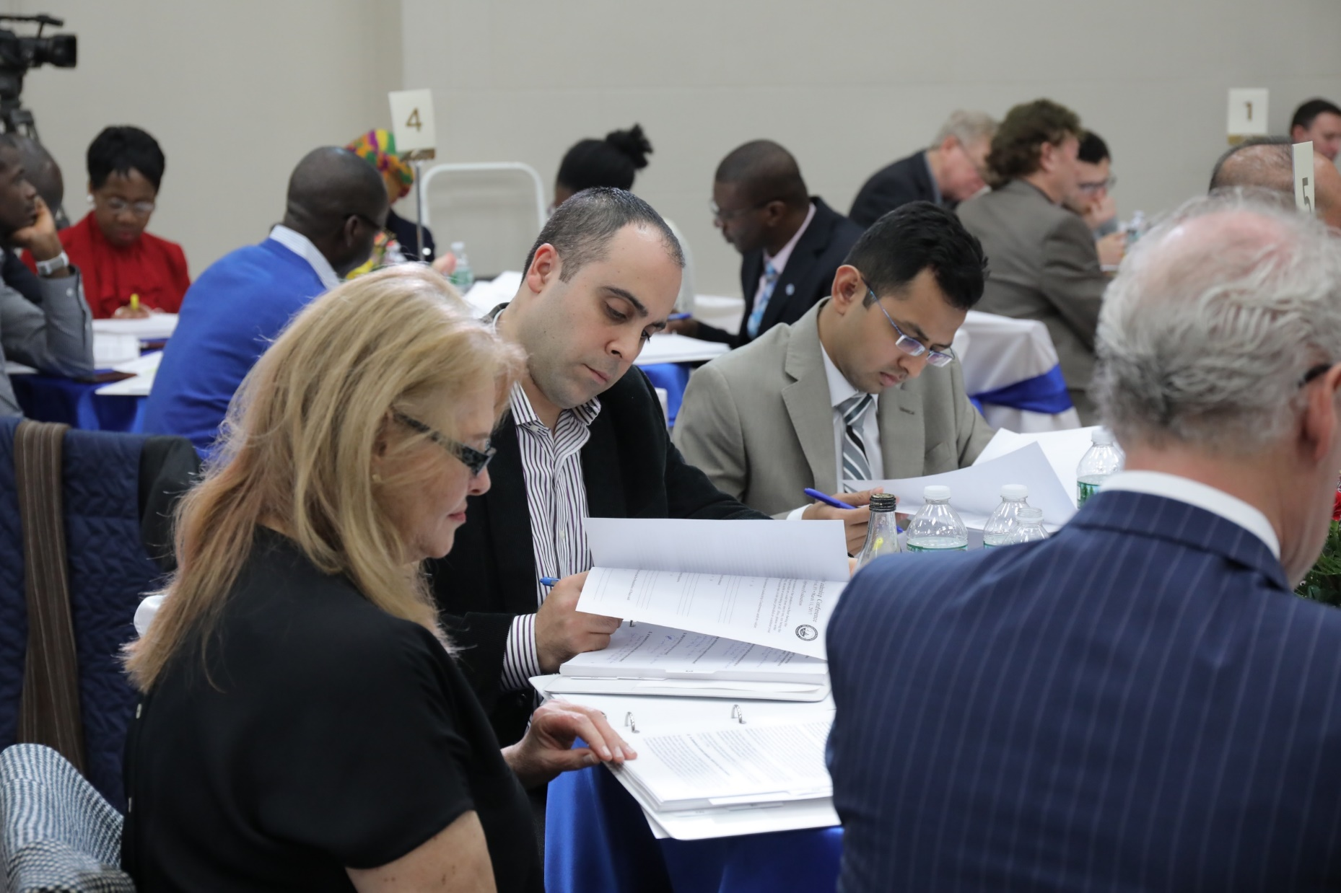

Slide 30
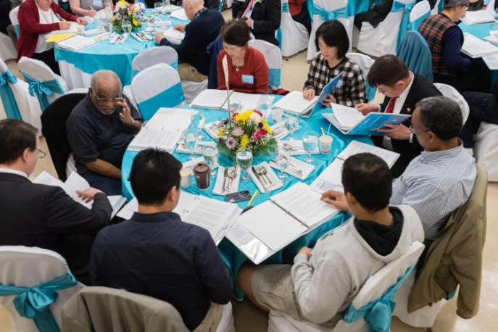

Slide 31
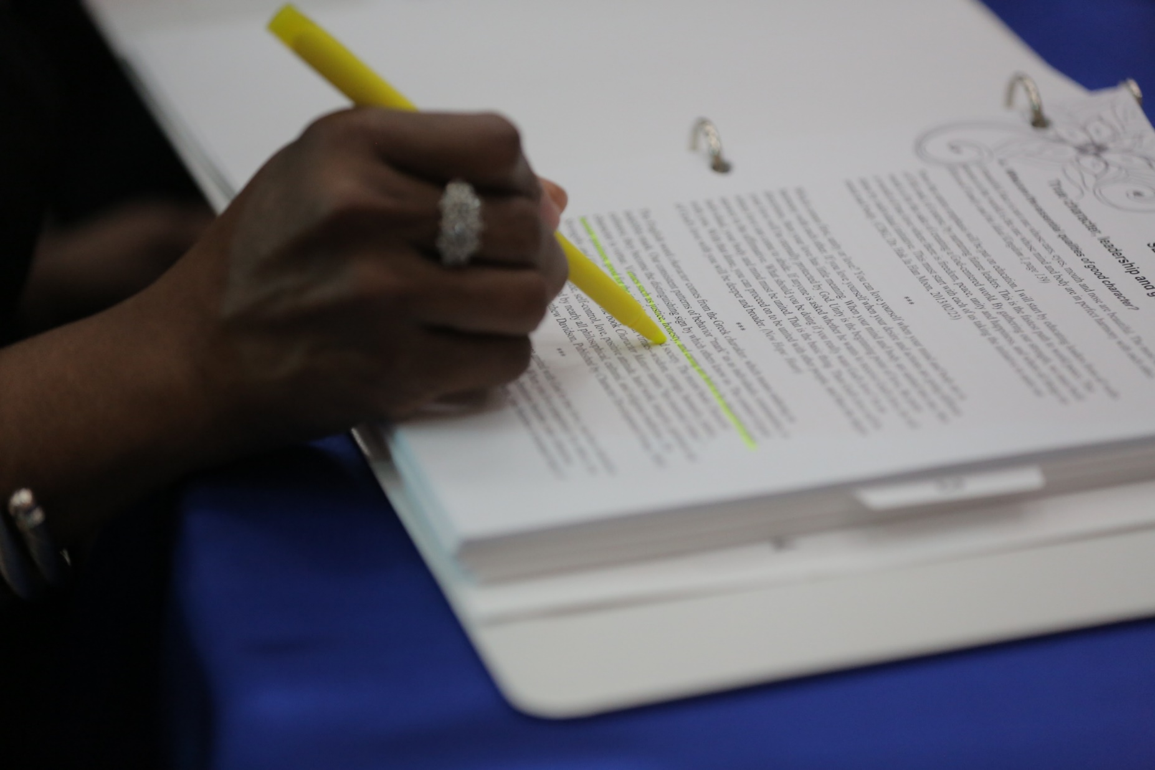

Slide 32
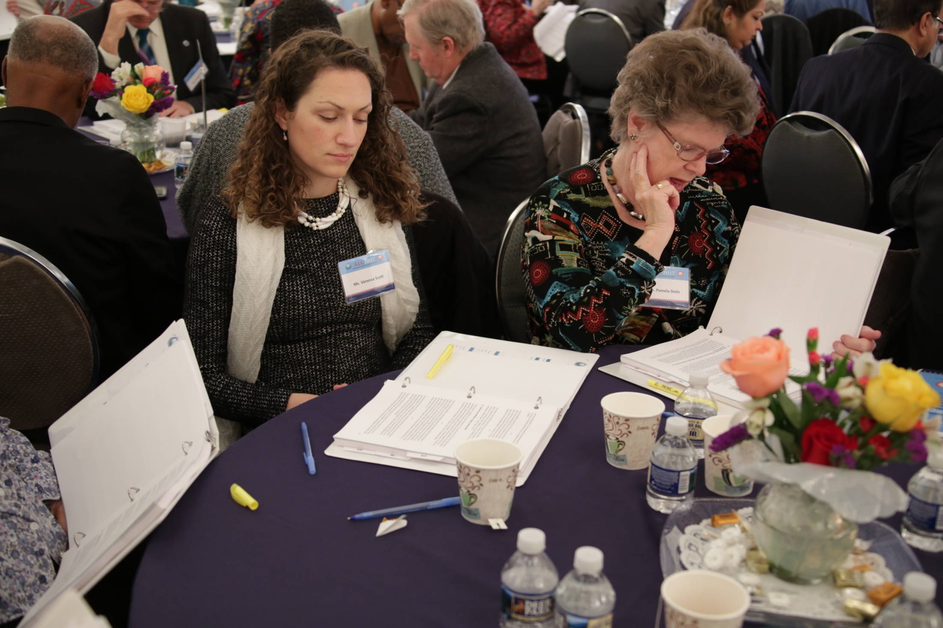

Slide 33
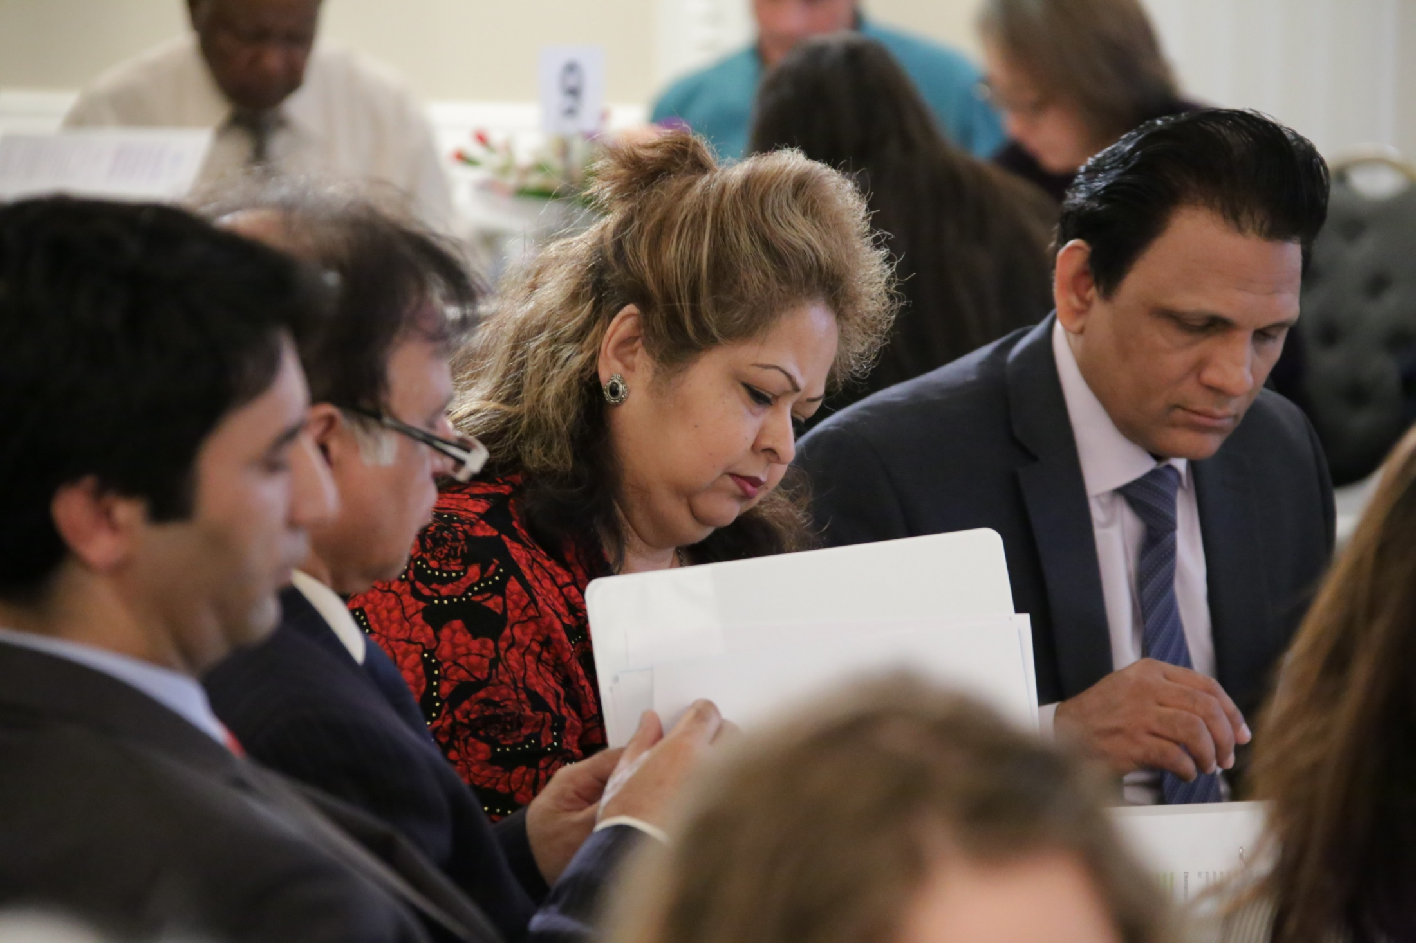

Slide 34
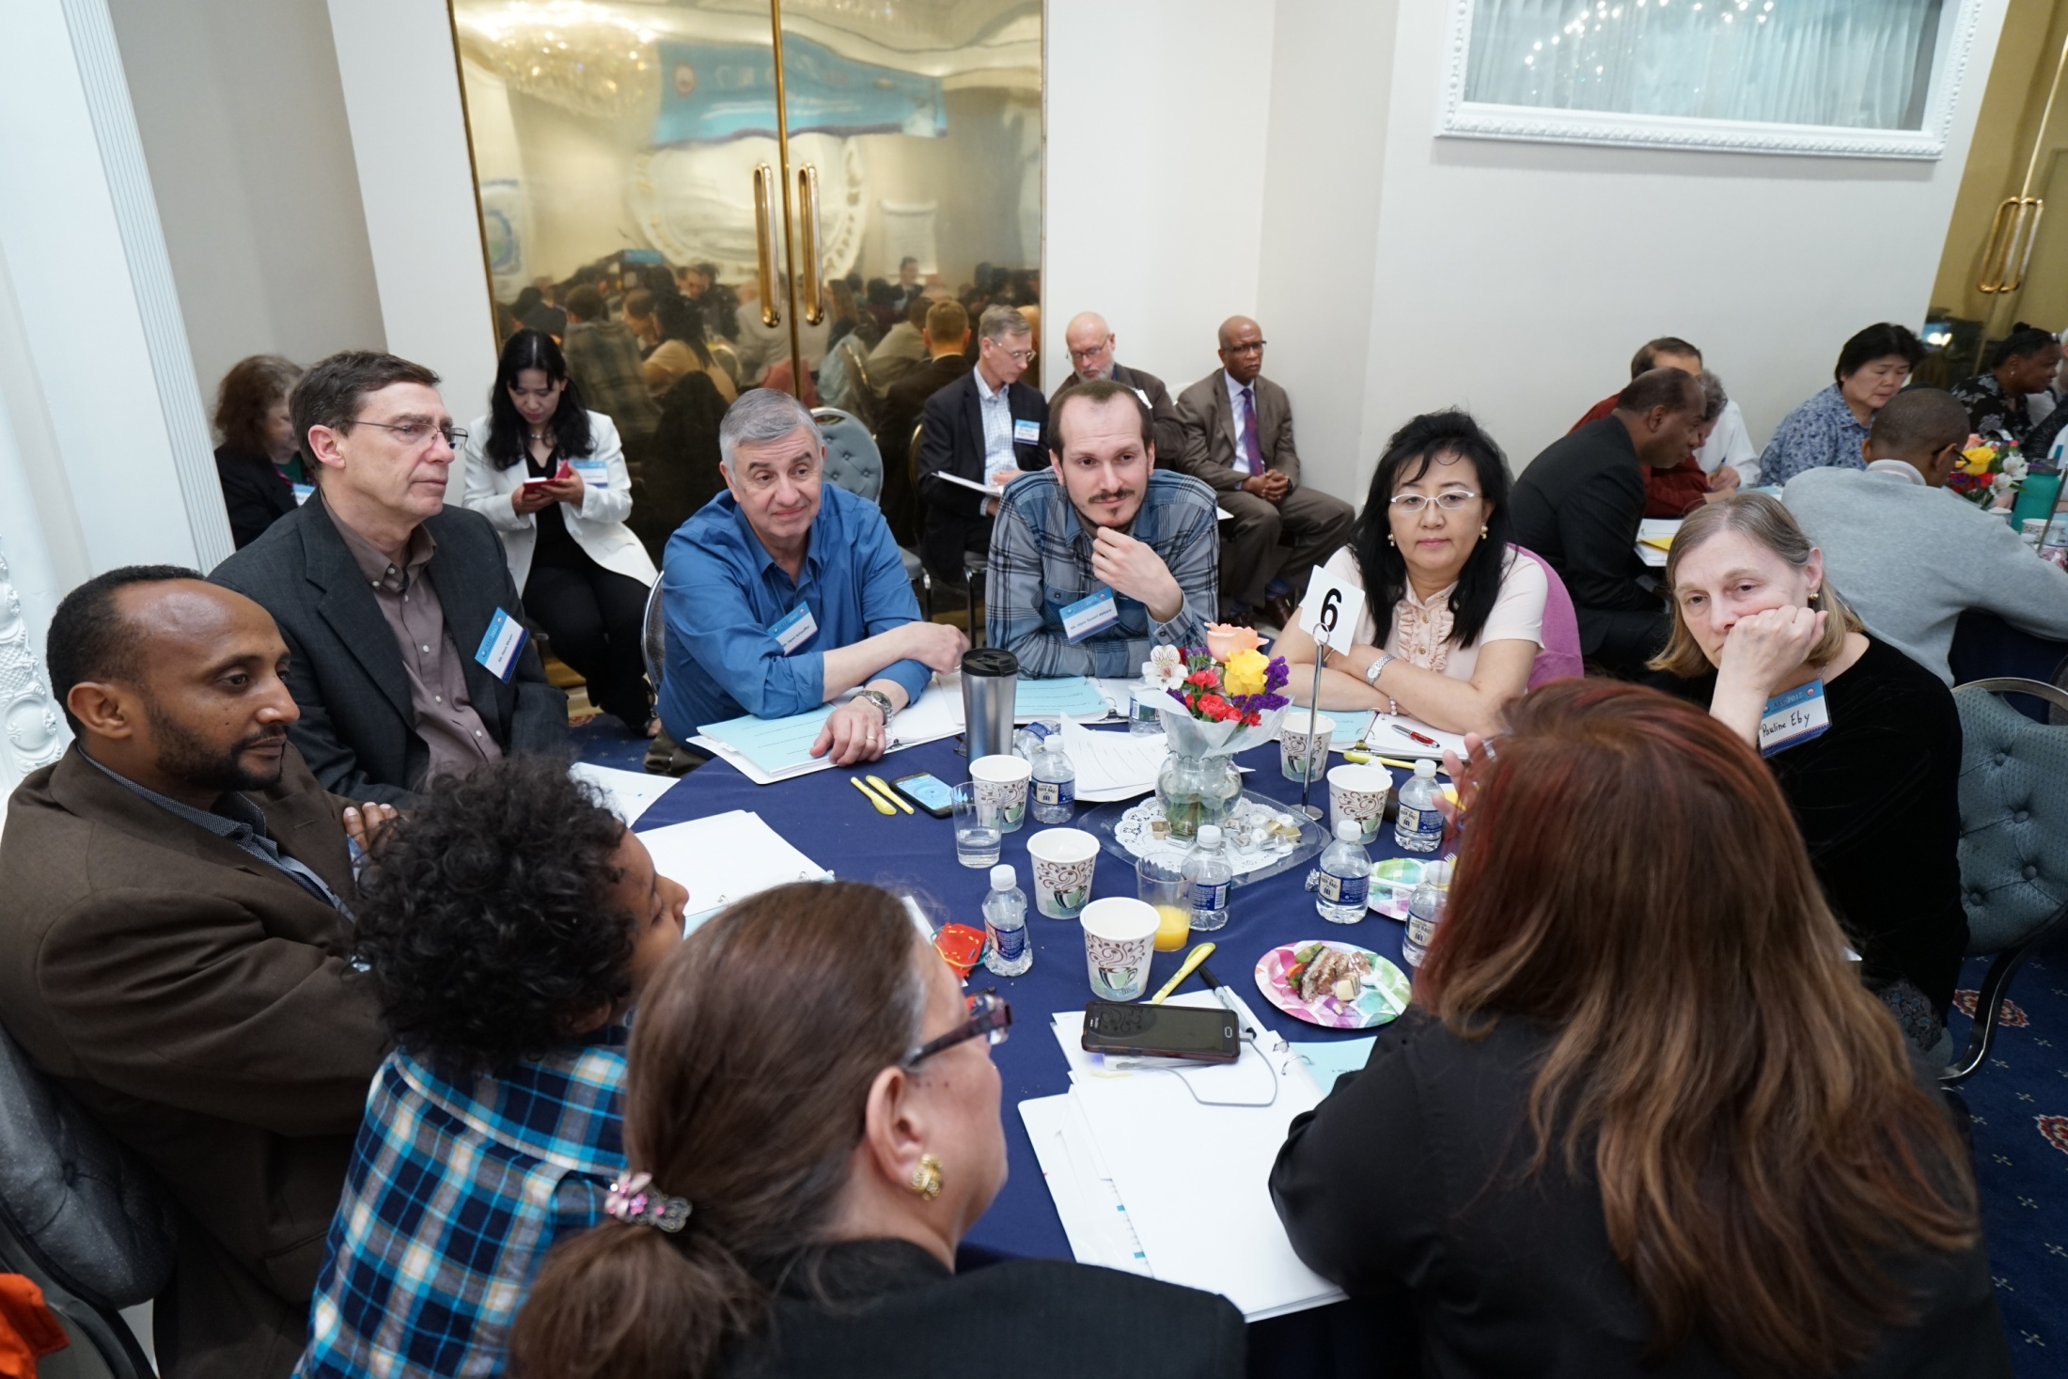

Slide 35
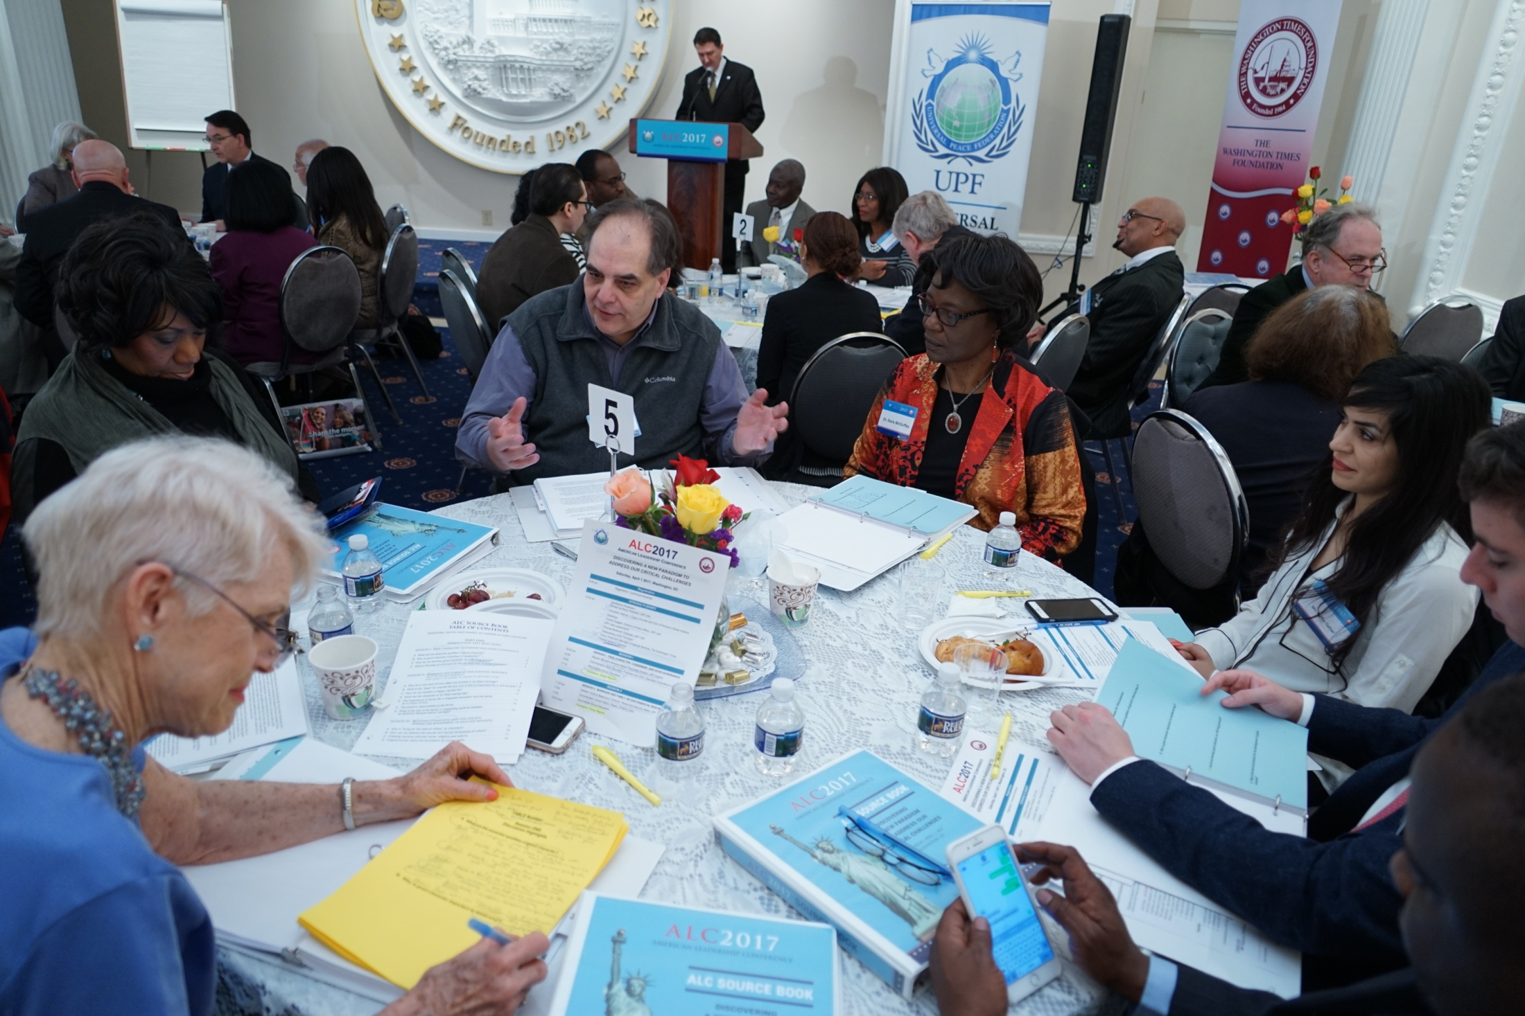

Slide 36
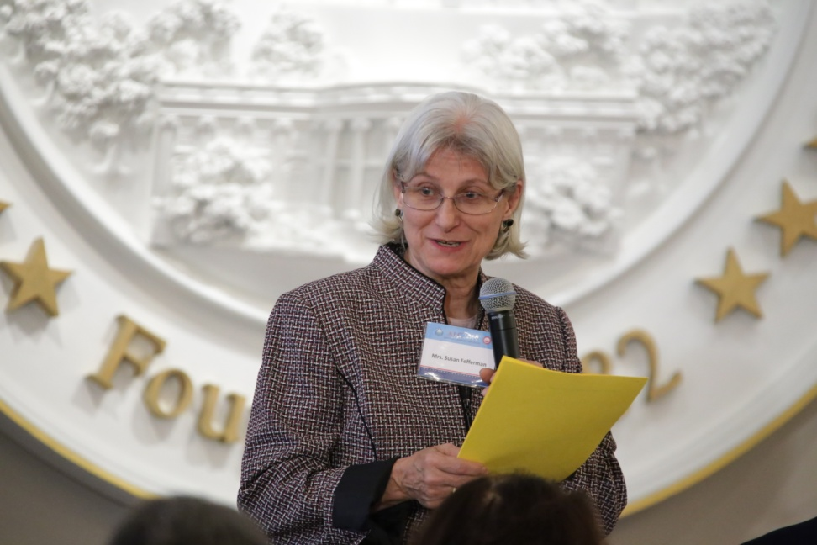
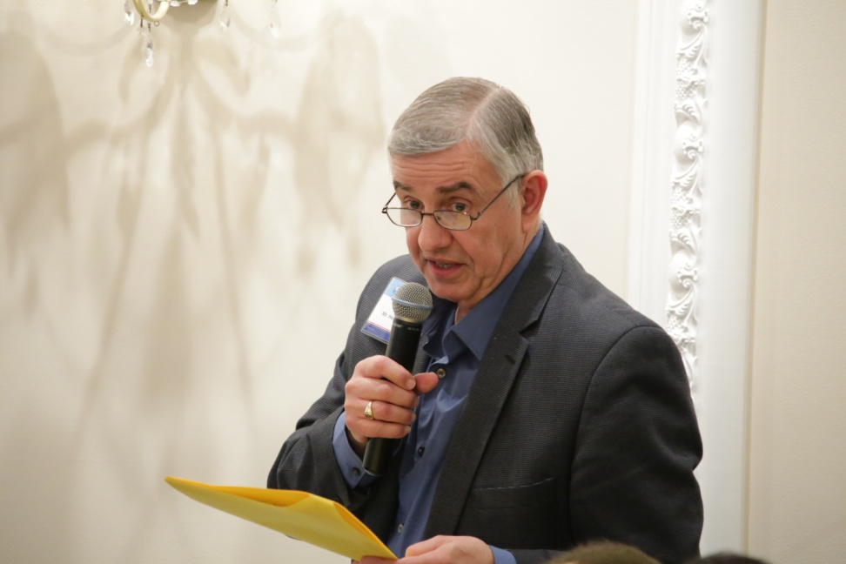
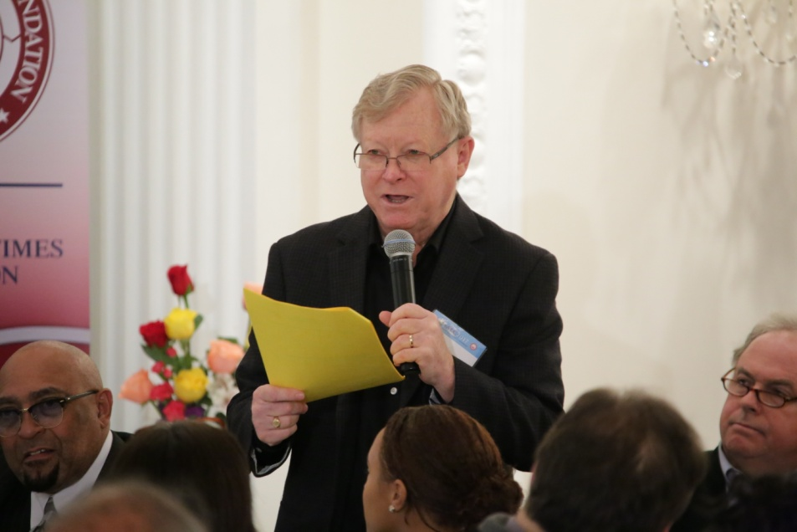
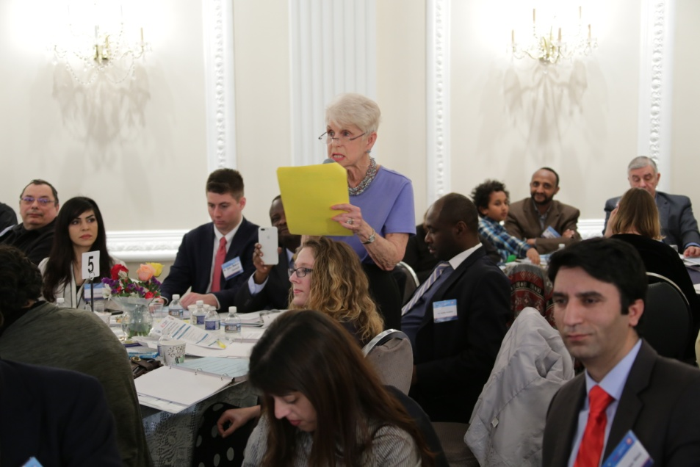

Slide 37
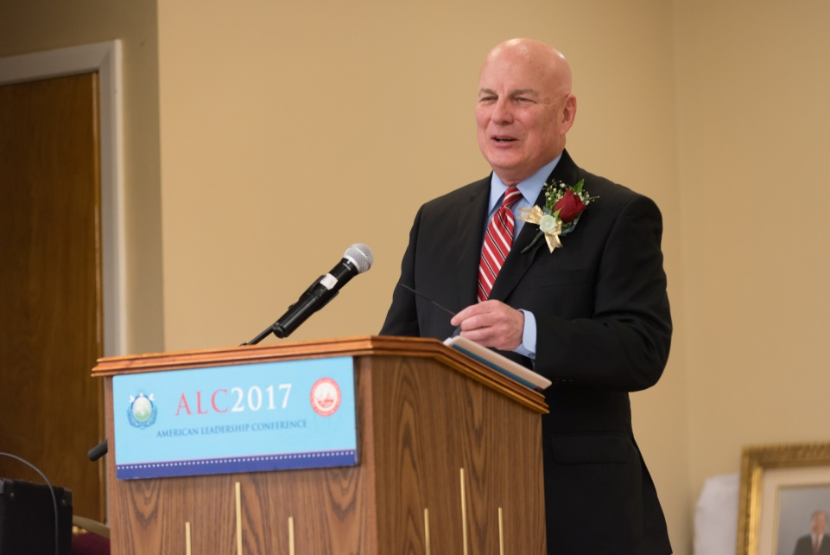
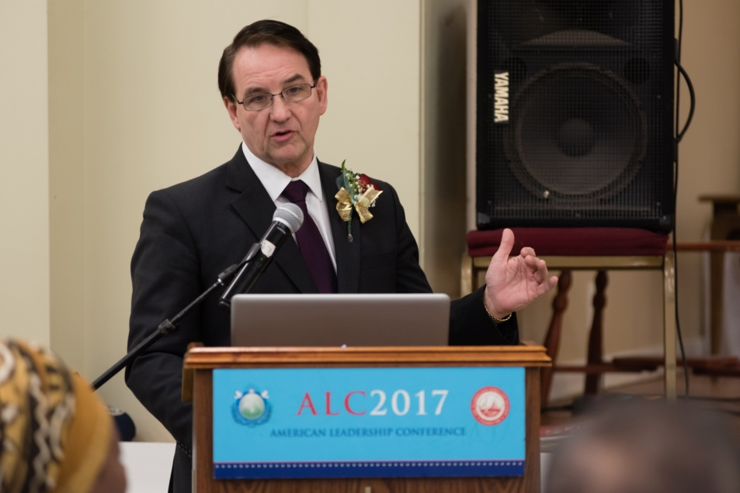
BRIEFING: IAPP, ILC, SHPP, World Summit & Fact Finding Tour

Slide 38
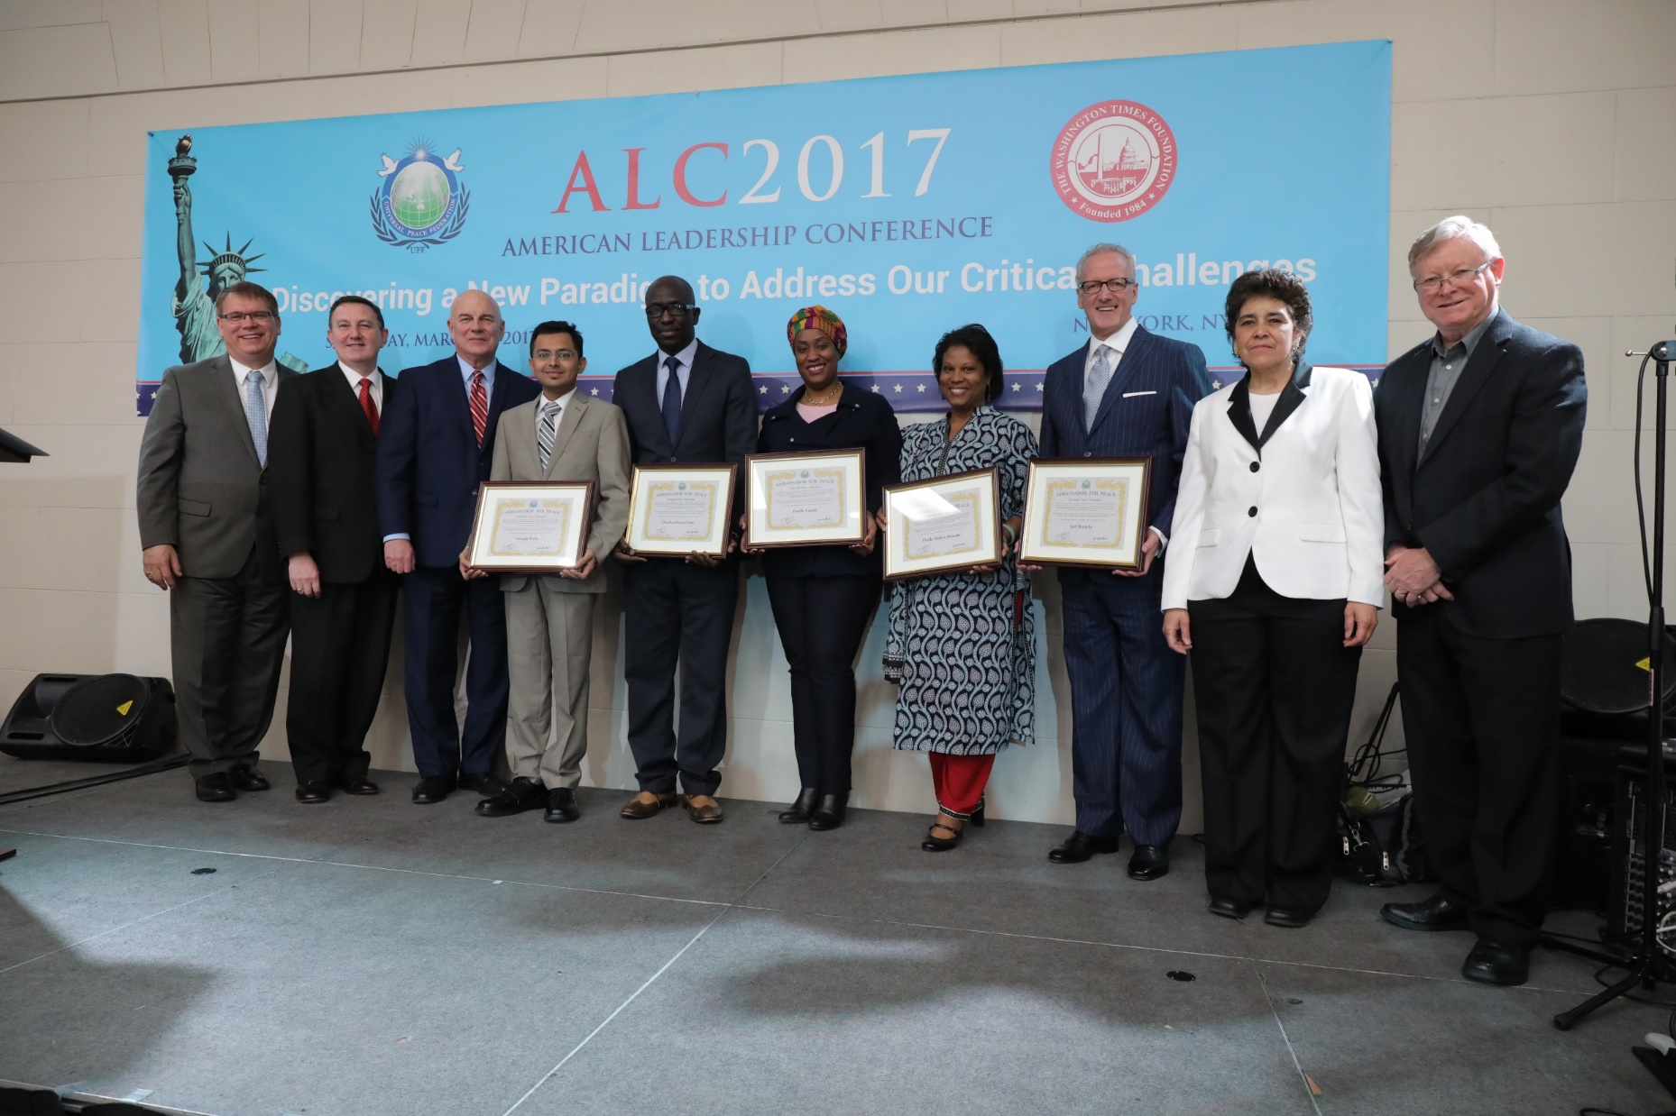

Slide 39
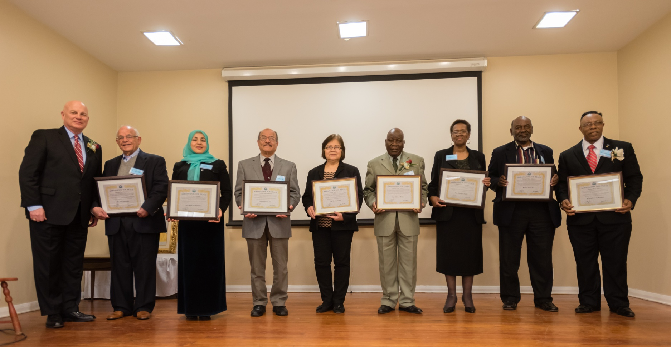
Appointed eight (8) new Ambassadors for Peace

Slide 40
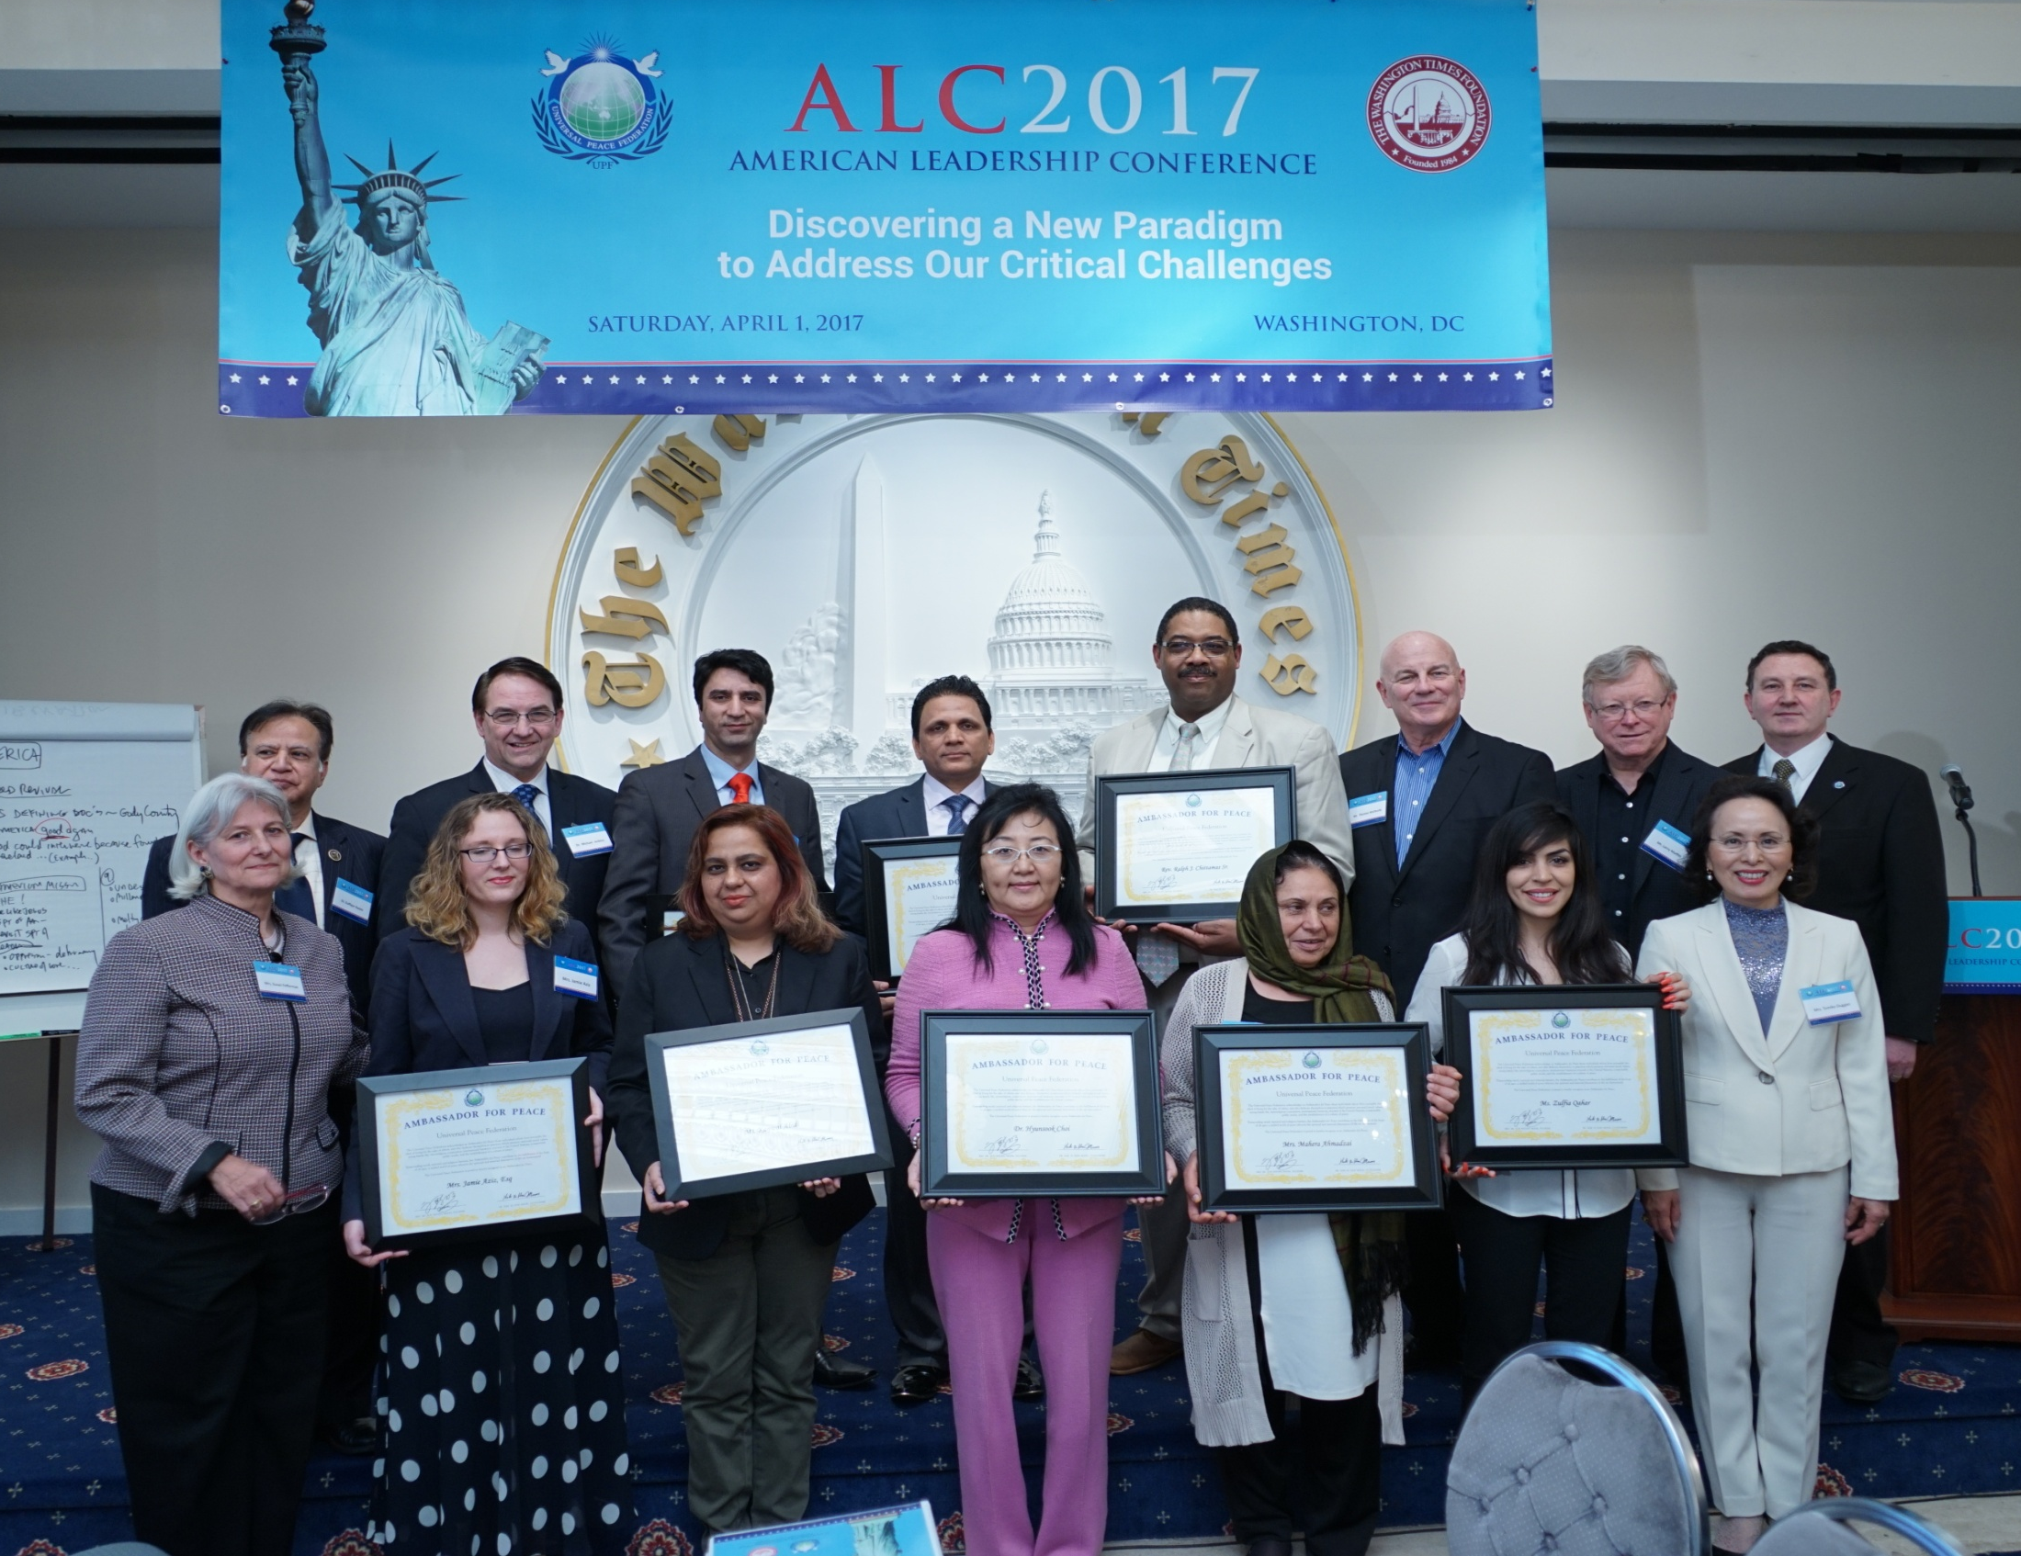

Slide 41
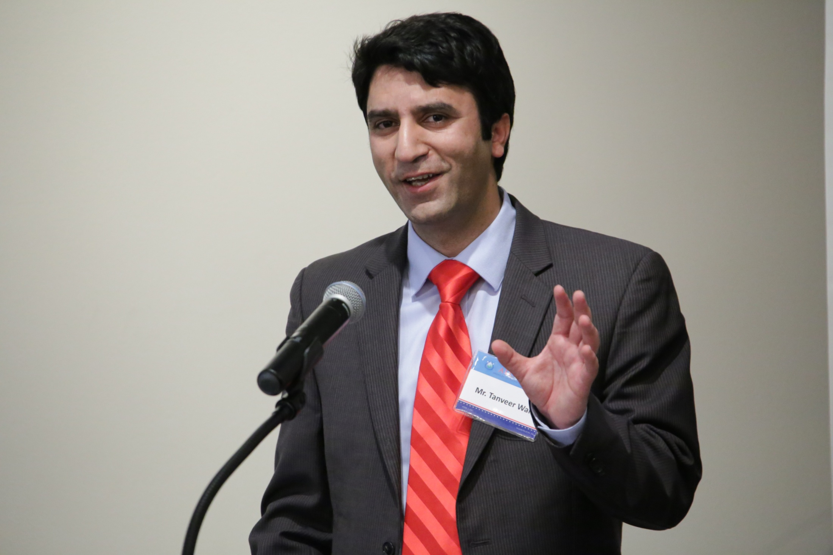

Slide 42
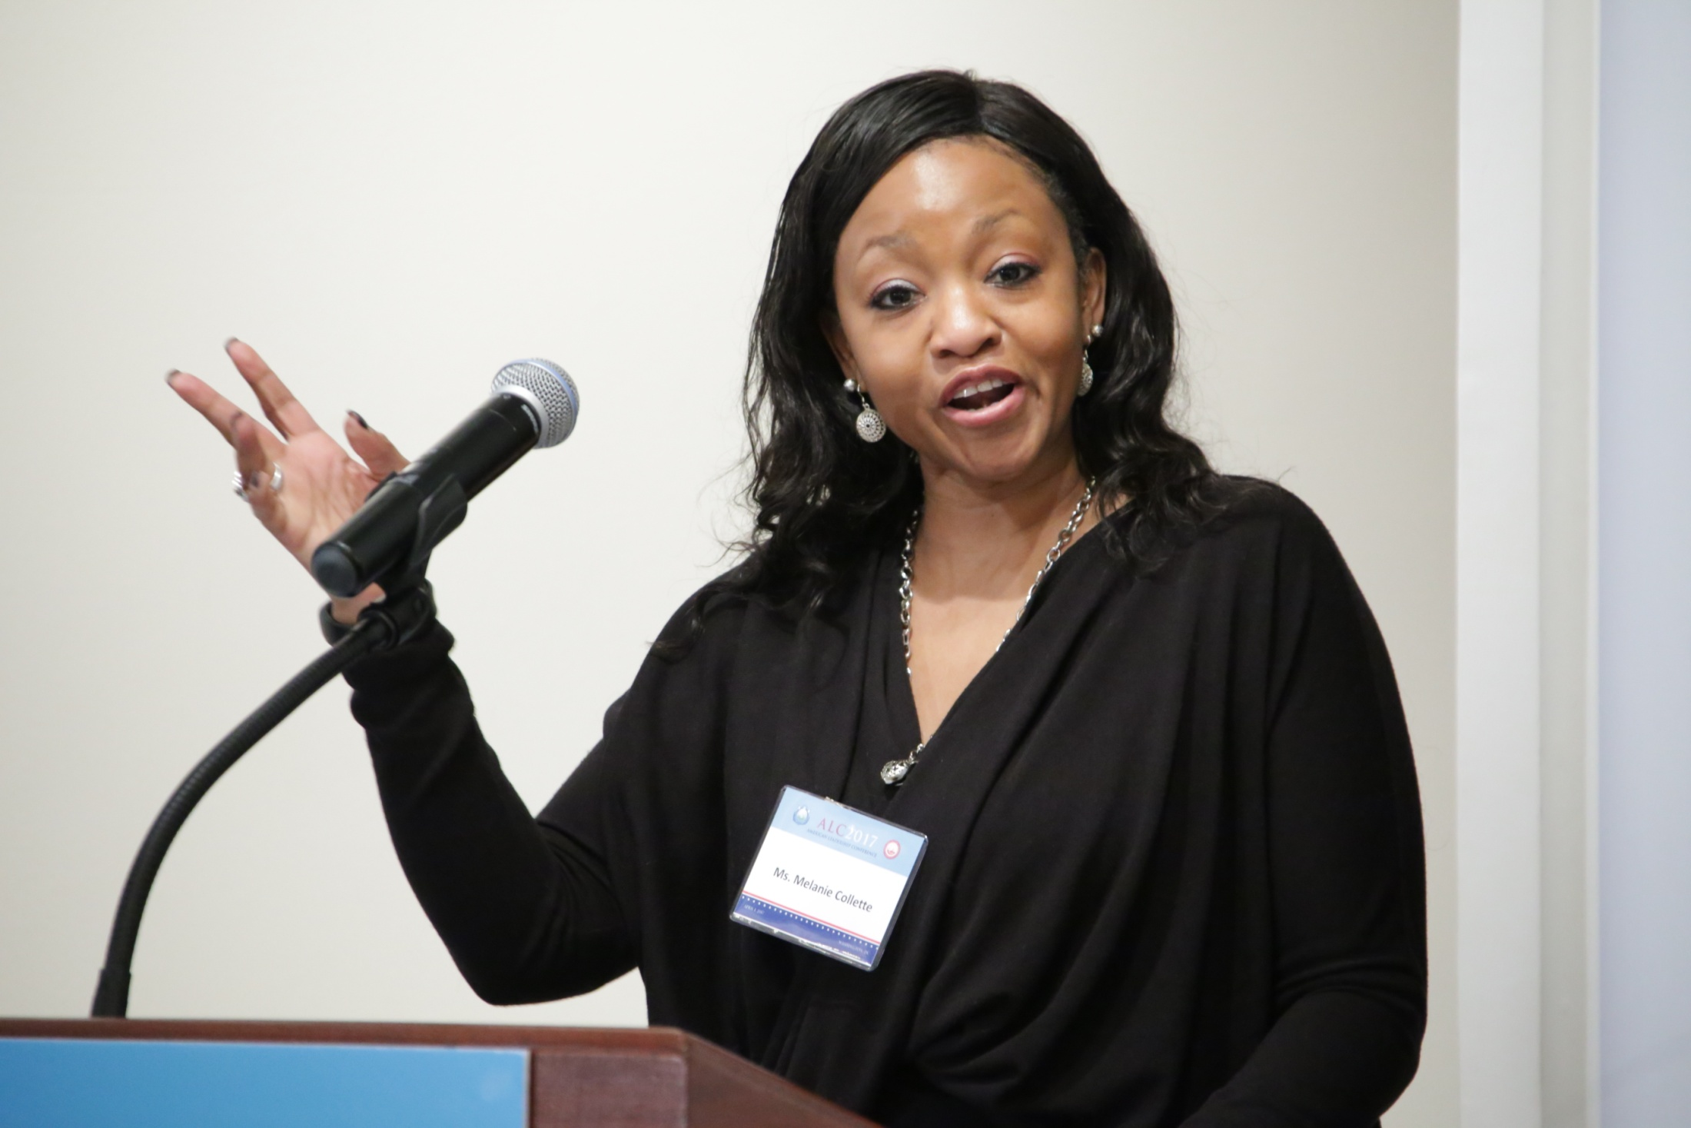

Slide 43
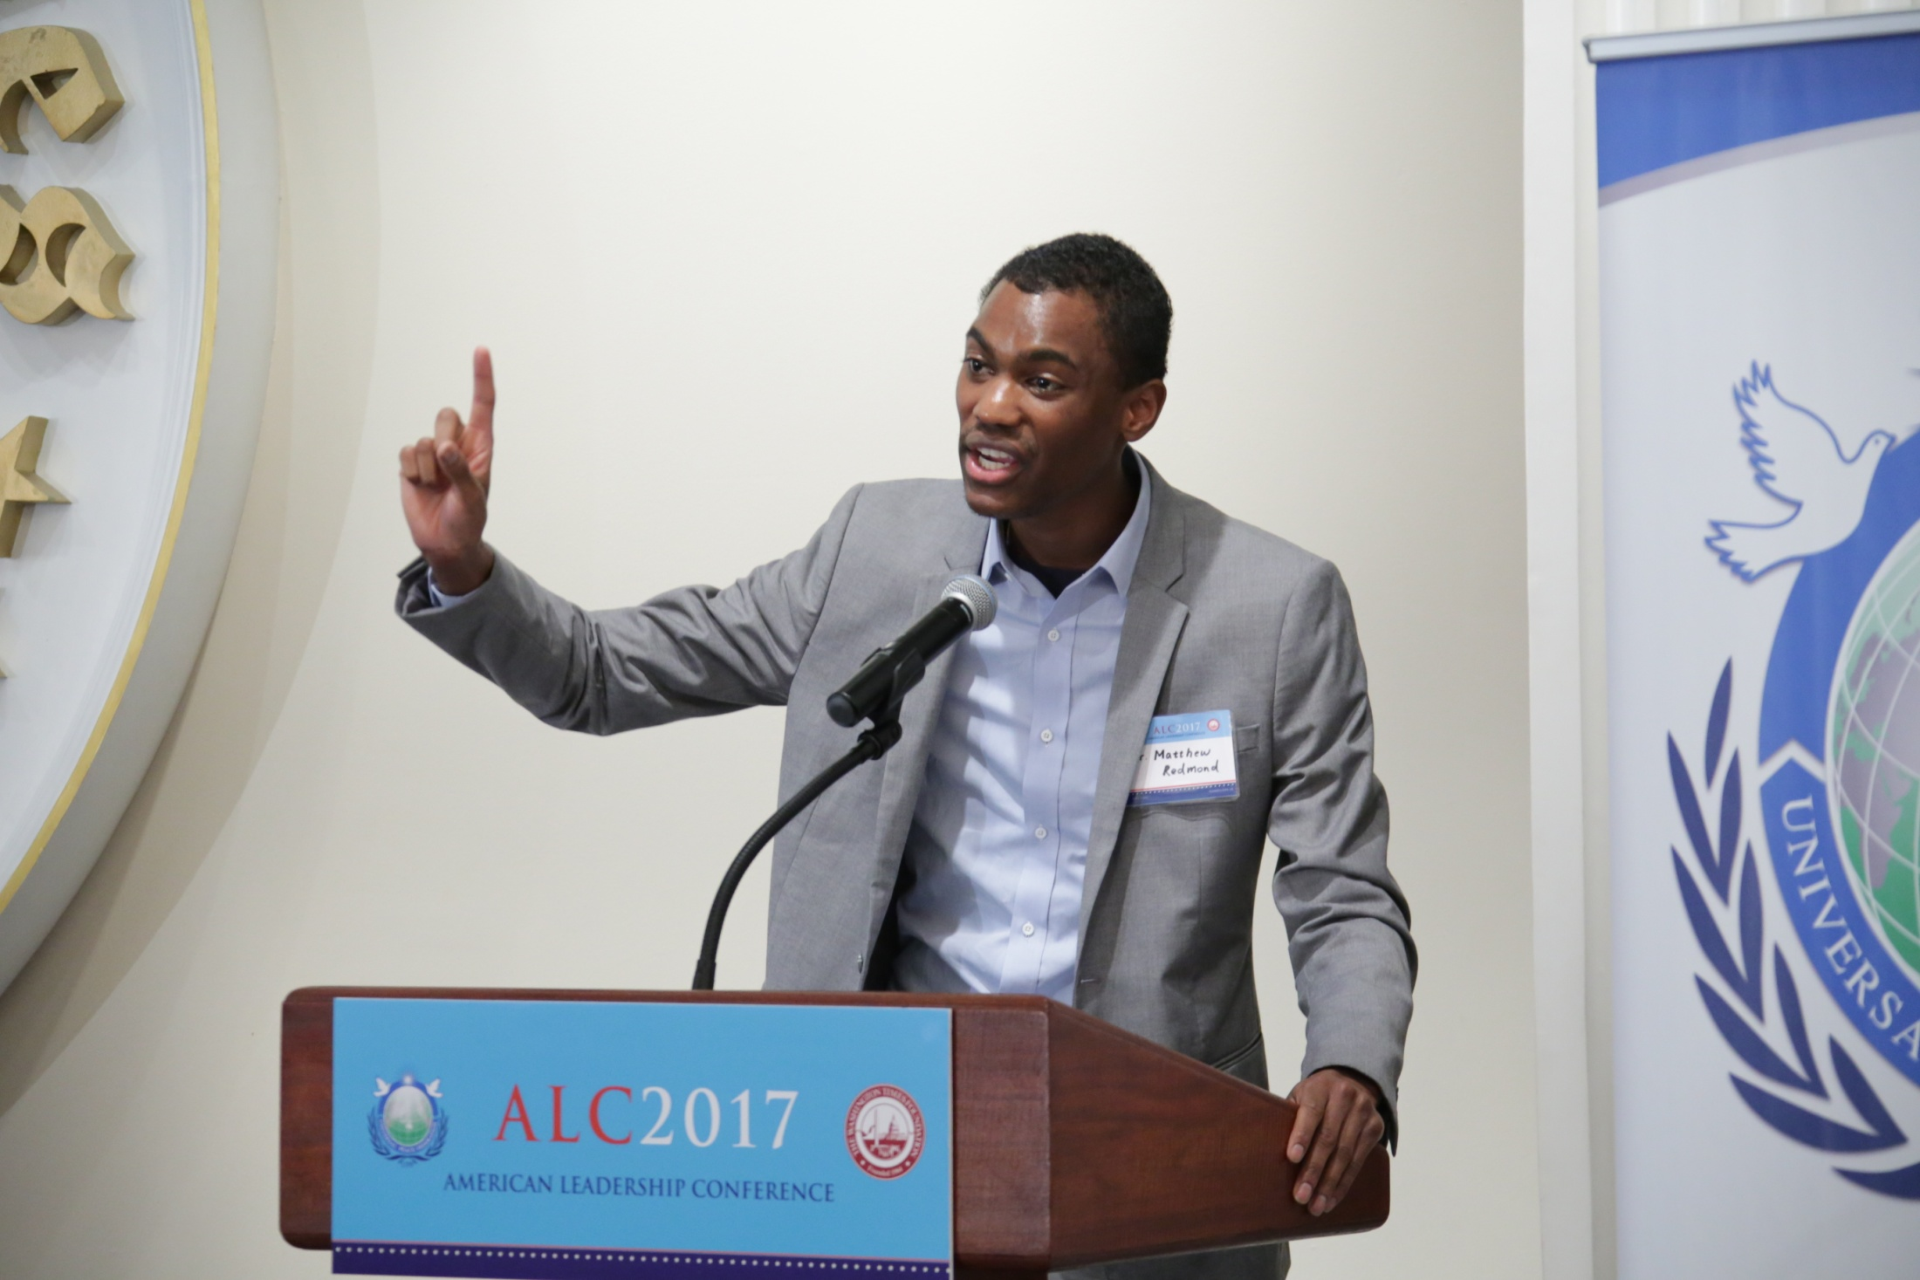

Slide 44


Slide 45


Slide 46

Participants, speakers and staff of the
American Leadership Conference in New Jersey

Slide 47


Slide 48
2017 Goal
To educate 12,000 leaders in America through the American Leadership Conference (ALC)

Slide 49
Hosting an American Leadership Conference in your District is an Excellent Tool to Fulfill Tribal Messiaship

Slide 50


Thank You True Parents!!!
Founders Dr. Sun Myung Moon and Dr. Hak Ja Han Moon, at the Inauguration of UPF in New York on September 12, 2005.
ECOSOC Special Consultative Status

