Slide 1
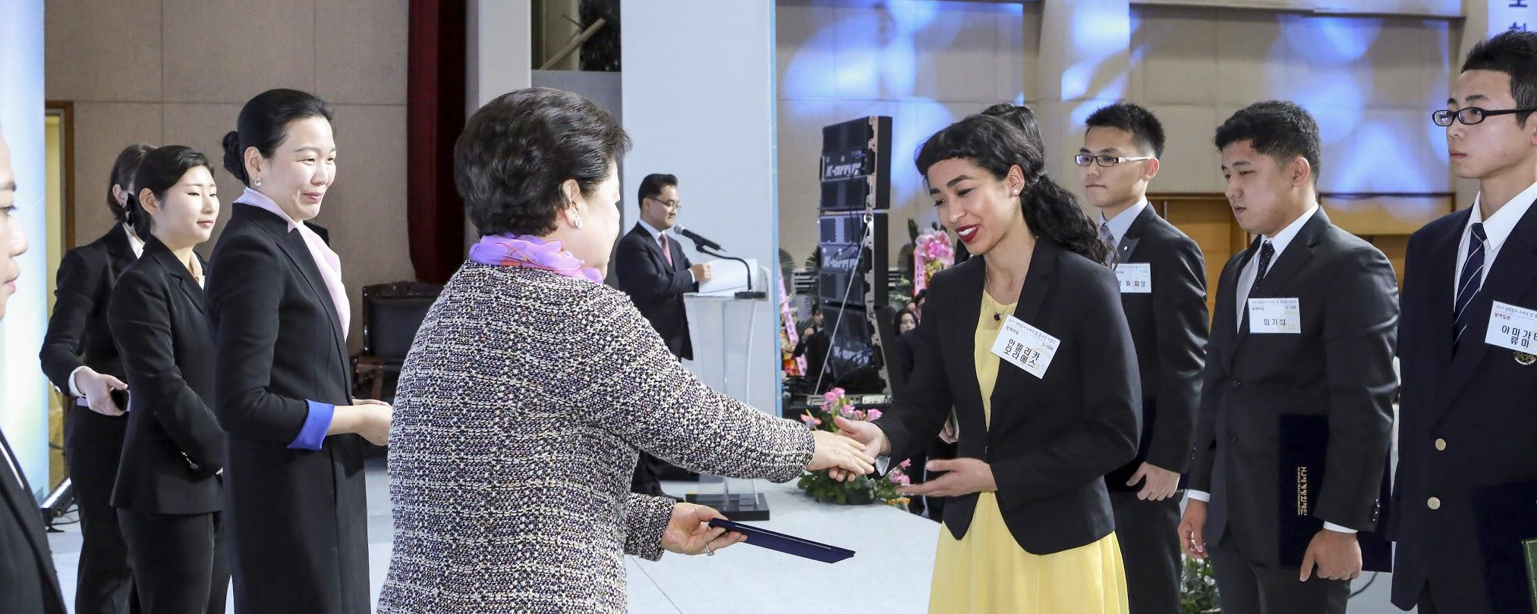
Wonmo Pyeongae Scholarship Recipients

Slide 2
Students Commit to a Public Lifestyle in Higher Ed
Daily HDH
Develop a plan for public service during school year
Submit 1-page written reports each semester
Maintain satisfactory academic progress
Attend a life of faith workshop at least once a year

Slide 3
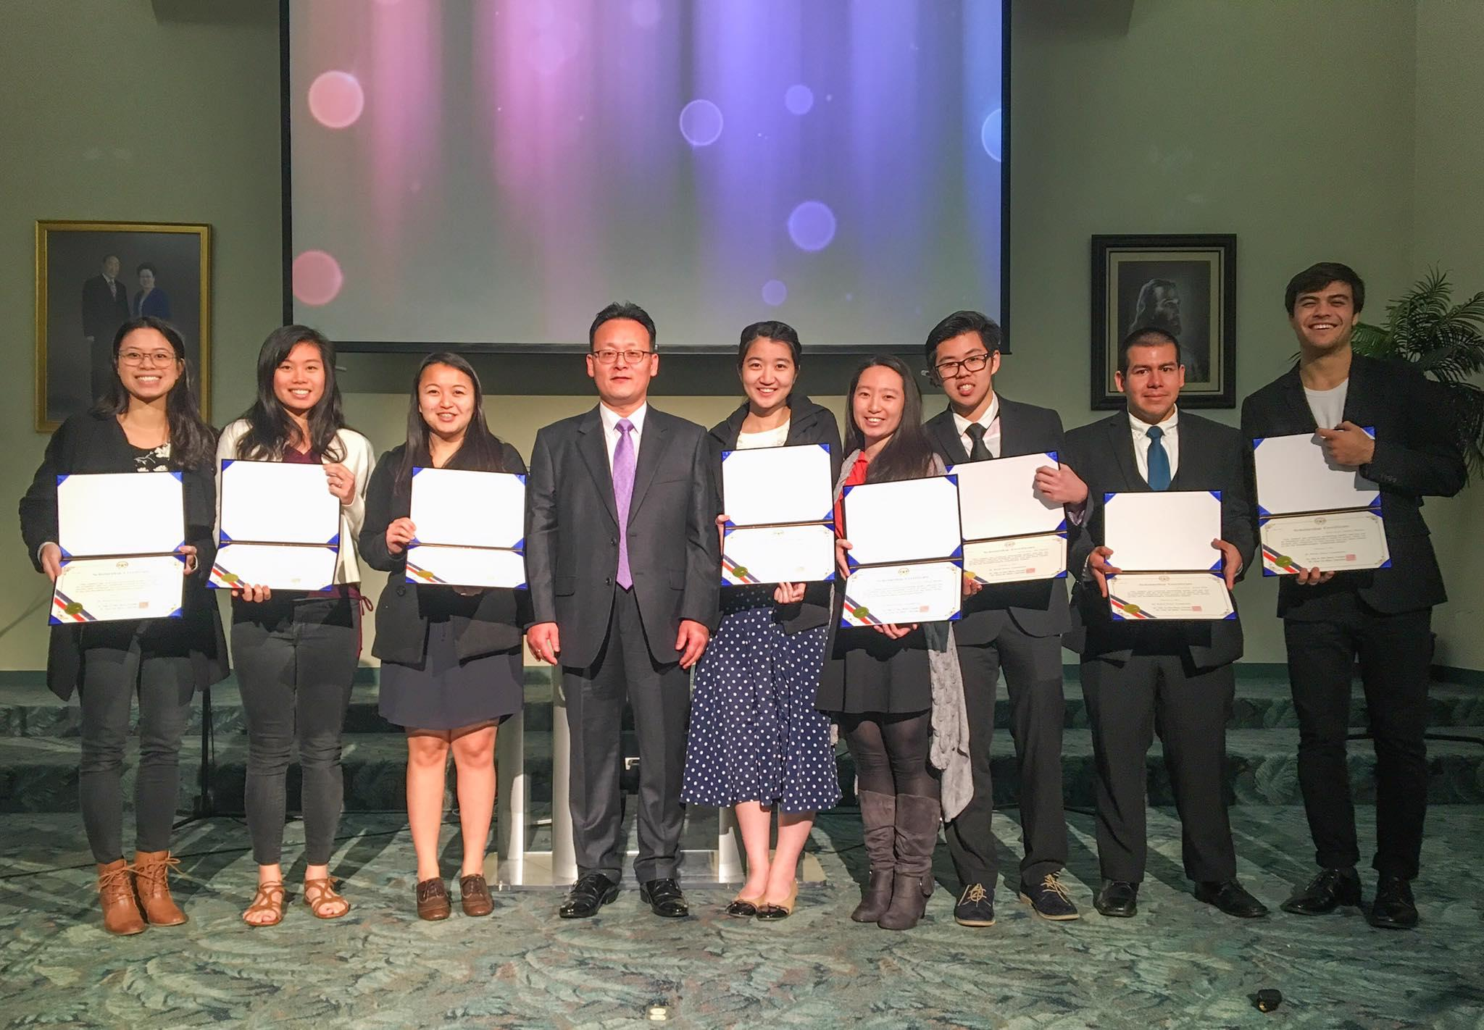

Slide 4
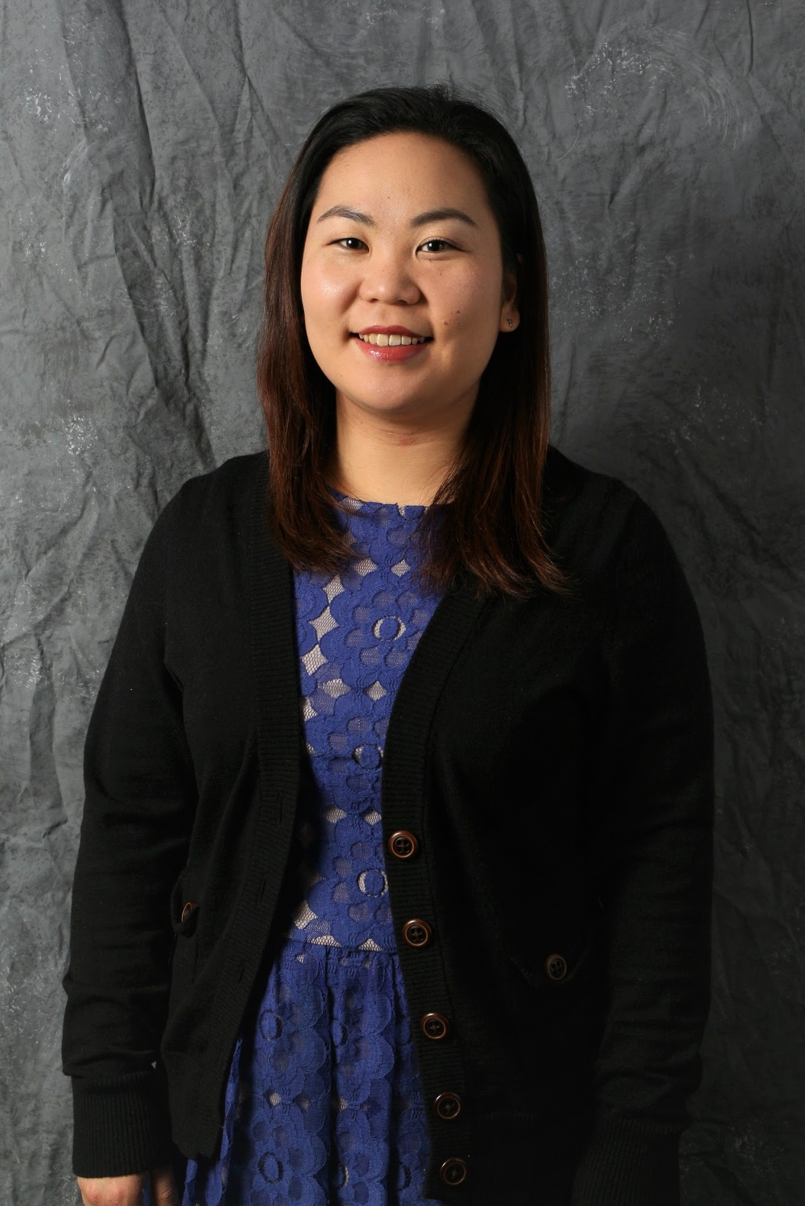
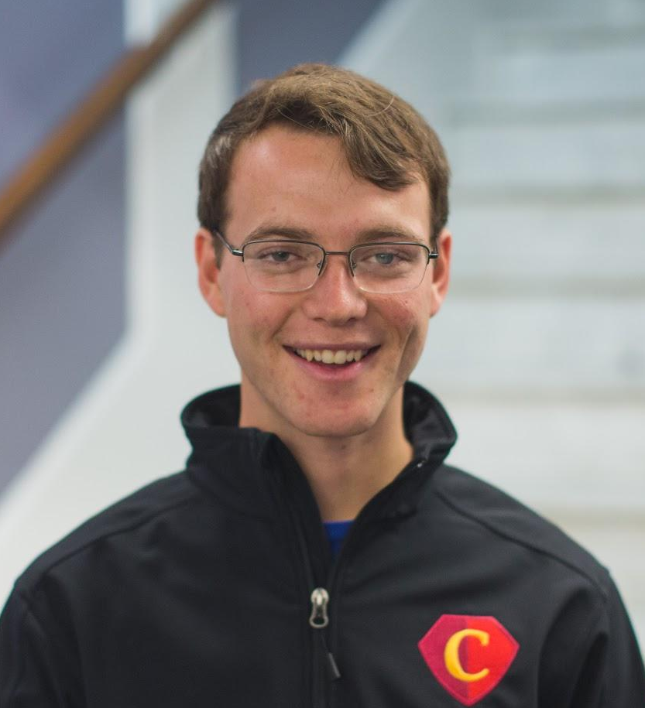
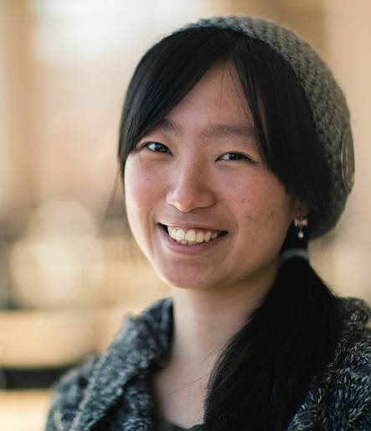
President’s Award ($2,500)
Harumi Miyakawa | Jinil Fleishman | Irvin Granstrom | Hitoe Hiraki
Music | Human Services | Int’l Studies | Art Teacher

Slide 5
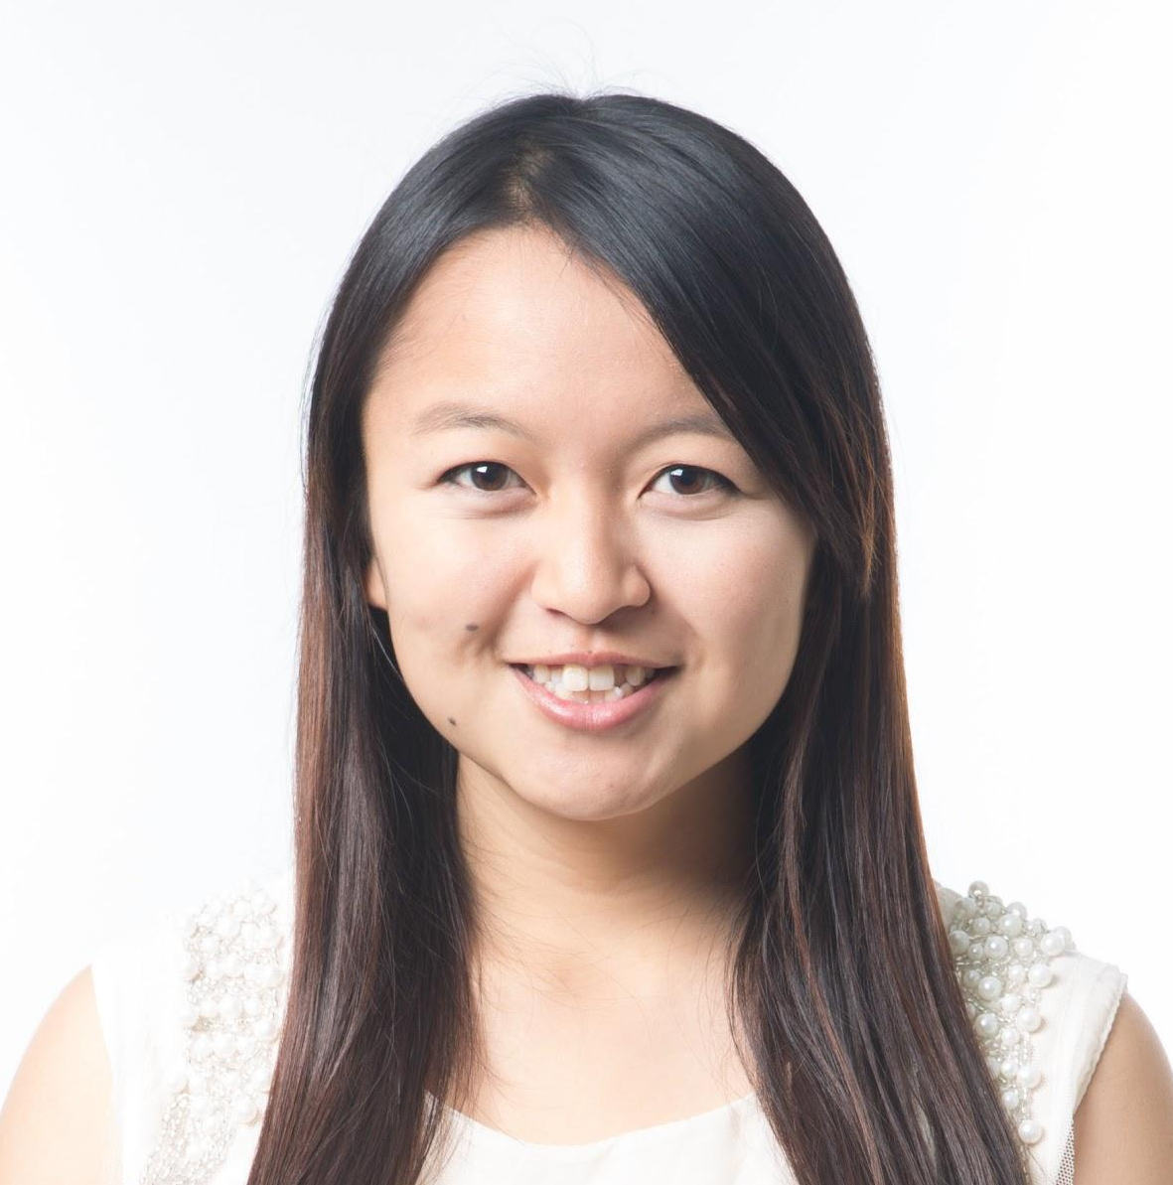
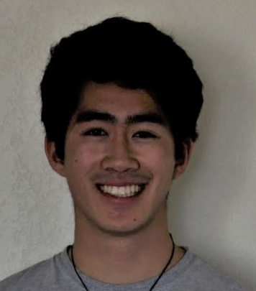
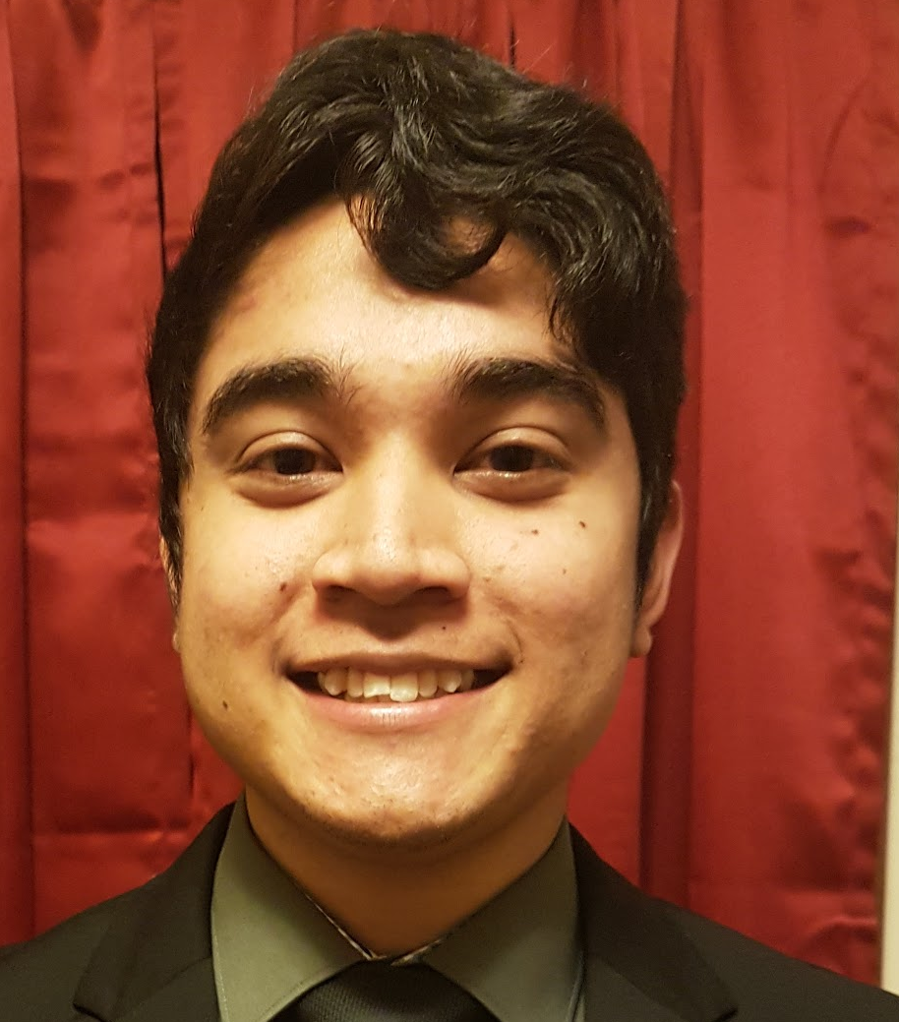
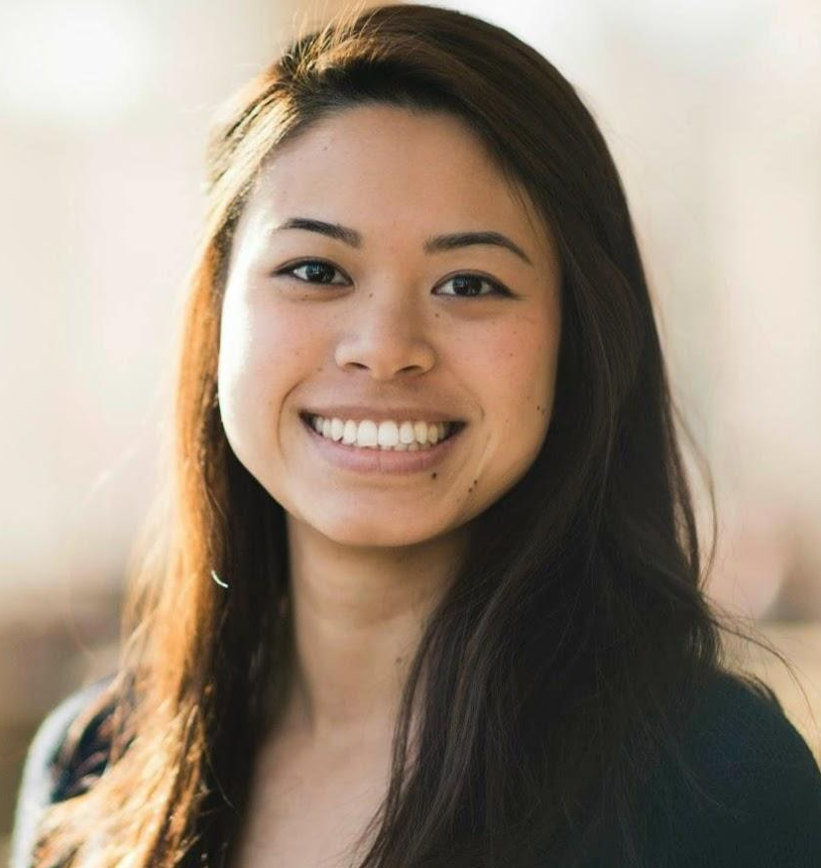
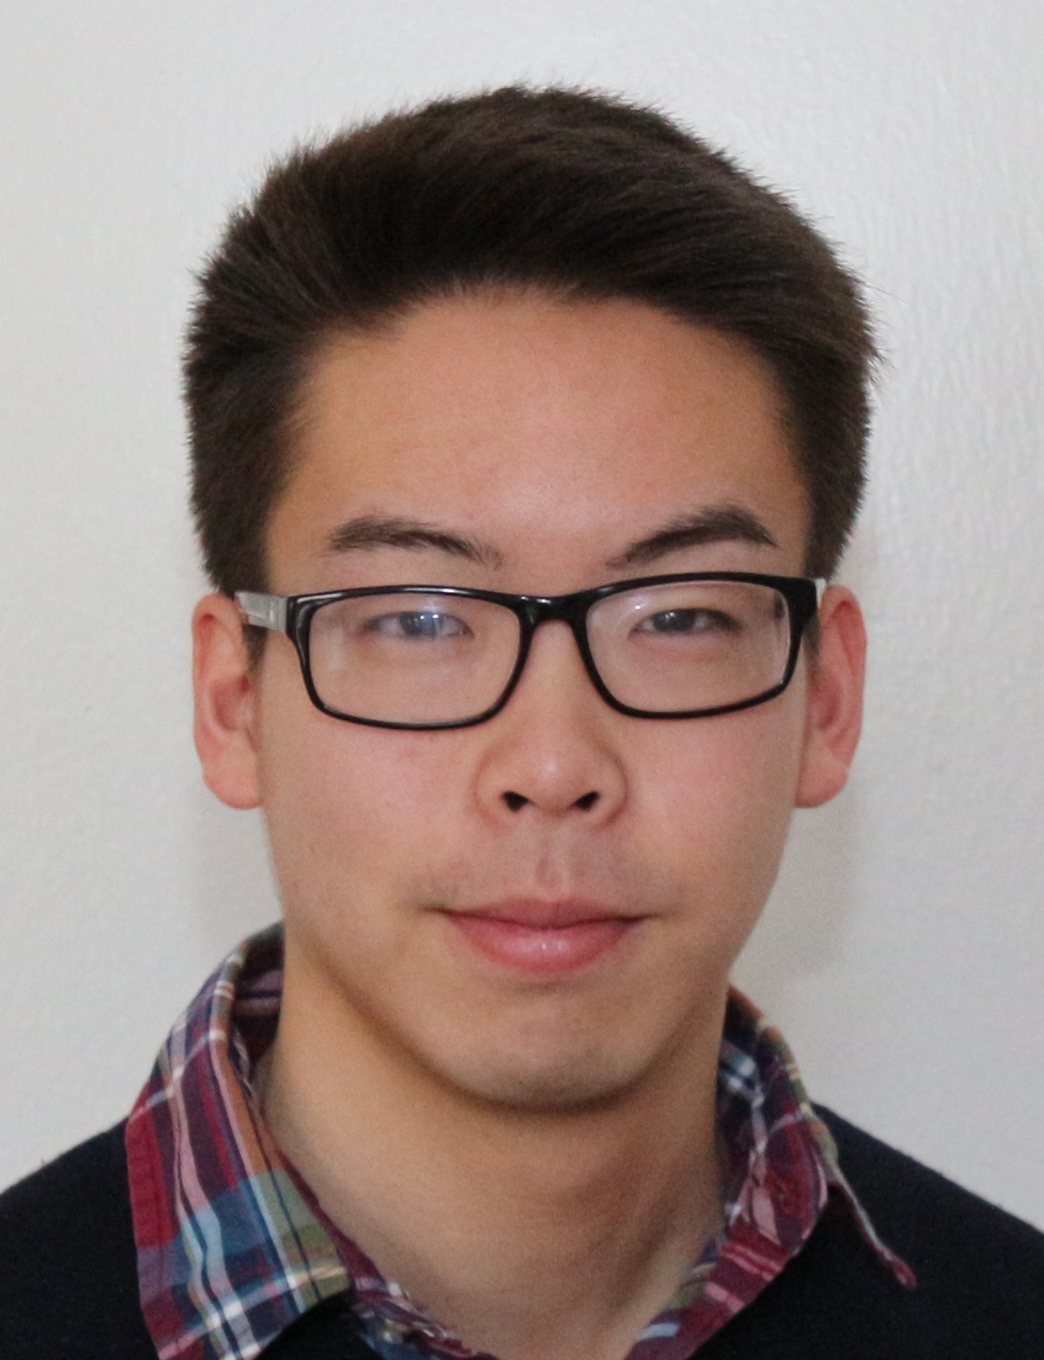
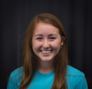
GPA Award ($2,000)
Megumi Homma | Sachika Iwamoto | Ryota Naito | Young Mi Ueda | Esther Pisano
Gabriel Melgarejo | Emily Iseda | Takafumi Nomura | Emiko Cunningham | Eiko Sullivan

Slide 6
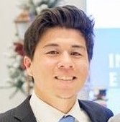
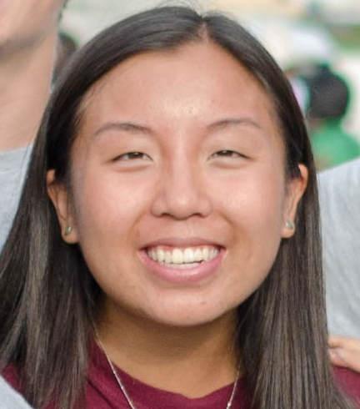
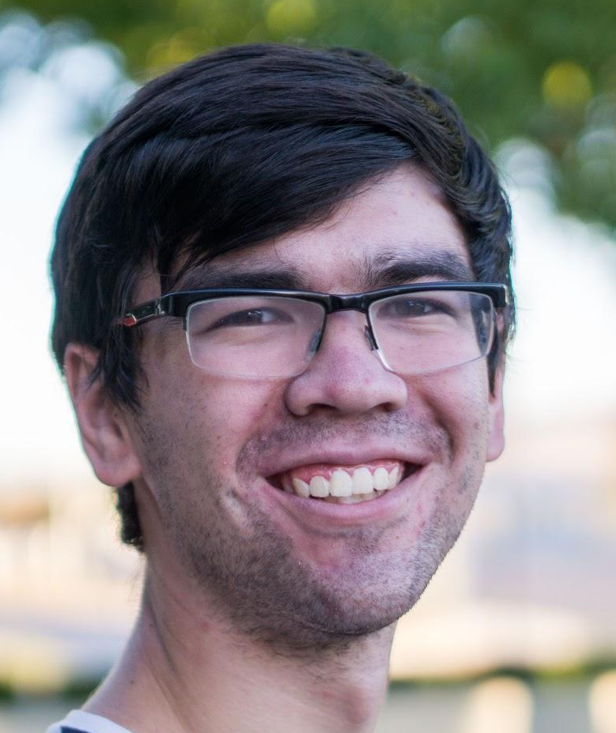
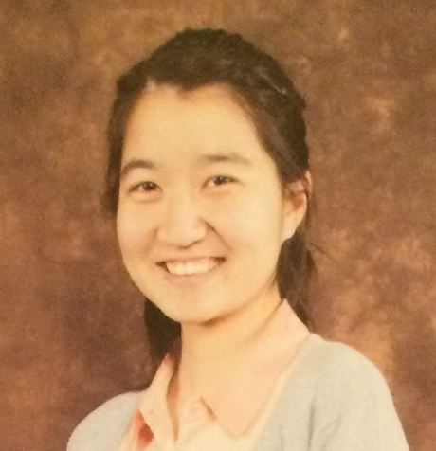
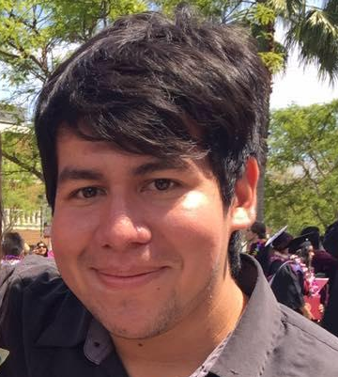
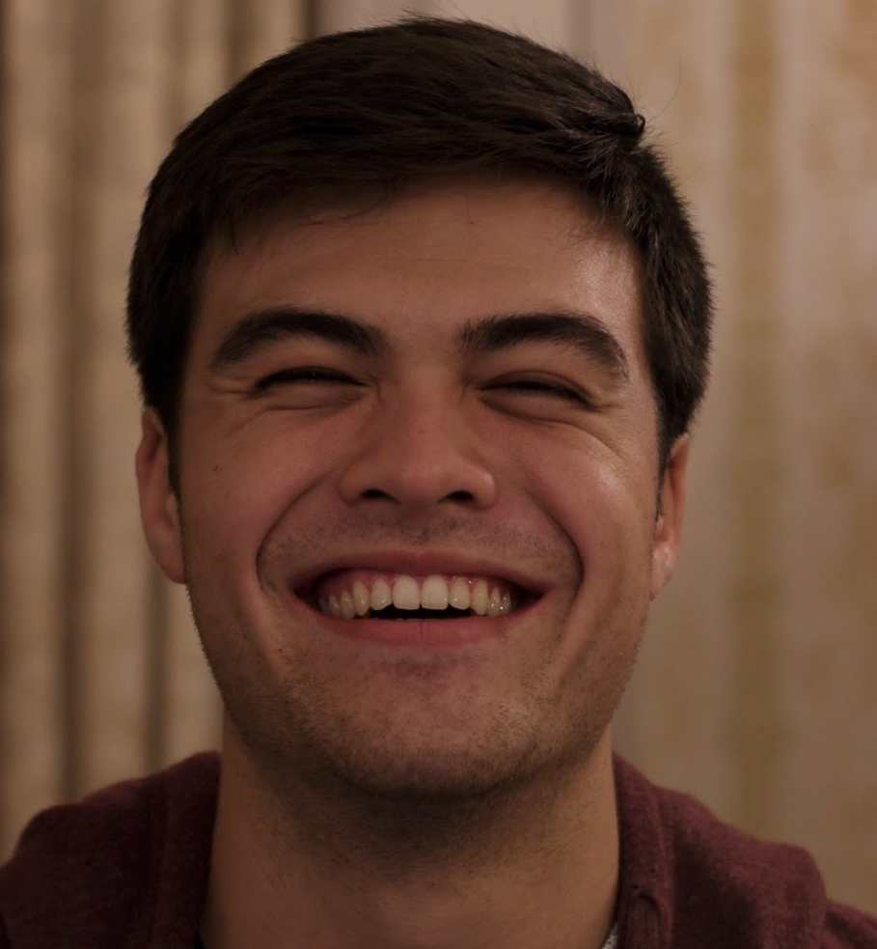
CARP Award A ($2,000)
ChungBom Katayama | Angelica Moraes | Kailey Teo | Ilya Hack | Takayo Hiraki
Pedro Diaz | Ruta Smith | JuYoung Okoth | Sung Soon Gaval | Josh Holmes

Slide 7
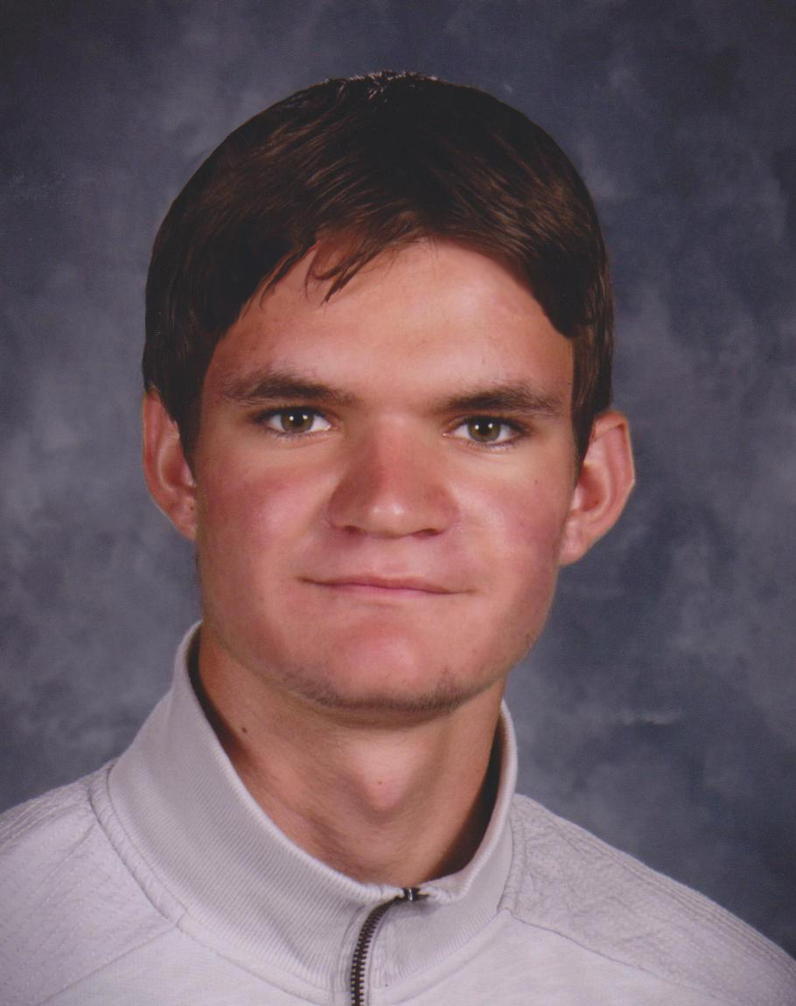
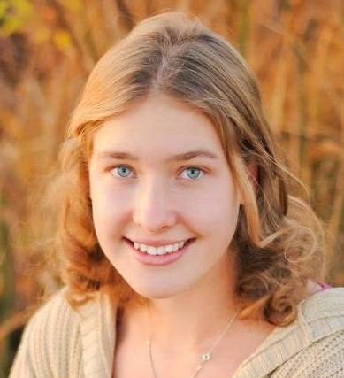
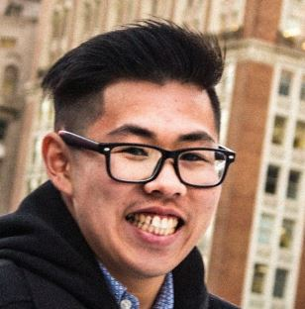
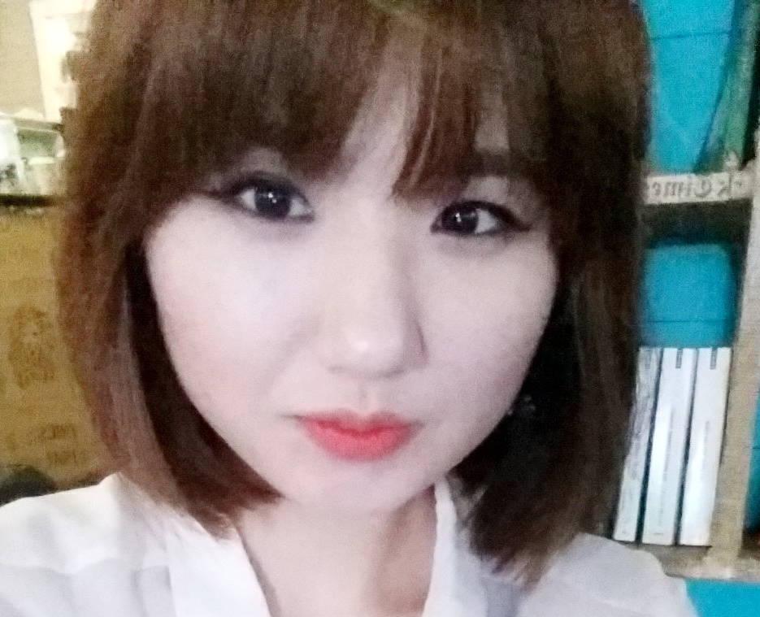
CARP Award B ($1,000)

Slide 8
Other Awards
ACLC - 3 recipients
Canada - 5 recipients

Slide 9
“Dear True Mother,
As one of this year’s recipients, I am grateful for the opportunities this scholarship can support me to continue develop my dreams.
My dream is to become a future leader in the Hyo Jeong Culture. This scholarship will encourage me to continue to grow as a spiritual mentor, raising young CARP members to build a stronger foundation to become Core leaders. It will also provide the financial support to develop as a professional musician. I hope one day I will be able to help students achieve their dreams to support True Parents as you have supported me.
Sincerely,
Angelica Moraes”

Slide 10
“I was surprised when I received a call from Teresa saying that I was a recipient of the Wonmo Pyeongae Scholarship. It felt like a blessing directly from True Parents but also an encouragement from Heavenly Parent to continue to work hard. I'm truly grateful.”
- Gabriel Melgarejo, Kansas
“Receiving the Wonmo Pyeongae Scholarship was the kind of encouragement that I had been hoping for. I feel empowered to give back to the Seattle community and achieve my goals as a student.”
Emiko Cunningham, Seattle

