Slide 1
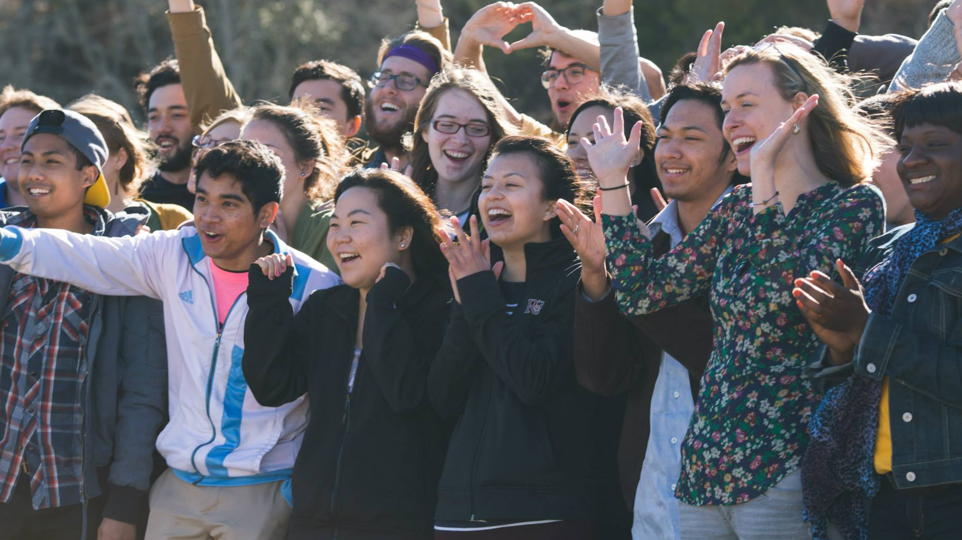
Why We Need Youth Ministry

Slide 2
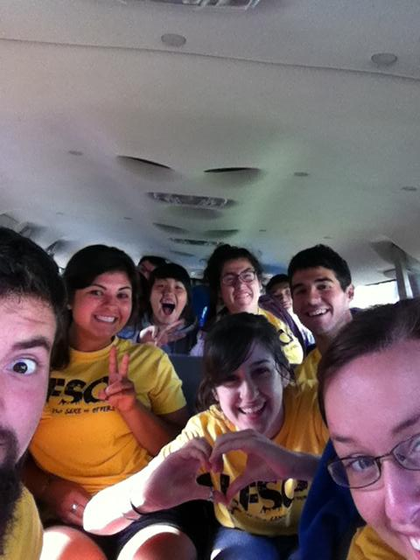

Slide 3


Slide 4
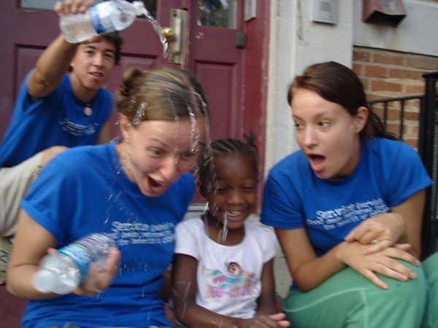

Slide 5
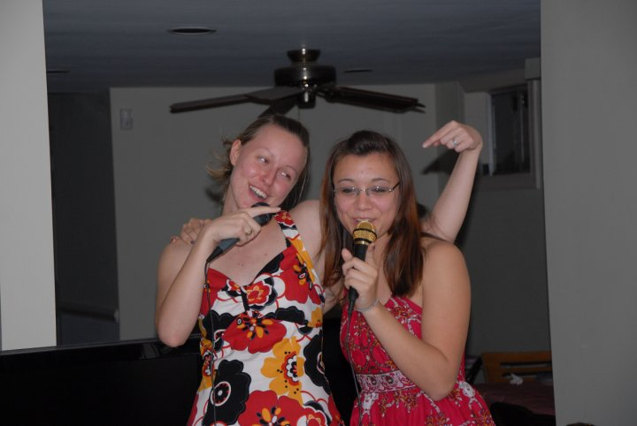

Slide 6
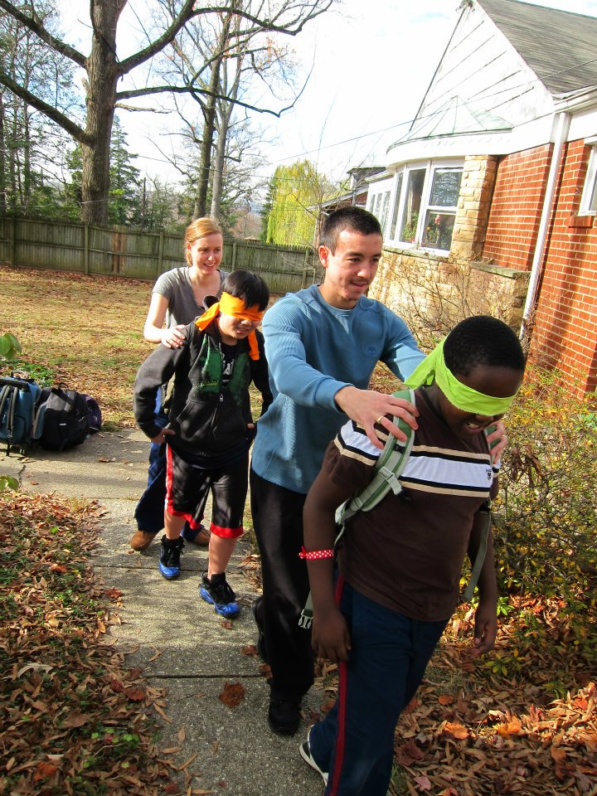

Slide 7
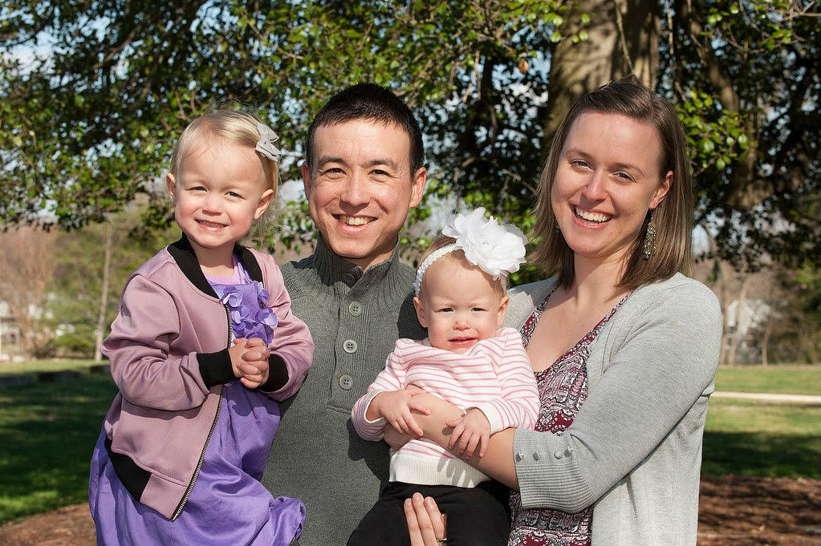

Slide 8
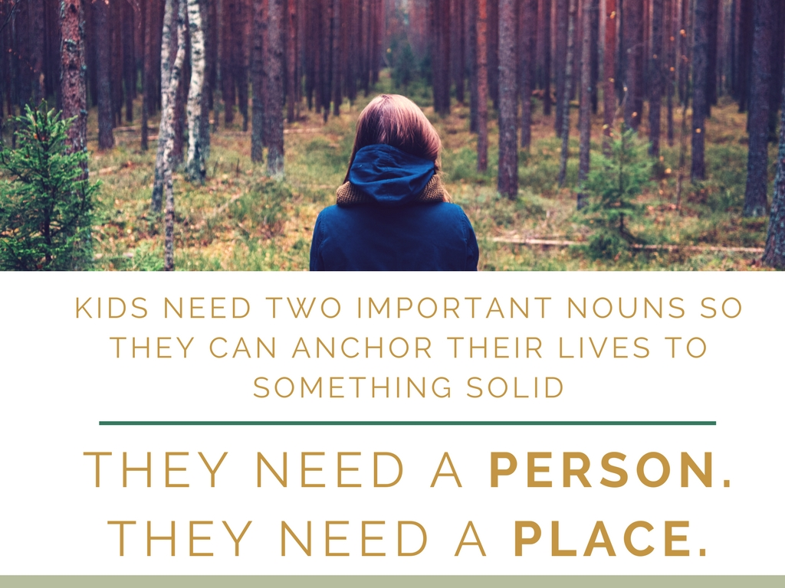

Slide 9
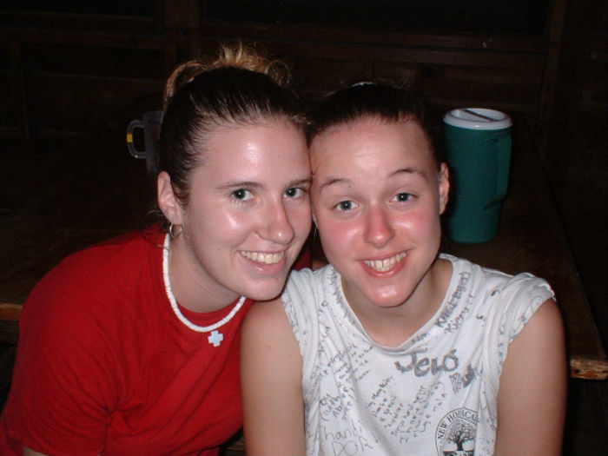
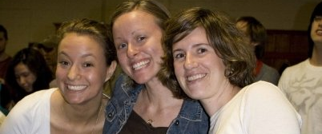
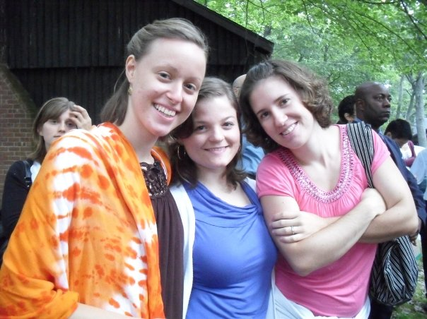
Youth Ministry gave
me a Person
Notes:
Eunha made me proud to be part of our church
My Youth Pastor was who I wanted to become
I could see a future for myself as a young adult because of her
Even when she stopped being my YP, thoughout all stages of my life she was a role model

Slide 10
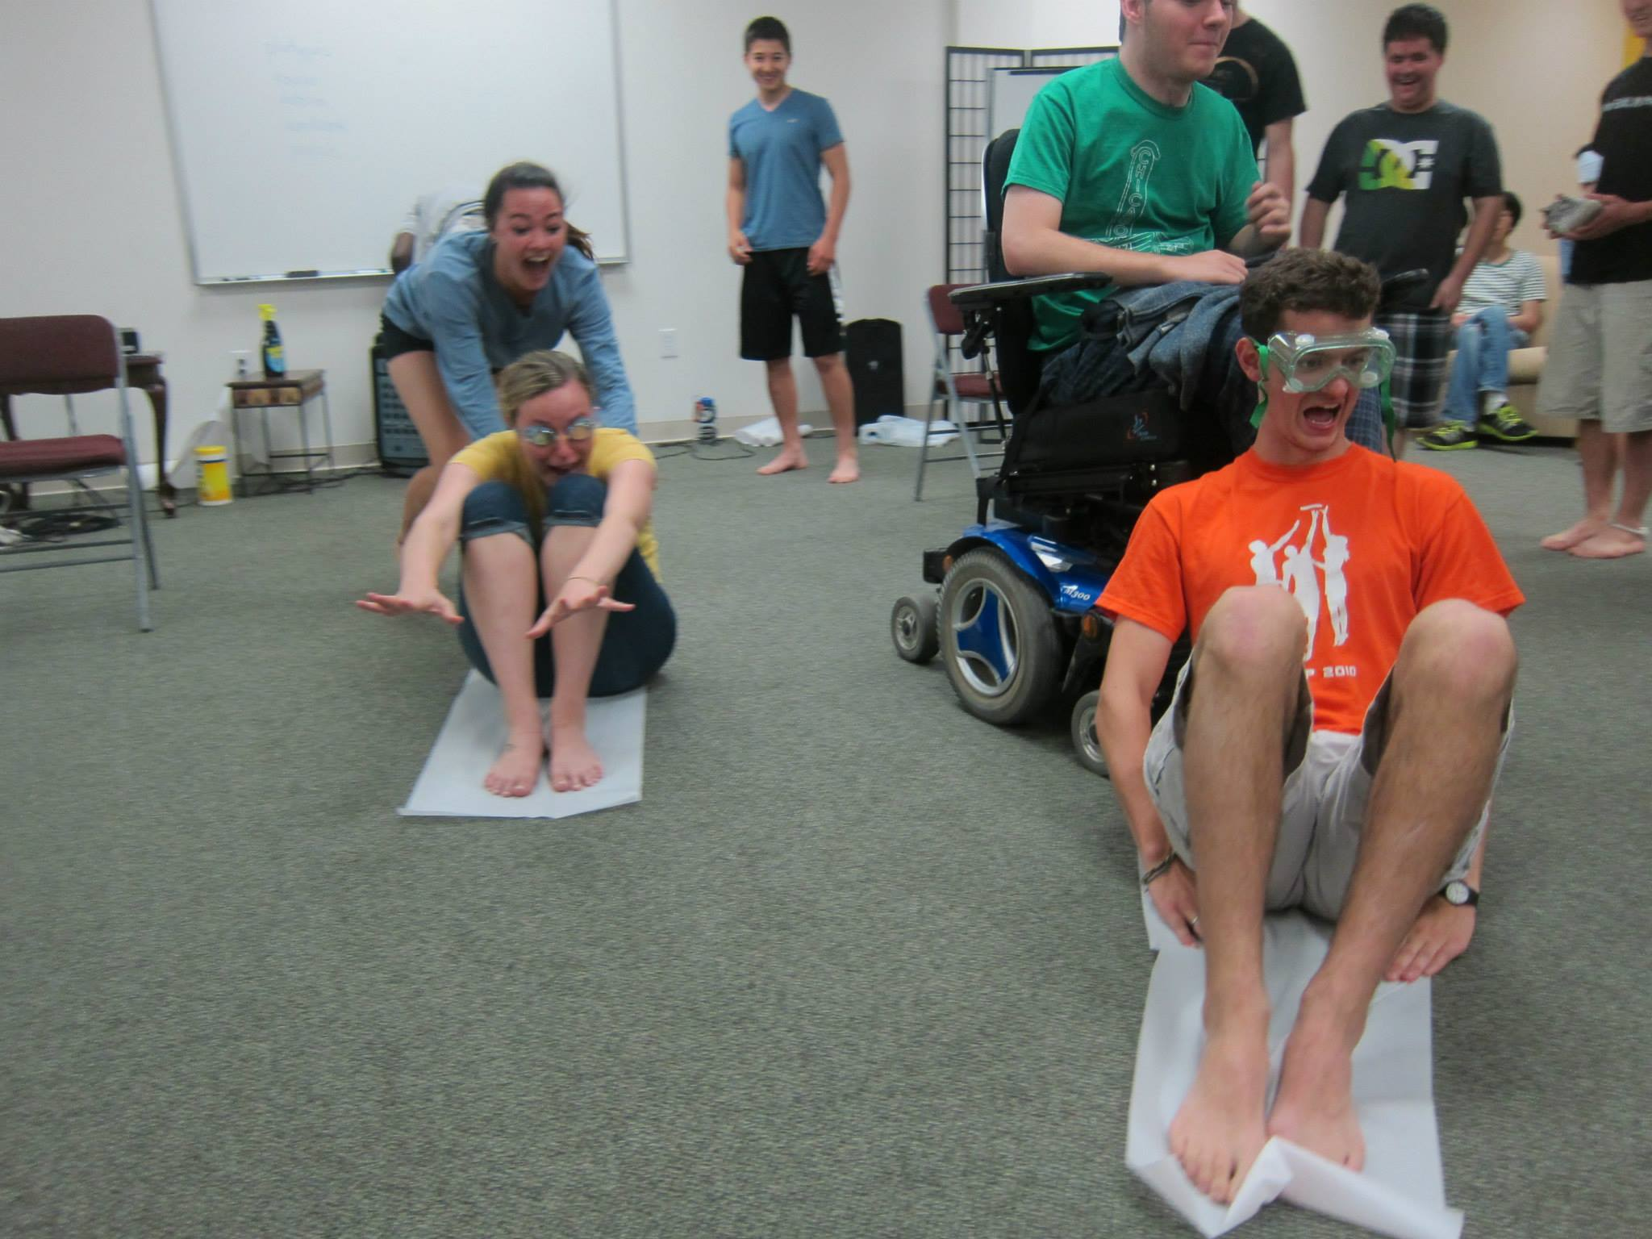
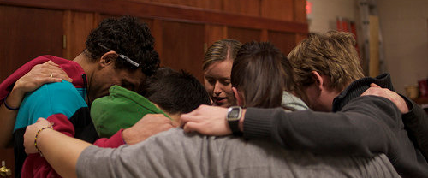
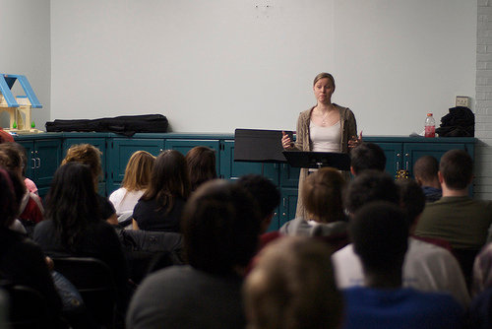
Youth Ministry gave
me a Place
Notes:
YM gave me a place to figure out who I was
Develop habits that I still use today
Grow my capacity for love

Slide 11

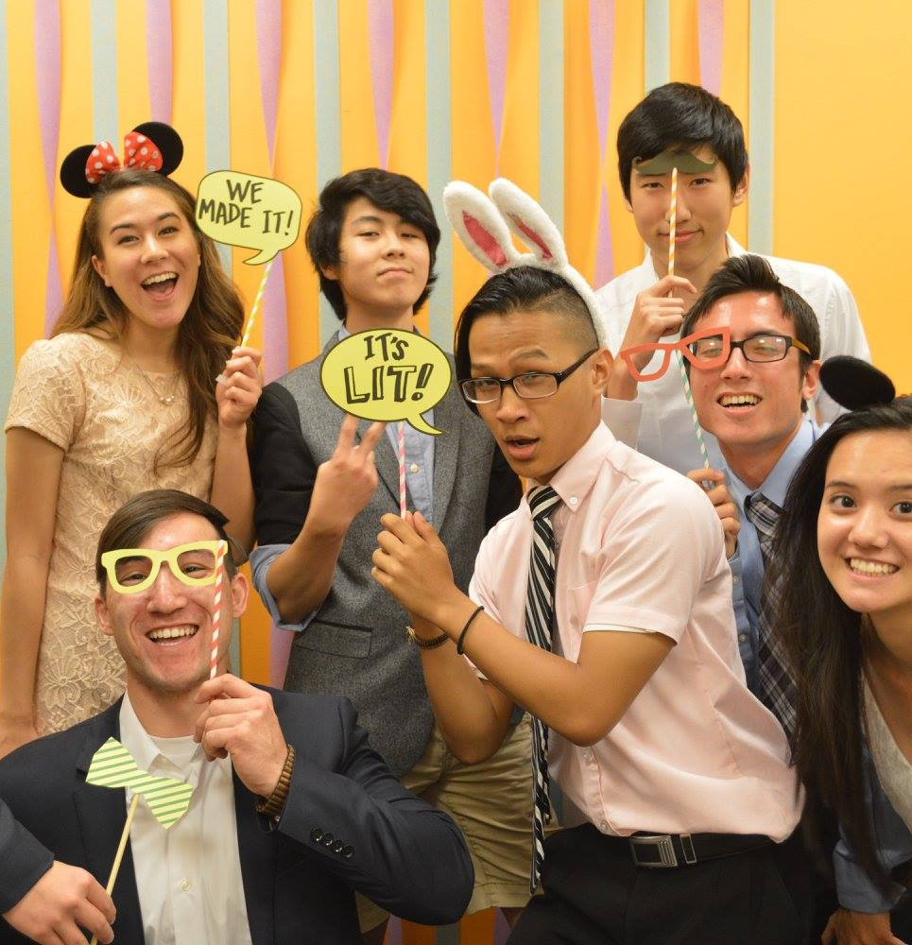
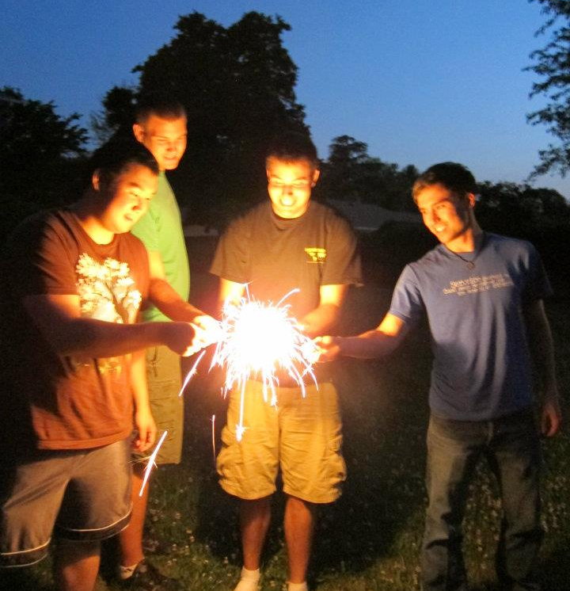
Keep the Church Relevant

Slide 12

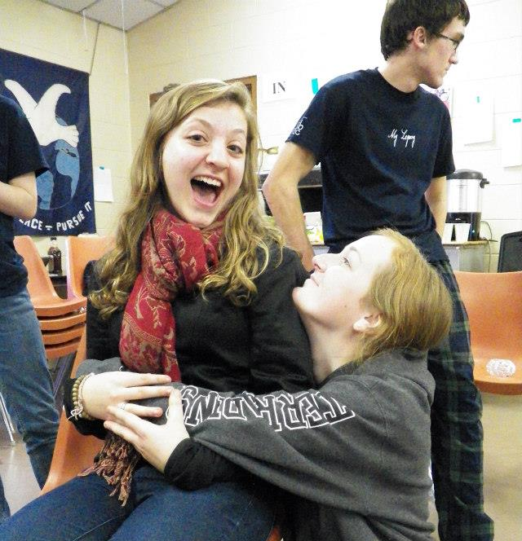
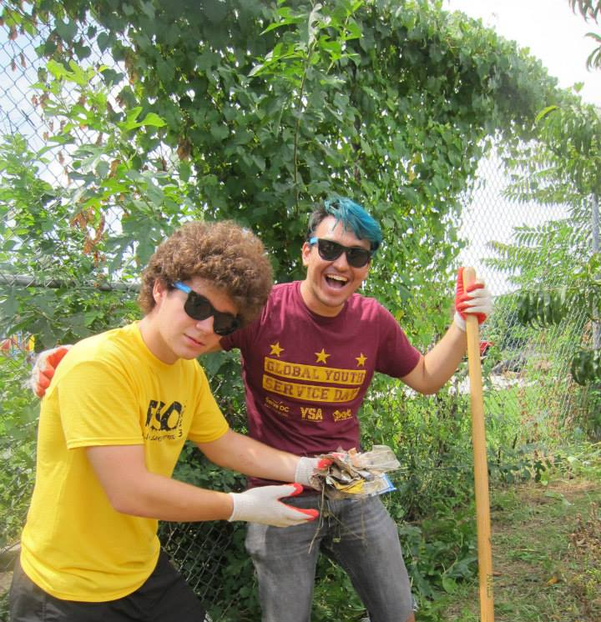
Give Youth a Person

Slide 13
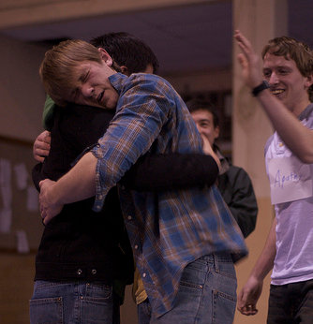
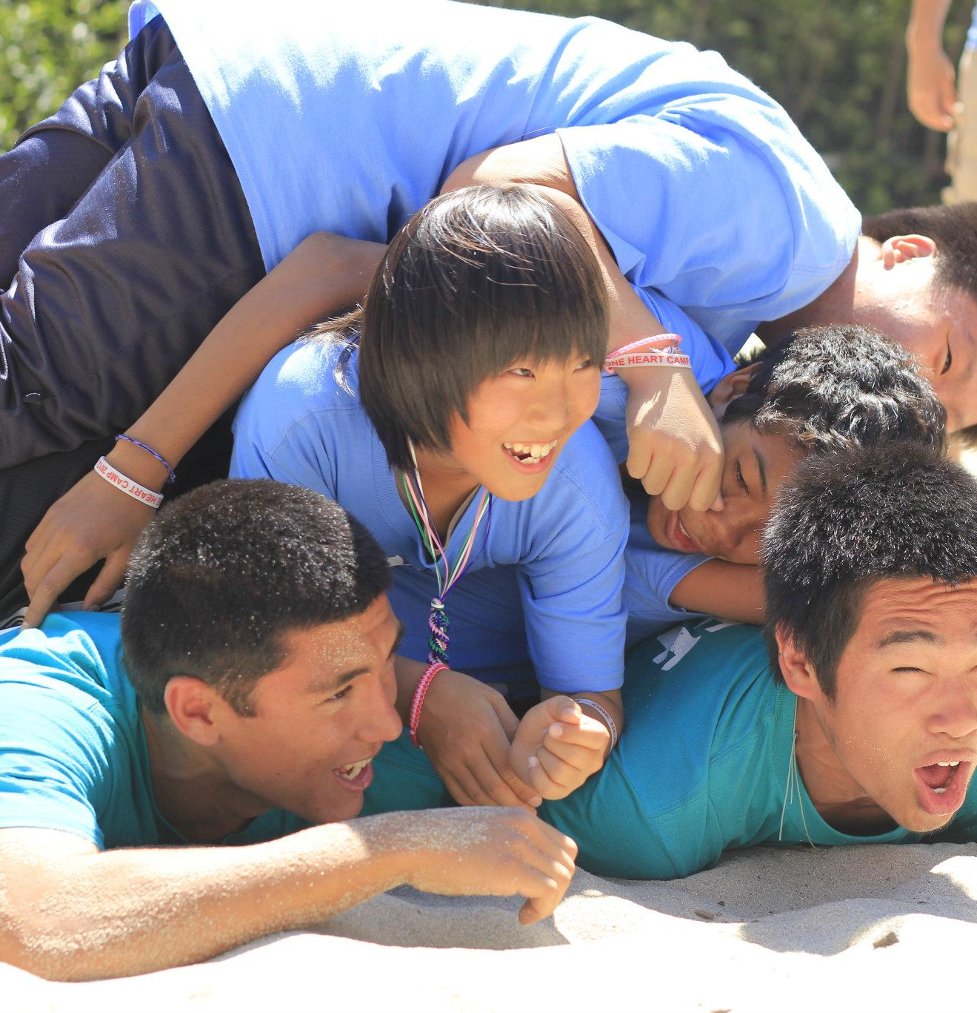
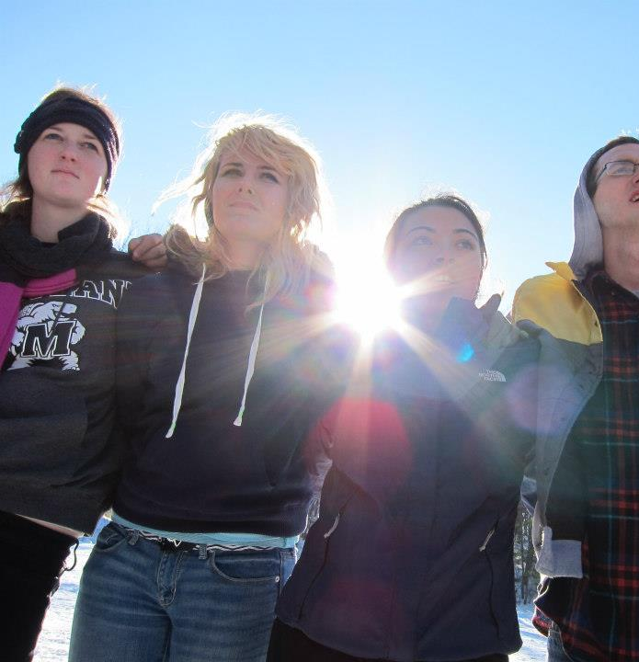
Give Youth a Place
Notes:
Identity Vs. Role Confusion
Habit Formation (Synapses) (Consistent reinder) School
Practicing Brother Sister Love, Realm of Heart
You had MFT and True Father
They have Youth Group & Workshops

Slide 14


Slide 15

National Themes
Local Customization

Slide 16
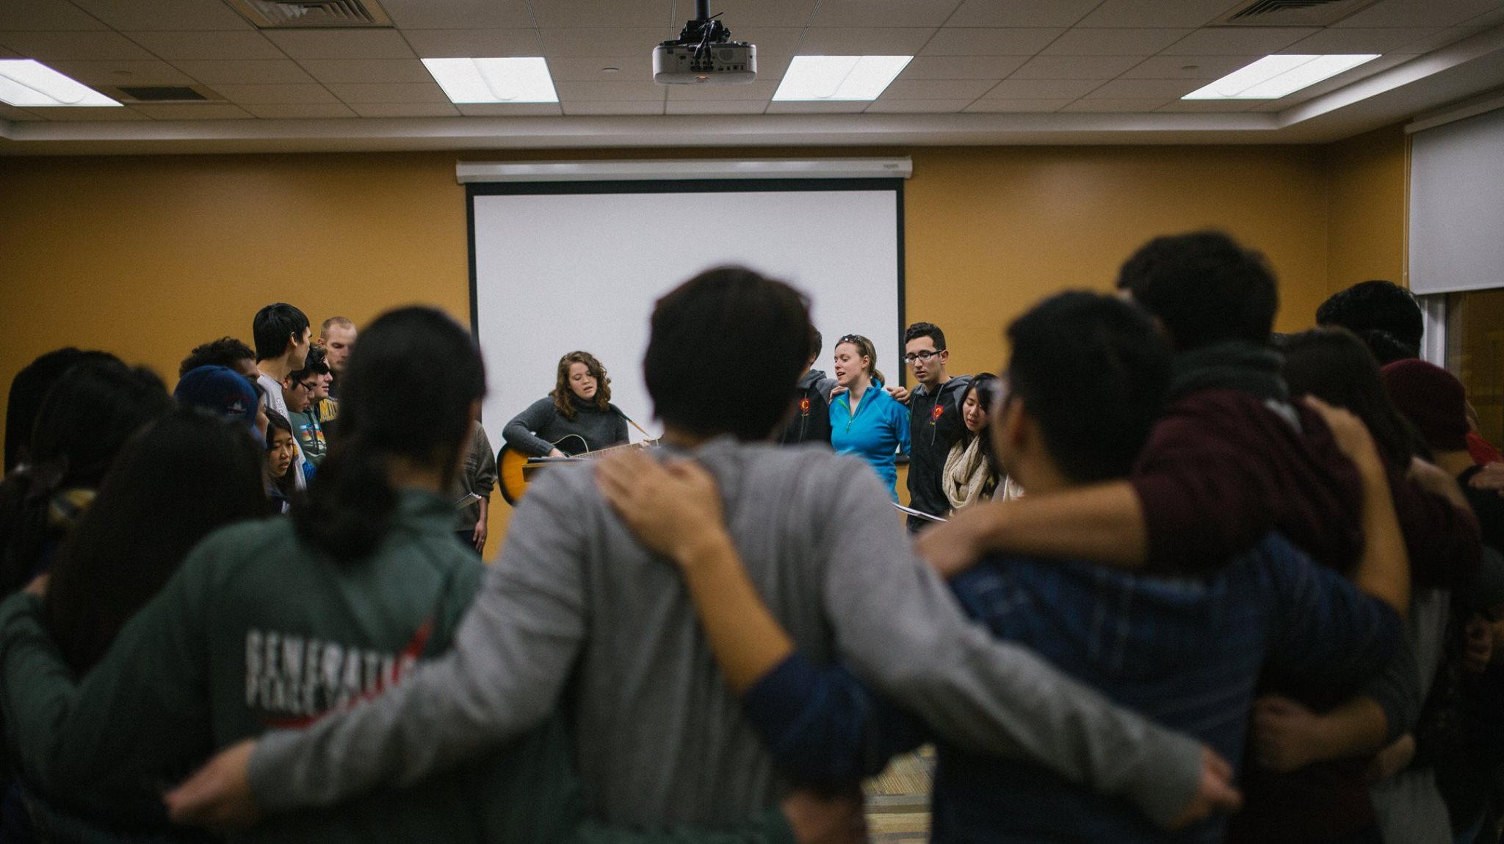
Support Network

Slide 17
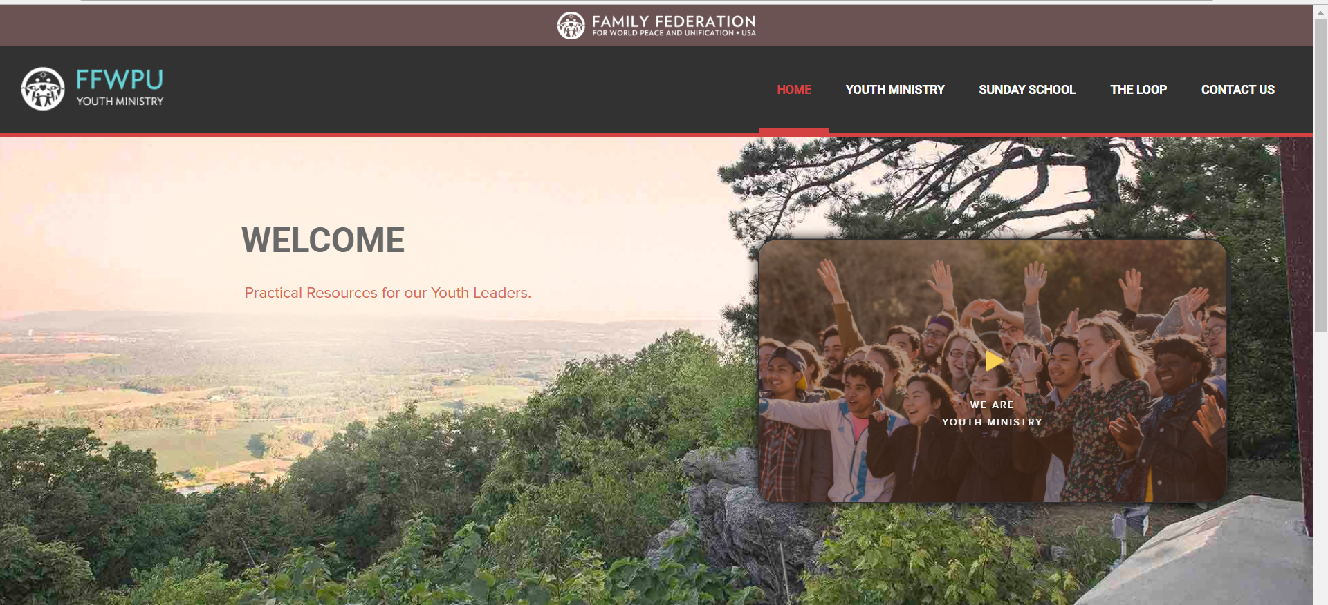
Website & Resources http://familyfed.org/youthministry

Slide 18
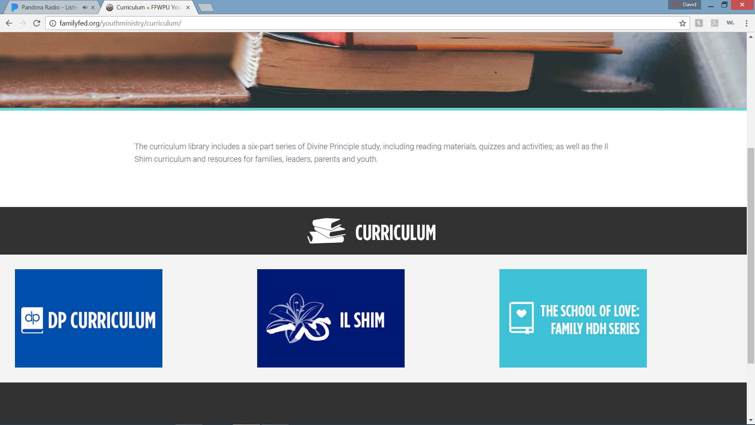

Slide 19
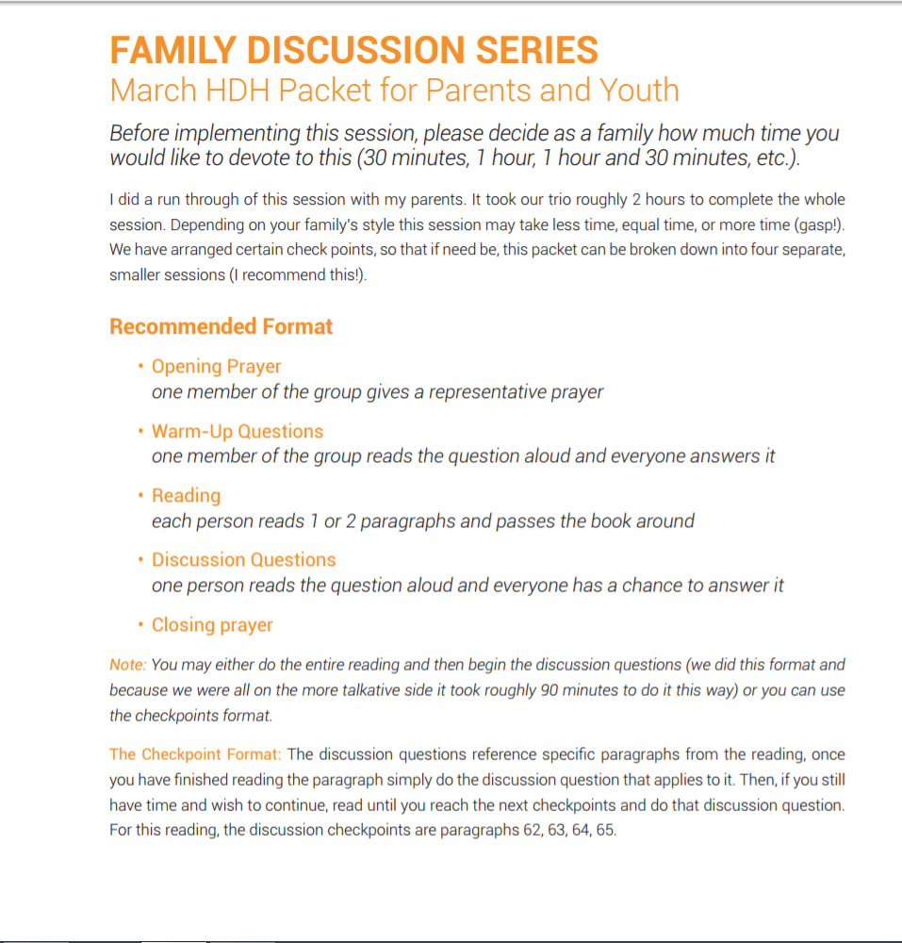
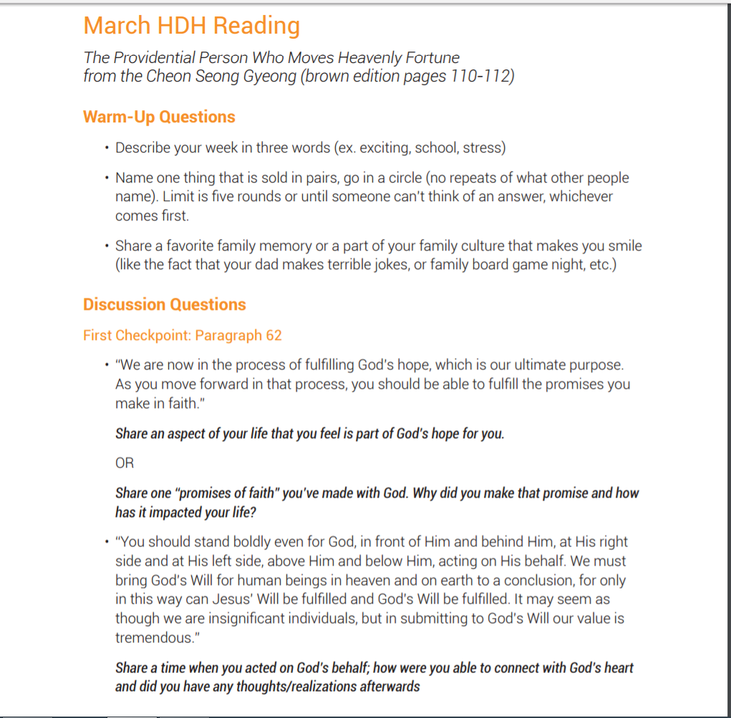

Slide 20


Slide 21


